Slide 1
GROW TOGETHER
Engagement of the private sector
in “Slovenia – UNIDO cooperation“
….Writing success stories together….

Slide 2
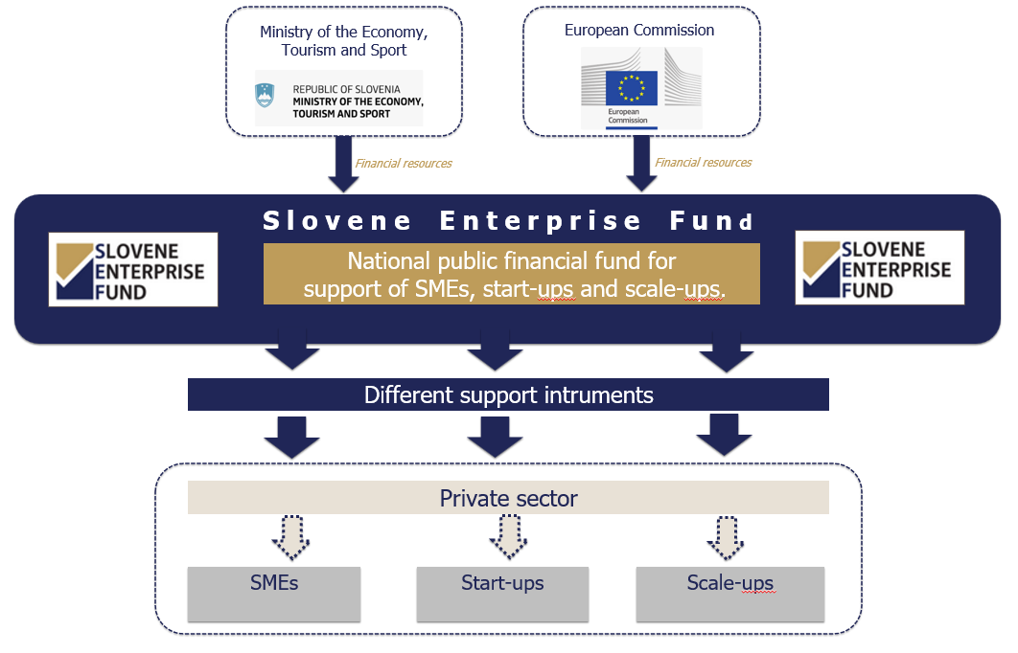
Results 2007–2023
2 billion approved incentives
Approx. 150 mio/year
35,000 supported projects
Approx. 2,500 projects/year
30 % of supported companies are technologically and development oriented
10 % of supported companies are start-ups

Slide 3
global instability (environment, wars, etc.)
2. inequality in access to resources (energy, food, water, medicine, etc.)
3. climate changes (global warming, etc.)
NEW REALITY
NEW REQUIREMENTS
greater involvement of private sector in….
PRIORITY DEVELOPMENT AREAS

Slide 4
OPERATIONAL ROLES
THE INITATOR OF THE CREATION OF NEW SPECIFIC PARTNERSHIPS WITH PRIVATE
SECTOR

Slide 6
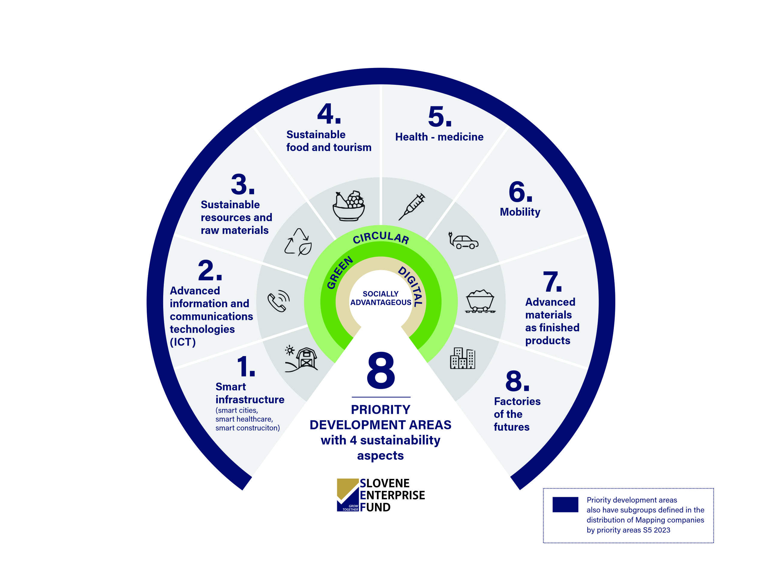
HOW TO CREATE SPECIFIC SUSTAINABLE DEVELOPMENT PARTNERSHIPS FOR PRIVATE SECTOR?

Slide 7
COMPONENTS
EU
USA
SI
BALKAN COUNTIES
OTHER MARKETS
LATIN AMERICA

Slide 8
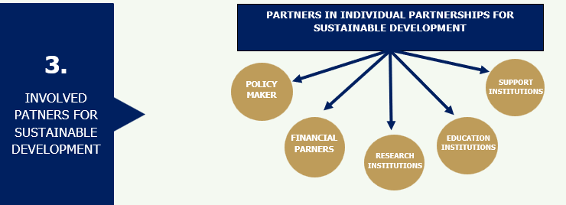
COMPONENTS

Slide 9
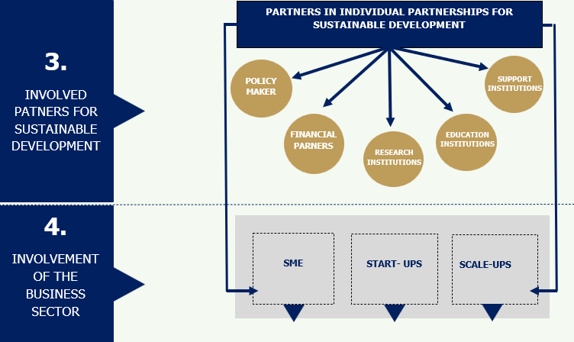
COMPONENTS

Slide 10
THE ROLE OF UNIDO IN SPECIFIC PARTNERSHIPS
FOR PRIVATE SECTOR
PARTNERSHIPS (clusters, virtual labs,…)
Foreign companies and institutions implementing the project
Knowledge transfer
Investments
Recognizability in a
foreign market
Business expansion
Prepares and manages the project
Distributes resources to the implementing partners
Slovenian companies, experts and institutions implementing the project

Slide 11
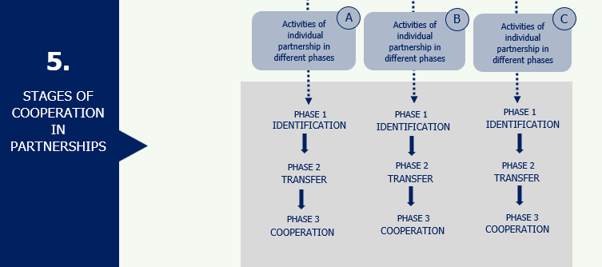
COMPONENTS

Slide 12
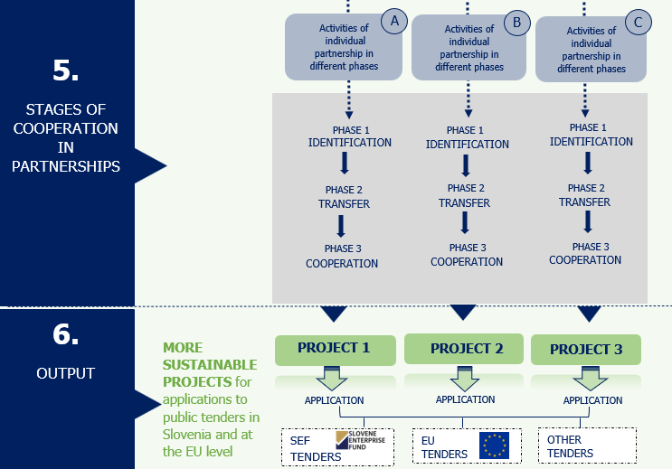
COMPONENTS

Slide 13
EXAMPLES OF DEVELOPMENT PARTNERSHIPS WITH UNIDO
Phase II
INTERNATIONAL BIOTEHNOLOGY CLUSTER
WESTERN BALKANS SMART MANUFACTURING INNOVATION CENTRE
PARTNERSHIP FOR TECHNOLOGIES AND KNOWLEDGE TRANSFER OF CULTURAL HERITAGE DIGITAL INNOVATIONS TO MONTENEGRO
INVOLVEMENT OF SLOVENIAN COMPANIES IN THE GLOBAL PARTNERSHIP FOR HYDROGEN IN INDUSTRY
Phase II

Slide 14
1. INTERNATIONAL BIOTEHNOLOGY CLUSTER
PHASE I - transfer
PHASE II - cooperation
SLOVENIAN PARTNERS | RESULTS
Faculty of Pharmacy, University of Ljubljana (FFA) Faculty of Chemistry and Chemical Technology, University of Ljubljana (FKKT) Slovene Enterprise Fund (SEF) Ministry of the Economy, Tourism and Sport COBIK, Centre of Excellence for Biosensors, Instrumentation and Process Control Slovenian biotechnological and pharmaceutical companies Educell d.o.o. Sferogen d.o.o. Biosistemika d.o.o. Acies Bio d.o.o. Labena d.o.o. Jafral d.o.o. mPOR d.o.o. PhaFarmed d.o.o. | Development of Biopharma Global Connect platform (https://www.biopharma-global-connect.com/ A portfolio of 39 projects (3 projects led by Slovenian companies stand out) Other knowledge products Workshops, trainings, thematic discussions, seminars, etc. Missions, study tours and field visits Related studies and feasibility assessments Formation of expert WGs Platform expansion (global market) Operationalization of identified priority projects Continuation of working groups activities Cluster and priority projects promotion Workshops with specific content Application for the EU funding programmes, e.g.: Horizon Europe, EU4Health, etc.
Cuban Centre for Advanced Studies (CEA) under the Ministry of Science, Technology and Environment (CITMA) of the Republic of Cuba Group of the Biotechnological & Pharmaceutical Industries (Biocubafarma) under the Ministries’ Council of the Republic of Cuba BRAZIL (Biolinker) VIETNAM (Pharmsol) CANADA (McMillan cluster) AFRICA OTHER INTERESTED COUNTRIES
Sartorius Bia d.o.o.
PharSol d.o.o.
Arctur d.o.o.
LYNX farmacevtika d.o.o.
Amplexor d.o.o.
BePharma d.o.o.
BIA d.o.o.
and more
FOREIGN PARTNERS

Slide 15
2. WESTERN BALKANS SMART MANUFACTURING INNOVATION CENTRE
PHASE I - transfer
PHASE II - cooperation
SLOVENIAN PARTNERS | RESULTS
Faculty of Electrical Engineering, University of Ljubljana (FEE) Competence centre for advanced control technologies Slovene Enterprise Fund (SEF) Ministry of the Economy, Tourism and Sport Digital Innovation Hub Slovenia (DIH Slovenia) with a group of Slovenian Companies having expertise in digital transformation | Establishment of a pilot Innovation Centre for Smart Manufacturing (SMIC) based in Novi Sad with a developed model of operations Full strategy for expanding this project to the regional level Other knowledge products Study visits Two-day study tour of the Serbian delegation consisting of members from industry and academia in Slovenia Knowledge transfer and integration between different manufacturing industries (automotive industry, white goods, etc.) Related studies and feasibility assessments International integration of companies, promotional activities, etc. Workshops, trainings, study visits on the level of start-ups, SMEs, students, etc. SMIC operationalization Offering practical AI-based manufacturing solutions in a real manufacturing environment Expanding SMIC to the Western Balkans region Building up partnership Establishment of working groups Developing mechanism for obtaining EU funding
Ministry of Education, Science and Technological Development of the Republic of Serbia Faculty of Technical Science, University of Novi Sad Faculty of Mechanical Engineering, University of Belgrade Partners from Albania, Bosnia and Herzegovina, Montenegro, North Macedonia, etc.
FOREIGN PARTNERS

Slide 16
3. PARTNERSHIP FOR TECHNOLOGIES AND KNOWLEDGE TRANSFER OF CULTURAL HERITAGE DIGITAL INNOVATIONS TO MONTENEGRO
PHASE I - transfer
PARTNERS | RESULTS
Slovene Enterprise Fund (SEF) Ministry of the Economy, Tourism and Sport High-tech companies in the field of digital interpretation technologies in tourism Technology providers and experts - programmers, designers, 3D animators and creators, heritage experts, storytellers, tourism product developers, surveyors, architects, and others | Capacity building for introduction of digital technologies in Montenegro leading to tourism 4.0 Education and training for companies as well as tourist destinations, heritage institutions on the topic of digital storytelling, digitization technologies (photogrammetry, laser scanning), digital interpretation technologies (VR, AR, XR, holograms, interactive screens, applications, etc.) and interpretation of cultural heritage Consulting and cooperation in designing system solutions to promote the use of advanced technologies for tourism and cultural heritage 1-on-1 consulting on concrete examples of tourist products and cultural heritage with the aim of developing attractive experiences Development of a Montenegro digital cultural heritage platform
Ministry of Economic Development of Montenegro University of Donja Gorica, Podgorica, Montenegro SMEs in tourism sector (providers of tourist experiences, hoteliers and room renters, managers of camps, recreational parks, etc., gastronomy providers, travel agencies, event organizers, renting companies of recreational and sports goods, operators of tourism product shops, craftsmen, etc.) Technology providers from Montenegro
Create unique
experiences with virtual
reality headsets in
remarkable historic
buildings, such as castles and fortifications.
FOREIGN PARTNERS

Slide 17
4. INVOLVEMENT OF SLOVENIAN COMPANIES IN THE GLOBAL PARTNERSHIP FOR HYDROGEN IN INDUSTRY
PHASE I - transfer
PARTNERS | RESULTS
Slovene Enterprise Fund (SEF) Ministry of the Economy, Tourism and Sport SMEs, start-ups and scale-ups, operating in hydrogen industry Chamber of Commerce and Industry of Slovenia Tehnology Park Ljubljana Research institutes | Involvement of members of the Slovenian Hydrogen Development Partnership in the Global Partnership for Hydrogen in Industry led by UNIDO Enable hydrogen experts and companies to connect with experts and companies from 17 other countries (developed countries, such as Austria, Italy, and Germany, as well as developing countries, such as Costa Rica, Morocco, and the Philippines) More countries are in the process of joining the partnership Identification of key global needs and priorities in the hydrogen field Skills development and transfer of best practices Meetings of working groups and global events Development of studies, knowledge products, technical guidelines, etc. Identification of key practices of hydrogen technology centres Establishment of a framework for common projects development Capacity building of institutions and private sector Identification of necessary skills and workers‘ profiles

Slide 18
MAIN ADVANTAGES OF COOPERATION WITH UNIDO
BENEFITS
Necessary approach in the face of today's global challenges
Identification of
specific projects
Boosting international development cooperation on the business level
Integration between different manufacturing, platforms, networking, etc.
Easier further steps towards mobilizing additional international funding
PARTNERSHIPS (clusters, virtual labs,…)
Foreign companies and institutions implementing the project
Knowledge transfer
Investments
Recognizability in a
foreign market
Business expansion
Prepares and manages the project
Distributes resources to the implementing partners
Slovenian companies, experts and institutions implementing the project

Slide 19
CONTACT US
Slovene Enterprise Fund
Ulica kneza Koclja 22, 2000 Maribor
Phone: + 386 234 12 60
E-mail: info@podjetniskisklad.si
Website: www.podjetniskisklad.si

