Slide 1
Mechanical properties of paper made from straw
Presenter
Iva Mikulić¹, Branka Lozo², Ana Tomšič³, Diana Gregor-Svetec³ ¹Paper industry Dravacel Ltd ²The Faculty of Graphic Arts of the University of Zagreb ³University of Ljubljana, Faculty of natural sciences and engineering, Department of Textiles, Graphic Arts and Design , Snežniška 5, Ljubljana, Slovenija

Slide 2
INTRODUCTION
Paper
We use paper every day for different purposes
Newspapers, toilet papers, office paper, wrapping paper, cardboard boxes, food boxes etc..
Paper usage is in constant growth
Paper production is in top 12% of world’s energy consumers
Notes:
Način na koji će prezentacija koristiti ciljnoj skupini: odrasle će tema više zanimati ako znaju kako je i zašto važna za njih.
Stručnost izlagača u temi prezentacije: ukratko navedite svoja postignuća na tom području ili objasnite zašto bi vas sudionici trebali poslušati.

Slide 3
Need for more environmental friendly pulping process is producers constant goal
From 1970 until today non-wood plant pulping has increased 2-3 times
Paper made from straw used for this properties measurement was made in process that is patented under number WO 150841 A1
Notes:
Opisi lekcija trebaju biti kratki.

Slide 4
This is continuous process for production cellulose pulp from grass like feedstock suitable for paper making that uses simplest possible equipment and process that allows maximal preservation of natural fibers with minimal power consumption
Steps:
Comminuting of feedstock, in this case straw
In step 2 straw was digested in water with very mild conditions regarding chemicals usage
Sulphur based chemical are not used
Digestion temperature is 70-100C

Slide 5
Cooked pulp is concentrated at the bottom of the digester and than discharged by the conveyor from the bottom of digester
At the same time new straw is added to digester
In the next step cooked pulp is diluted with water from starting concentration of 18% to 3-6%
Diluted pulp is then processed through screening and transferred to auxiliary vessel
Pulp is then dewatered and ready for paper production

Slide 6
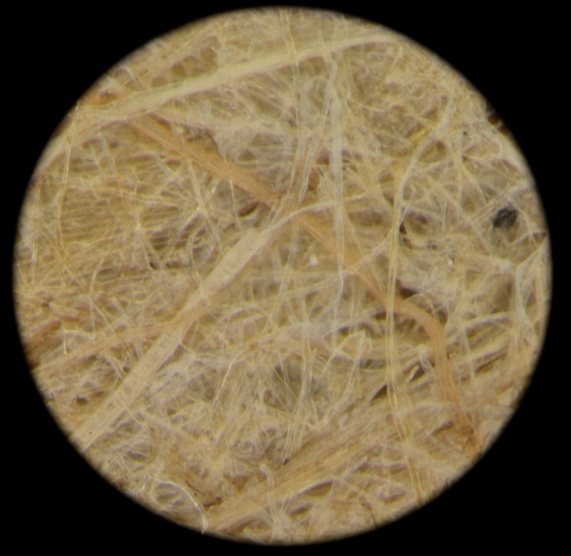
Basic properties
Basic weight (g/m²) | Thickness (µm) | Apparent Density (kg/m³)
104.7 ± 0.085 | 251 ± 0.019 | 419.4 ± 25.311
Microscopic view of paper made from straw

Slide 7
Paper from straw
Surface properties: mean value ± standard deviation
 | Felt side | Wire side
Surface roughness - Bendtsen (ml/min) | 2754 ± 104 | 2635 ± 61
Air permeability - Bendtsen (ml/min) | 258 ±10.2 | 335 ± 53.7
ISO brightness (%) | 16.4 ± 0.57 | 15.6 ± 0.38
Opacity (%) | 97.9 ± 0.89 | 97.6 ± 1.19
CIE Lab - L* | 67.38 ± 0.73 | 68.51 ± 0.71
CIE Lab - a* | 3.5 ± 0.19 | 3.71 ± 0.21
CIE Lab - b* | 24.84 ± 0.37 | 24.15 ± 0.36

Slide 8
Mechanical properties: mean value ± standard deviation
Tearing strength (mN) | 538± 138
Tearing index (mN m²/g) | 5.1
Bursting strength (kPa) | 195.2 ± 12.9
Bursting index (kPa m²/g) | 1.86
Tensile strength (kN/m) | 4.66 ± 0.95
Tensile index (N m/g) | 44.55
Tensile breaking strain (%) | 1.4 ± 0.2
Tensile energy absorption (J/m²) | 18.4 ± 7.1
Modulus of elasticity (GPa) | 1.97 ± 0.32

Slide 9
Recycled paper from Vipap Videm Krško (if you wish to compare)
Basic weight (g/m²) | Thickness (µm) | Apparent Density (kg/m³)
80 | 117 | 685.9
 | Felt side | Wire side
Surface roughness - Bendtsen (ml/min) | 457 | 430
Air permeability - Bendtsen (ml/min) | 168 | 166
ISO brightness (%) | 68.2 | 67.8
Opacity (%) | 68.2 | 67.8
CIE Lab - L* | 87.11 | 87.29
CIE Lab - a* | 1.18 | 1.3
CIE Lab - b* | -1.8 | -3.59

Slide 10
Recycled paper
Mechanical properties: in Machine direction (MD) and Cross direction (CD)
 | MD | CD
Tearing strength (mN) | 396 | 466
Tearing index (mN m²/g) | 4.94 | 5.82
Bursting strength (kPa) | 144
Bursting index (kPa m²/g) | 1.79
Tensile strength (kN/m) | 4.28 | 1.80
Tensile index (N m/g) | 53.52 | 22.51
Tensile breaking strain (%) | 1.48 | 2.62
Tensile energy absorption (J/m²) | 19.87 | 17.37
Modulus of elasticity (GPa) | 1.82 | 1.53

Slide 12
TEARING STRENGHT (mN) and TEARING FACTOR (mN m2/)
Tearing strength of paper is the resistance of a paper sheet to tearing force that it is subjected to.
Tearing strength depends on fiber length and fiber bonding among other factors
Tearing strength is important characteristic for cover papers, wrapping, toughness of packaging papers, bond papers, envelope papers, printer etc.

Slide 13
TEARING STRENGHT STRAW VS RECYCLED PAPER

Slide 14
TEARING INDEKS (mN m2/g) STRAW VS RECYCLED PAPER

Slide 15
BURSTNG STRENGHT (kPa) AND BURSTING INDEKS (kPa m2/g)
The bursting strength of paper or paperboard is a composite strength property that is affected by various other properties of the sheet, principally tensile strength and stretch
It is resistance to rupturing

Slide 16
BURSTING STRENGHT (kPa) STRAW VS RECYCLED

Slide 17
BURSTING INDEX (kPa m2/g) STRAW VS RECYCLED PAPER

Slide 18
TENSILE STRENGHT (kN/m) and TENSILE INDEKS (N m/g)
The tensile strength is the maximum stress to break a strip of paper sheet
It is greater in machine direction than in cross direction

Slide 19
TENSILE STRENGHT (kN/m) STRAW VS RECYCLED

Slide 20
TENSILE INDEX (kN m/g) STRAW VS RECYCLED PAPER

Slide 21
MODULUS OF ELASTICITY (GPa) STRAW PAPER VS RECYCLED PAPER

Slide 22
CONCLUSION
Paper made from straw has mechanical properties that are comparable and even higher than paper produced from waste paper
This technology offers lower costs and more environmental friendly process
As source for pulp productions variety of plants similar to straw like corn stem, hemp, cane , etc.
In real production on machines even higher result are expected

