Slide 1
TRENDS ON ENERGY MARKETS and
AN INSIGHT INTO THE FUTURE DEVELOPMENT OF ENERGY SECTOR
Dr. Dejan Paravan
Chief innovation officer, GEN-I

Slide 2
Trends on energy markets

Slide 3
Oil

Slide 4
Coal

Slide 5
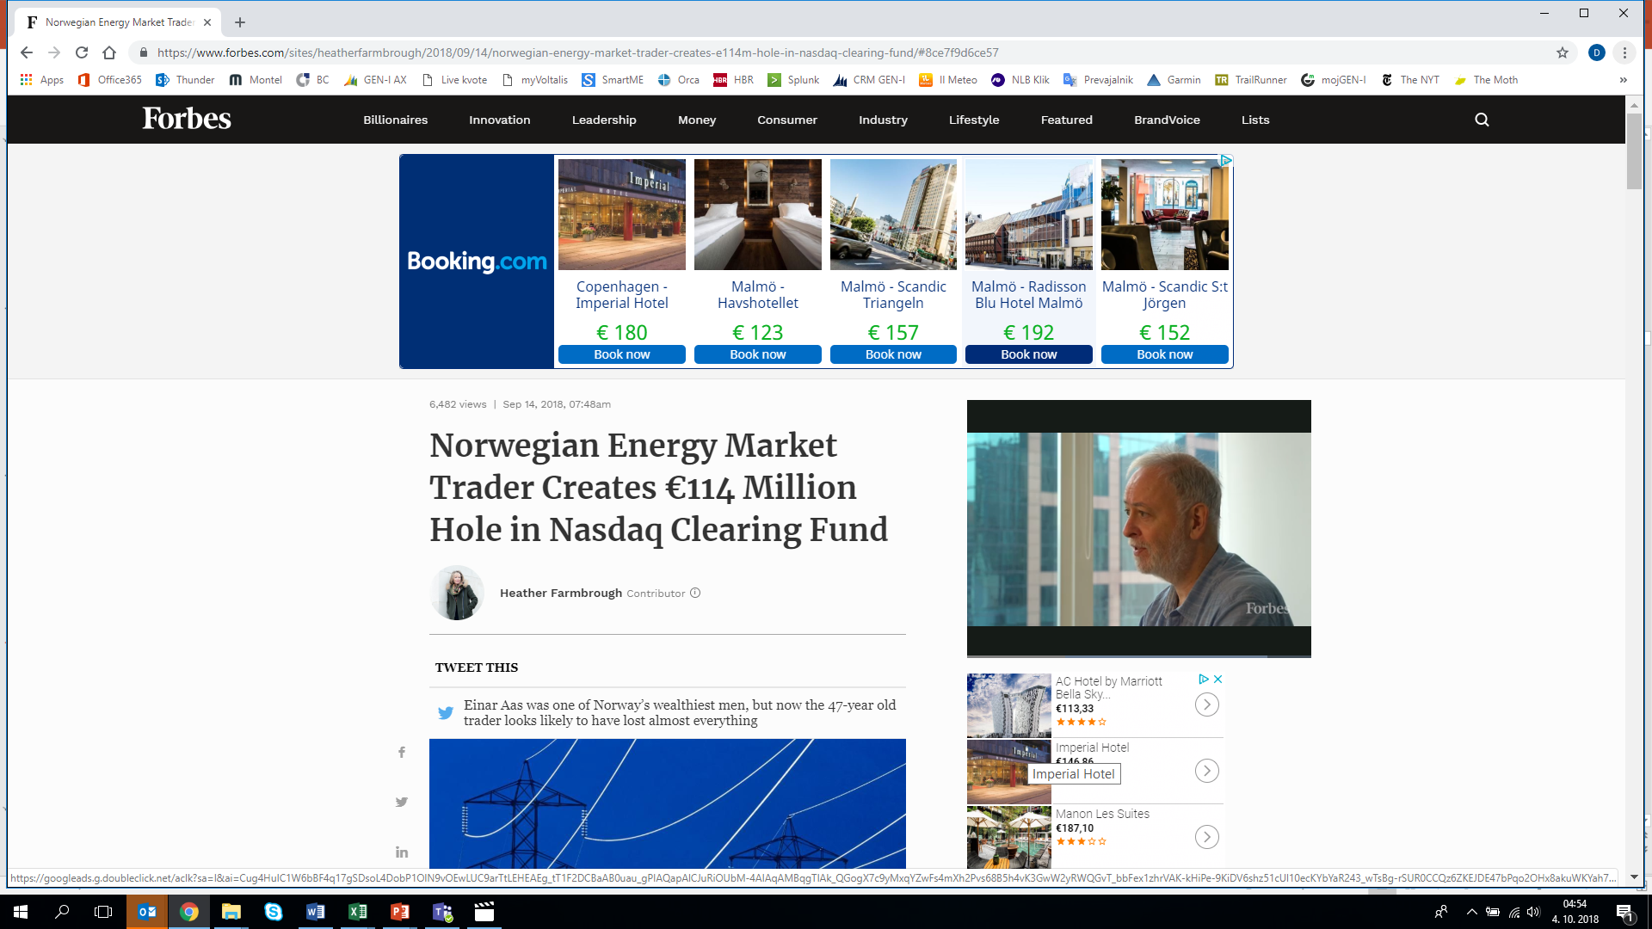
EUA (CO₂)

Slide 6
Natural gas

Slide 7
Hydrological situation in the region

Slide 8
Electricity

Slide 9
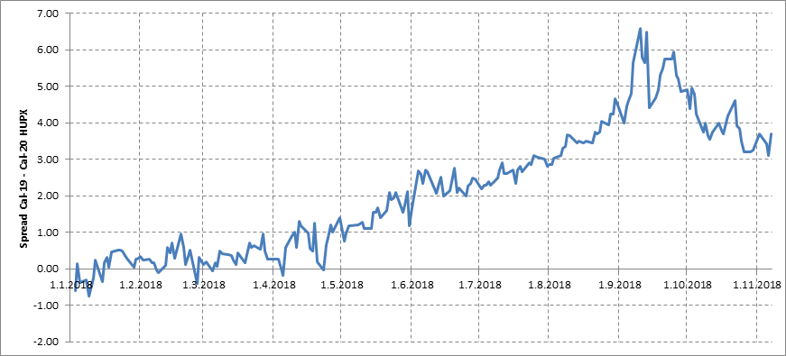
Spreads between years

Slide 10
What is different compared to one year ago?
Region CWE
Demand in Europe is 2-3% higher compared to 2017
10% growth in hydro and wind production
Hydro production 15% higher compared to 2017, although record high snow conditions in winter
The main reason for electricity price growth were EUA (CO2)
  Average CO2 price during 2017 was 5.8€/t, today the price is app. 20€/t. EUA growth of 1€ reflects in 0.9€/MWh growth in electricity price.
Price of gas went up by more than 30%

Slide 11
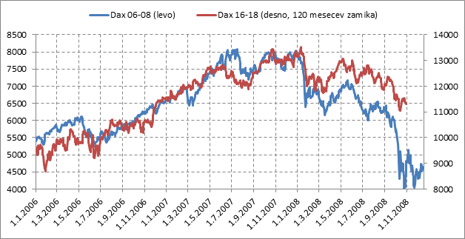
Déjà vu: is 2018 comparable with 2008?

Slide 12
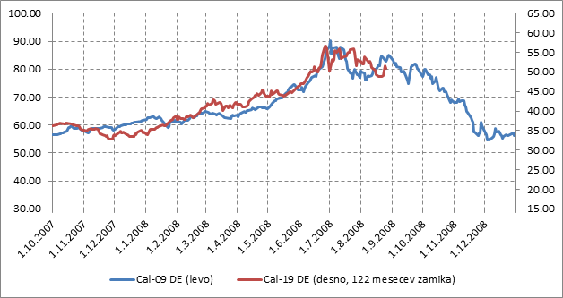
Déjà vu: is 2018 comparable with 2008?
!
Scale…

Slide 13
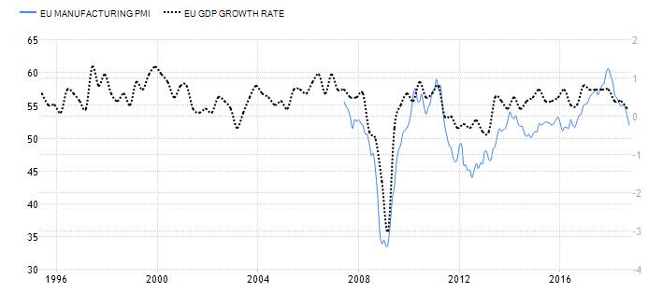
Déjà vu: is 2018 comparable with 2008?

Slide 14
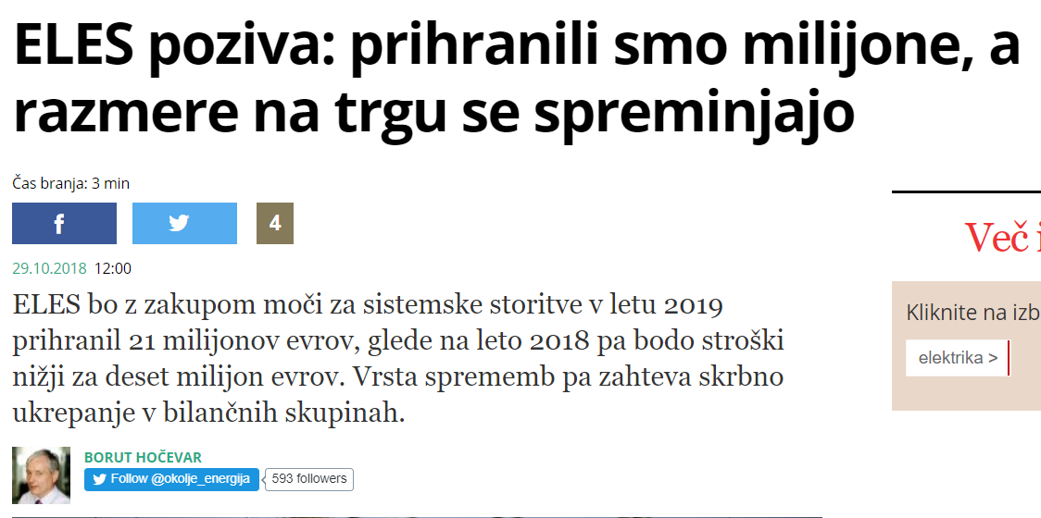
ELES bo z zakupom moči za sistemske storitve v letu 2019 prihranil 21 milijonov evrov, glede na leto 2018 pa bodo stroški nižji za deset milijon evrov. Vrsta sprememb pa zahteva skrbno ukrepanje v bilančnih skupinah.
„Višje cene bodo vplivale na stroške izravnave slovenskih bilančnih skupin. Kakšni bodo dejanski stroški izravnave, bo odvisno predvsem od kakovosti napovedi dobav in porabe bilančnih skupin.“

Slide 15
Trends on energy markets - overview
Maine reason for electricity price growth were EUA, prices of energy commodities and economic growth
Current situation:
  EUA market is extremely volatile (history shows that is subject to regulatory intervention)
  Growth of commodity prices has stopped/(?)trend change
  Economic growth is cooling down, stock markets on wild ride
Extremely high volatility on the market
Spreads between years age coming down, but still present

Slide 16
The future development of energy sector and going green

Slide 17


Slide 18
Going green: when a company makes a concerted effort to reduce its negative environmental impact

Slide 19
Why?
1. It saves money in the long term
2. Consumers recognize green companies
3. Go Green for your Employees
4. It can stimulate innovation
5. It helps the environment

Slide 20
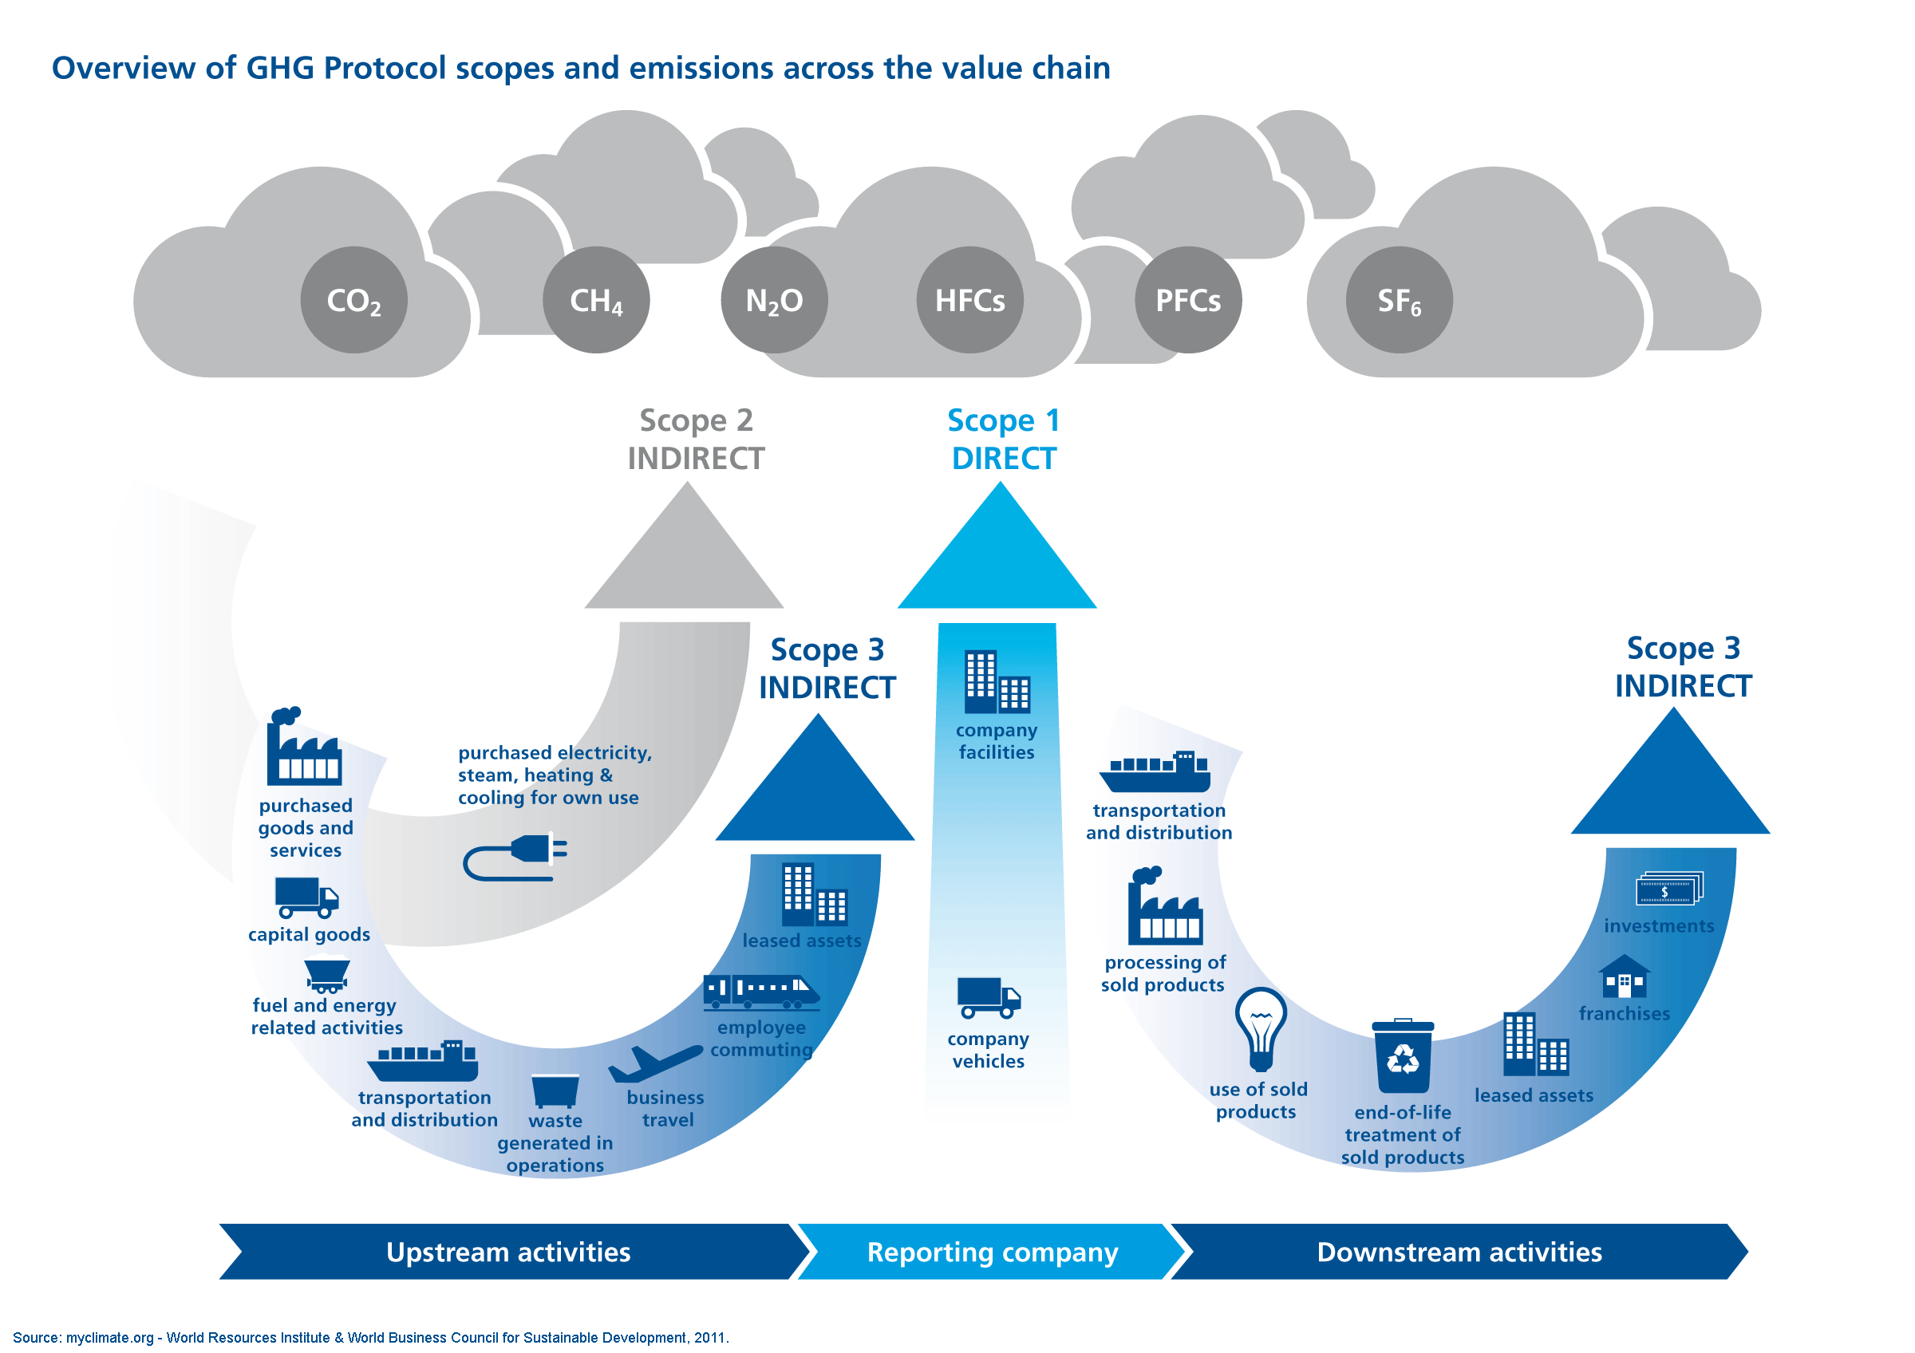

Slide 21
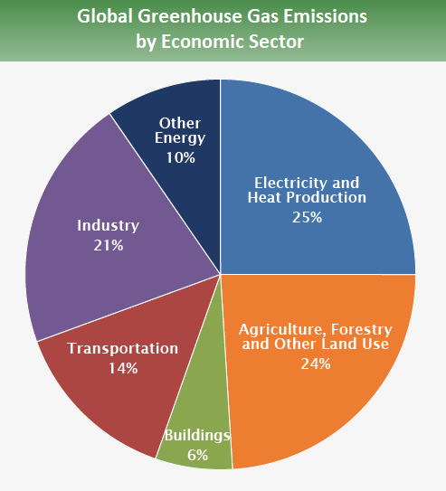
Source: IPCC (2014)

Slide 22
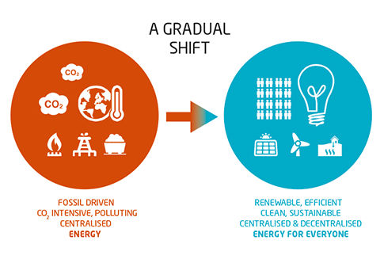

Slide 23
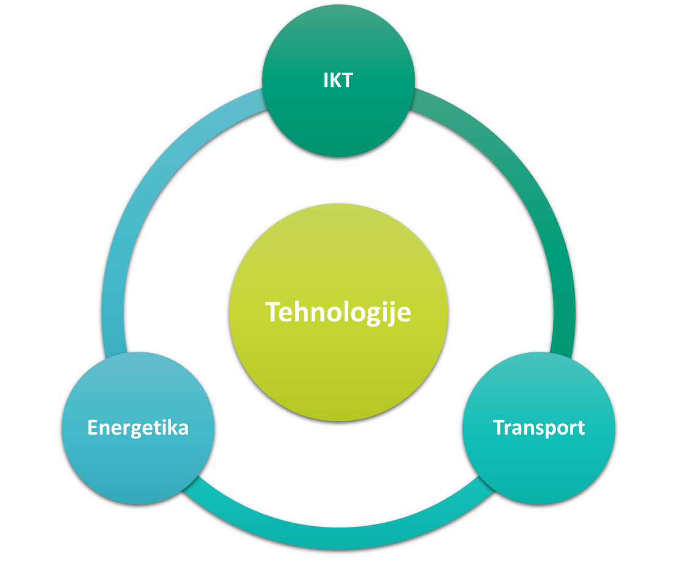

Slide 24


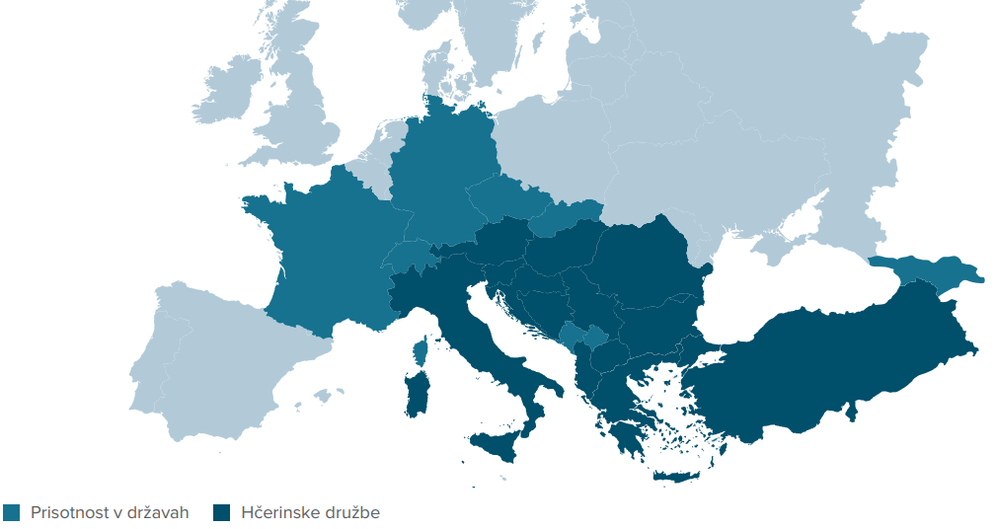


GEN-I business pillars
Electricity and gas
sales
Electricity and gas trading
Energy services
e-Mobility
Demand response

Slide 25

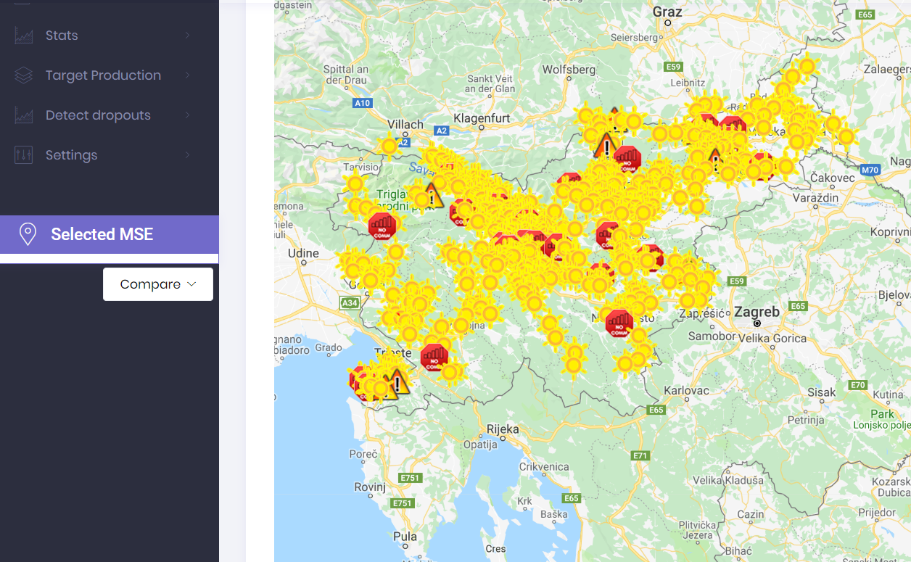

Slide 26
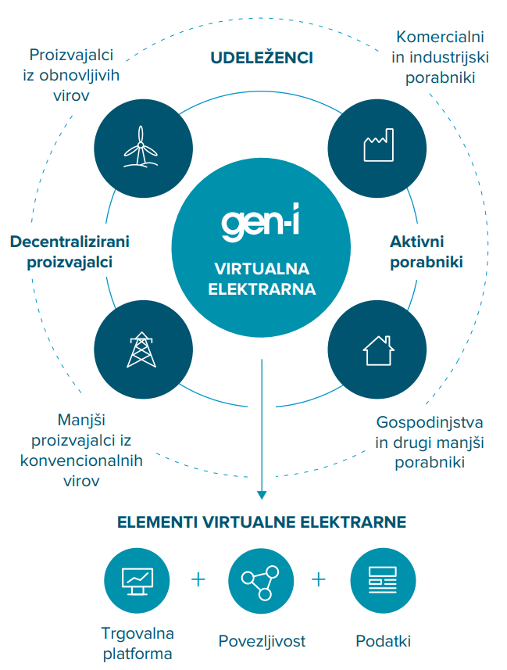

Fleksibility – demand response
https://youtu.be/RWhIP0n1Xbo

Slide 27
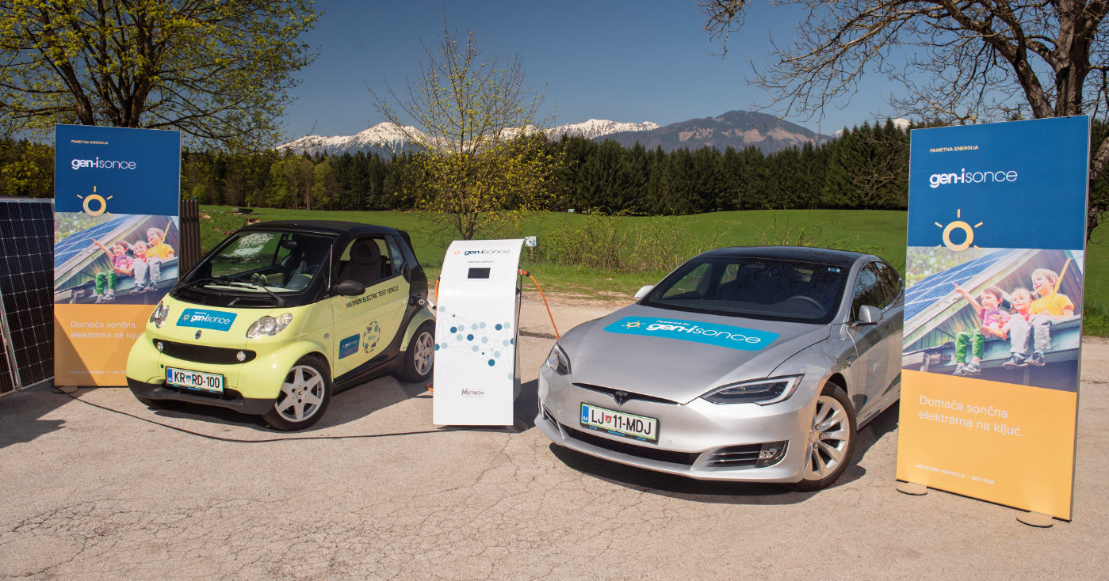
Autonomous charging station for EV, working on distributed ledger technologies
Notes:
Funkcionalnosti
avtonomno delovanje z ali brez priključitve na električno omrežje
primerna za odročne kraje, kot tudi za urbana področja
modularnost
z ali brez hranilnika energije
Z in brez sončne elektrarne
Z in brez priključitve na omrežje
Z in brez polnilnega mesta
prost prehod energije od avta do avta, od avta do hiše, baterije do omrežja, avta do omrežja
aplikacija za lastnika naprave
aplikacija za gosta
Ekonomski in sociološki aspekt
Klasična dobava
Delitev energije (od lastnika baterije, lastnika avta(hranilnik) do potreb gosta (polnjenje svojega hranilnika energije na kolesih)
Možna samooskrba
Solidarnost (avto=mobilna baterija!)
Koncepti aktivnega odjemalca na avtonomen način
Videz?
Made in Slovenia
GEN-I
Najboljši strokovnjaki na področju energetskih trgov in storitev
REC
Najboljši strokovnjaki obvladovanja baterijskih sklopov
INŠTITUT METRON
Najboljši strokovnjaki na področju e-mobilnosti
NETIS
Najboljši strokovnjaki v IoT in tehnologijah razpršenih evidenc

Slide 28


Slide 29
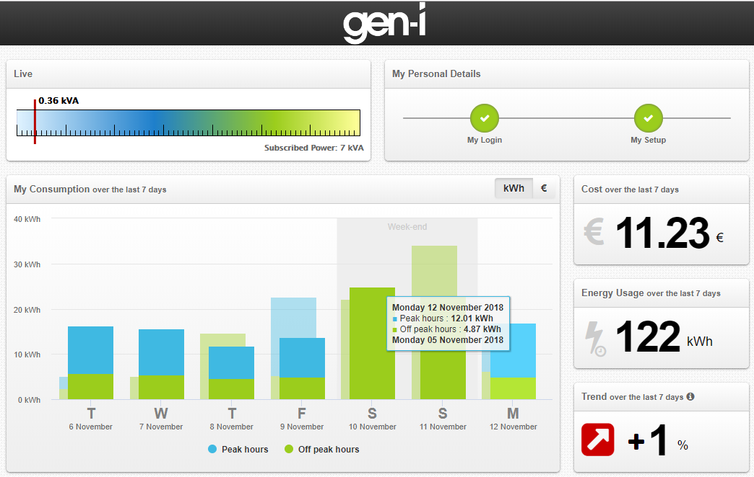

Slide 30

GEN-I as a partner for going green
Network charges, levies and taxes
Self-consumption
Flexibility
Energy bill
EMS
Energy
E-mobility
New
energy bill
GoO
Purchasing strategy consultancy and managing energy costs
Self-consumption (own production)
Fleksibility
(DR)
Energy monitoring and energy management
E-mobility
Electricity
Gas

Slide 31
Thynk you for your attention!

