Slide 1
A Pact for Skills for the Agri-Food Ecosystem
With the support of

Slide 2
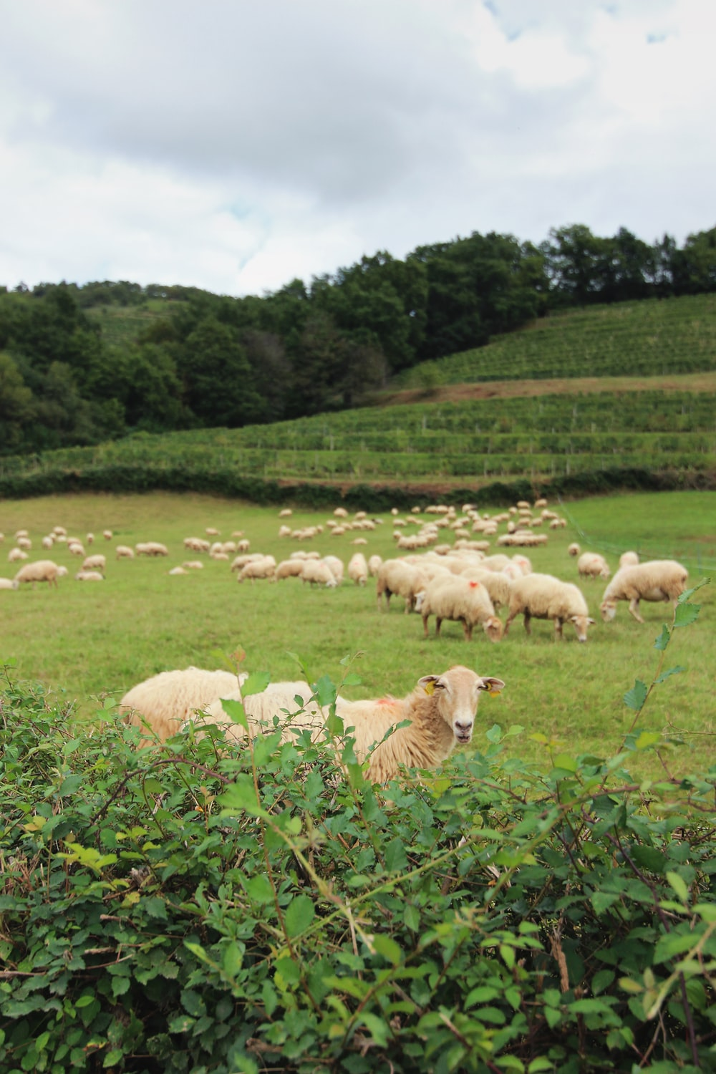
The Agri-food Ecosystem
10 million farms and 22.000 agri-food cooperatives
20 million professionals
47 % of the total EU land area
289.000 food processing companies
4.5 million professionals
15.1 % of the total manufacturing
Notes:
The agriculture and food industry is the largest producing and manufacturing sector in Europe. More than 10 million farms and 22.000 agri-food cooperatives in the EU create jobs for a
workforce of 20 million employees, especially in rural areas, and more than 294.000 food processing companies provide jobs for 4.8 million people. Overall, the agri-food ecosystem is
by far the biggest employment sector in Europe; it has a significant impact on rural and urban communities, as an aggregated ecosystem that includes more than 99% of small and medium-sized enterprises (SMEs).
According to Eurostat, farms covered 191.9 million hectares of land in the EU in 2016, equivalent to 47 % of the total land area. More than four fifths (81.6 %) of the farm area in the EU was used for agricultural production in 2016, a total of 156.7 million hectares.
The vast majority of the EU’s F&B processors were micro or small enterprises that employed fewer than 50 persons. By contrast, large enterprises — employing 250 or more persons — accounted for 55.8 % of the total value added in food processing, and for an even higher share (67.0 %) of the added value in beverage processing.

Slide 3
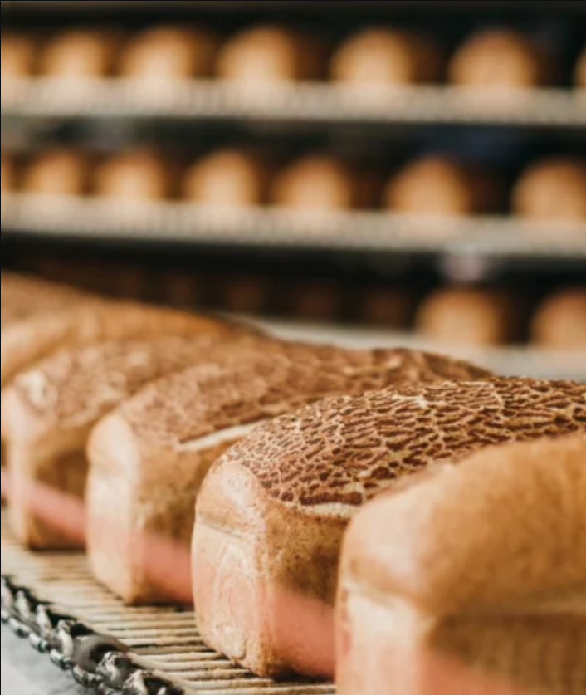
Objectives of the Pact
Upskilling to promote:
Generational renewal
Ecosystem attractiveness
Employment in rural areas
Reskilling to safeguard:
Micro, small and medium companies
Progressive technological transition
Traditional sustainable practices

Slide 4
The Pact for Skills
Large-scale partnerships
Pact for skills in construction
Aerospace & defence skills partnership
Automotive skills alliance
.
.
.
.
.
.
.
.
Agri-Food ecosystem
DG GROW
DG EMPL
DG AGRI

Slide 5
Summary of activities
10 Nov 2020
EC launches Pact for Skills
18 Feb 2021
Agri-Food Roundtable
18 Oct 2021
Stakeholder’s meeting
18 Feb 2022
Launch
18 Jul 2022
1st meeting Steering
1-2 Sep 2022 I-RESTART project KOM
16 Dec 2022 Annual meeting

Slide 6
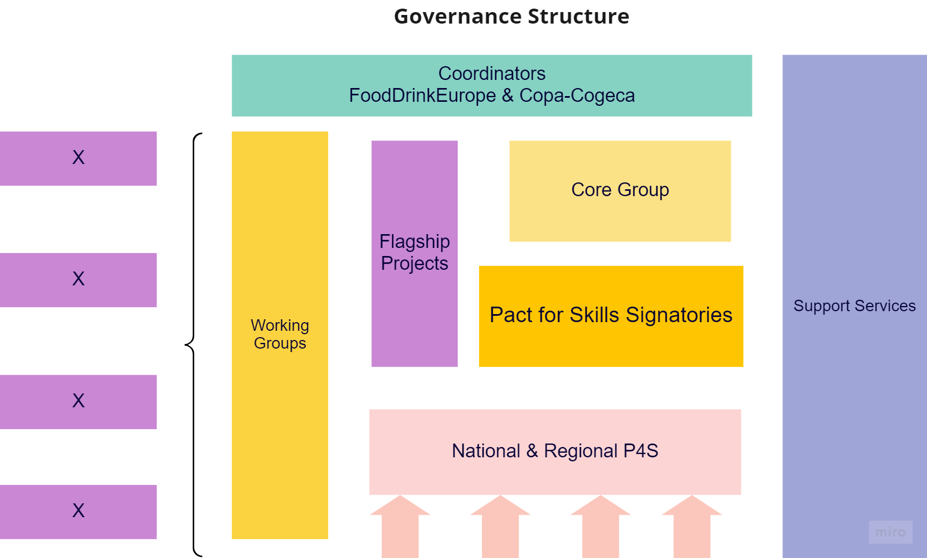
Governance structure
Dissemination and Communication
Promotion and networking
Forecasting, KPIs and monitoring
Social Dialogue

Slide 7
Coordination
Core group
+95
+78
+22
+11
+138
+23
Assembly

Slide 8
Roadmap
Support services
Ecorys
Funding opportunities
Erasmus+, Social Dialogue, Horizon, ESF+
Key Performance Indicators
Under development
Governance structure
Communication & outreach

Slide 9
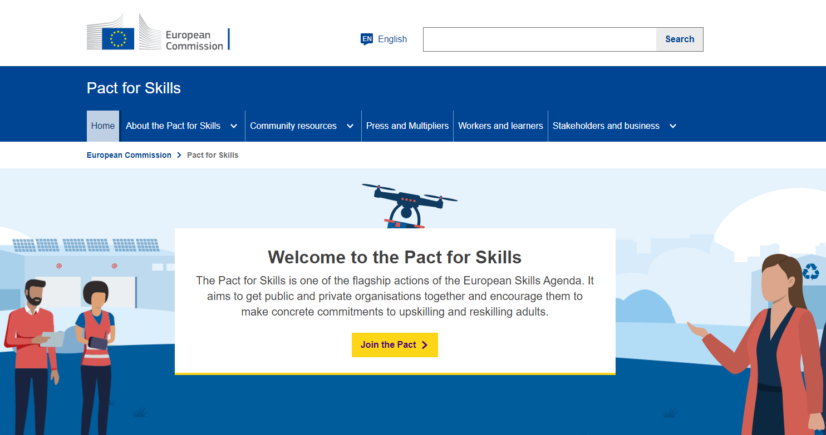
Communication & outreach
New website
New LSP icon
Under development
Dedicated LinkedIn group
Under development
Members and new members will have to upload their profile in the new EC Website:
https://ec.europa.eu/eusurvey/runner/Pact_for_Skills_FORM

Slide 10
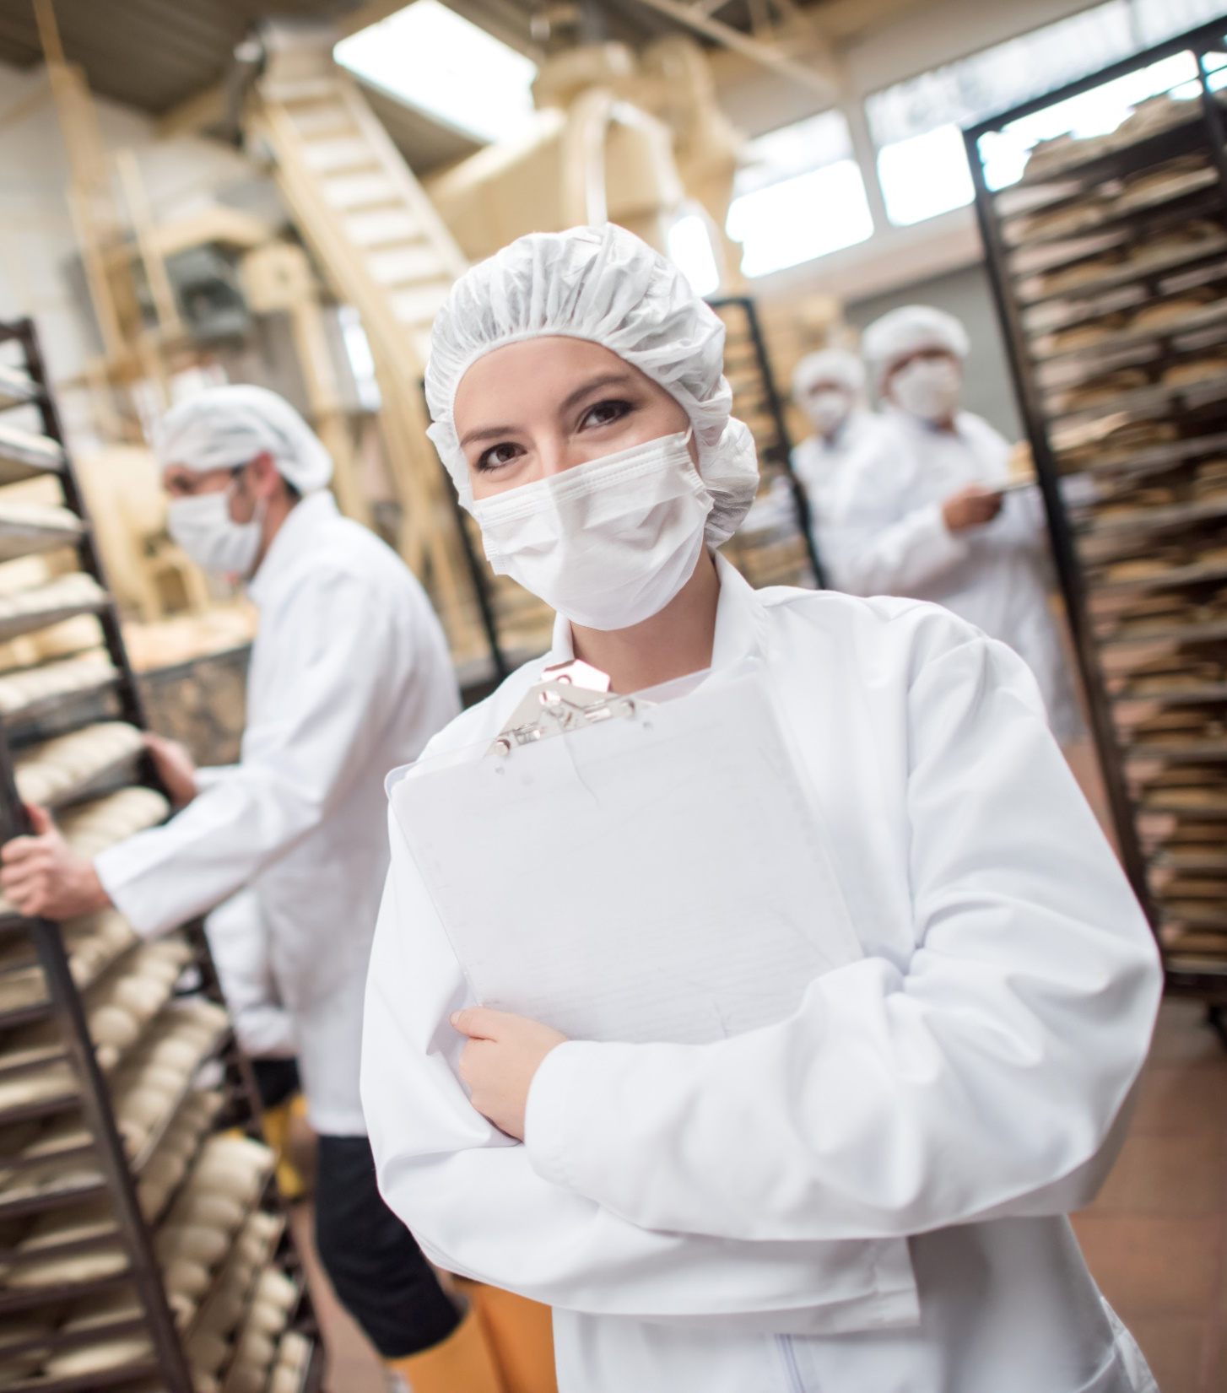
The Pact in 2023
EU Year of Skills
Activation of working groups
FIELDS activities
I-RESTART activities
Policy making event in Rome on 27-28 June 2023
Assembly of I -Restart/Fields summer 2023
Annual event December 2023
EIT-Food activities
EQVEGAN activities
GEEK4FOOD activities

Slide 11
What does the Pact offer
Networking Hub:
Finding partners
Link to existing EU tools
Knowledge Hub:
Access to best practices and tools Online events: webinars, seminars, peer learning
Updates on EU policies and instruments
Information on ongoing projects
Guidance Hub:
Finding partners
Link to existing EU tools

Slide 12
Join the Pact
Who can join?
National, regional and local authorities
Social partners
Cross-industry and sectoral organisations
Companies
Chambers of commerce
Education and training providers
Employment services

Slide 13
Join the Pact
The Charter:
Promoting a culture of lifelong learning for all
Building strong skill partnerships
Monitoring skill supply/demand and anticipating skill needs
Working against discrimination and for gender equality and equal opportunities.
Notes:
All members of the Pact sign up to the Charter and agree to uphold its four key principles:
Promoting a culture of lifelong learning for all
Building strong skill partnerships
Monitoring skill supply/demand and anticipating skill needs
Working against discrimination and for gender equality and equal opportunities.

Slide 14
Thank you!

