Slide 1


Addressing the current and future skill needs for sustainability, digitalization, and the bio-Economy in agriculture: European skills agenda and Strategy – FIELDS project
Remigio Berruto(*), Daniele Rossi(**), Patrizia Busato (*)
CONFAGRICOLTURA(**) & DIST (*)
Rome & Turin, Italy
ENTRECOMP Food MEETING –
26° of January 2023
Grand Sablon, Bruxelles

Slide 2
Specific blueprint sector: Bio-economy, new technologies & innovation in agriculture
Lot 3 - Sector Skills Alliances for implementing a new strategic approach (Blueprint) to sectoral cooperation on skills:
  Bio-economy, circular economy and bio-based products
  Agricultural sustainability, management of natural resources and climate action
  Digital technologies, digitalization, big data and artificial intelligence
FIELDS – Addressing the current and Future skIll needs for sustainabilty, digitalization, and the bio-Economy in agricuLture: European skills agenDa and Strategy
Duration Project 4 years (Jan 2020 – Dec 2023)
Funding 4 M EUR

Slide 3
Focus groups. Skill needs assessment
The trend towards business and entrepreneurship skills was already confirmed when the project partners developed the skills lists where it soon became apparent that it was necessary to treat these skills separately as one skill category and not subordinate to bioeconomy skills. Bioeconomy alltogheter count also 23% like sustainability
When looking at the whole picture, there is not clear evidence on a predominant skills category among the selected skills.
Horizontal skills are more
Than 50% of the needs
Distribution of skills among the categories

Slide 4
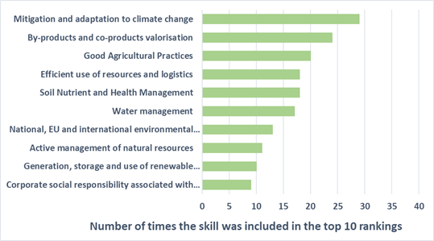
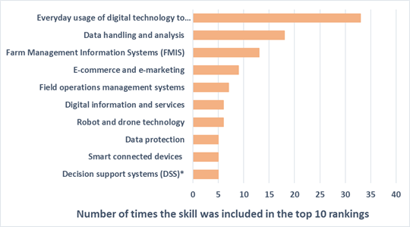
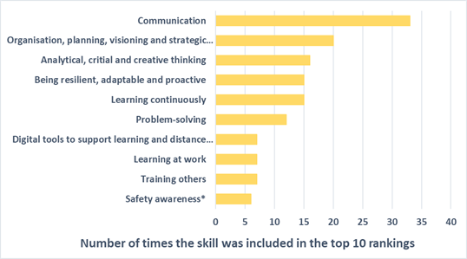
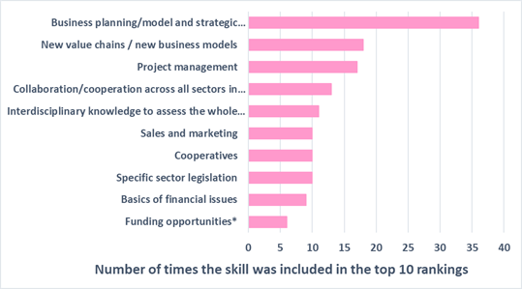
Focus groups. Skill needs assessment, categories
digitalisation
sustainability
business-entrepreneurhsip
soft skills

Slide 5
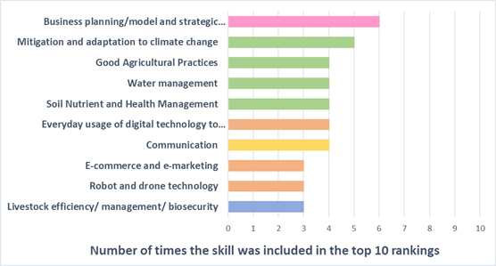
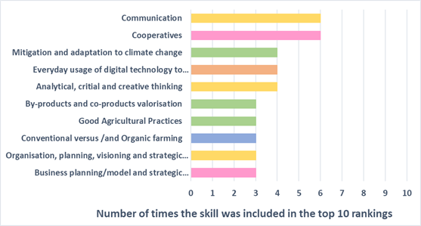
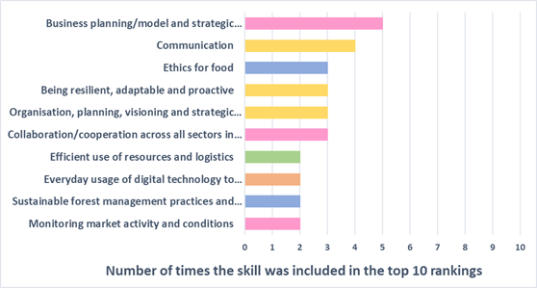
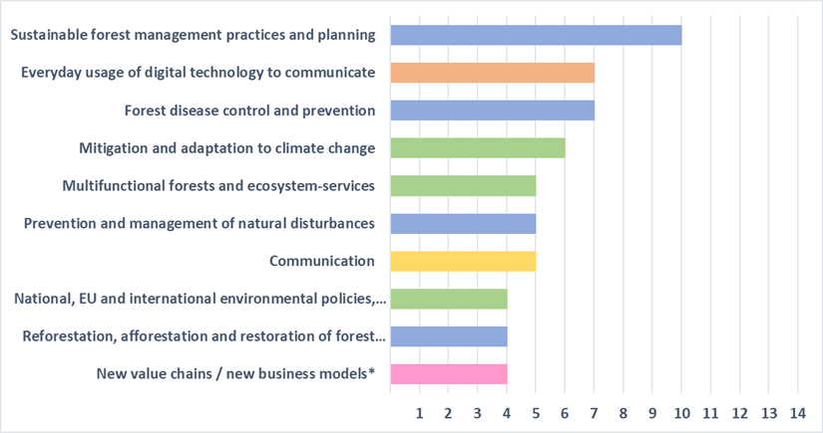
Focus groups. Skill needs assessment, stakeholders
Farmers
Agro-cooperatives
Forestry FG
Agri-food companies

Slide 6
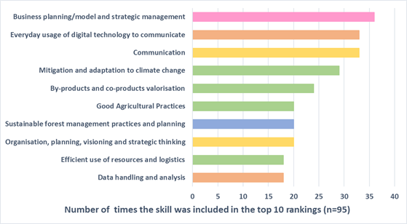
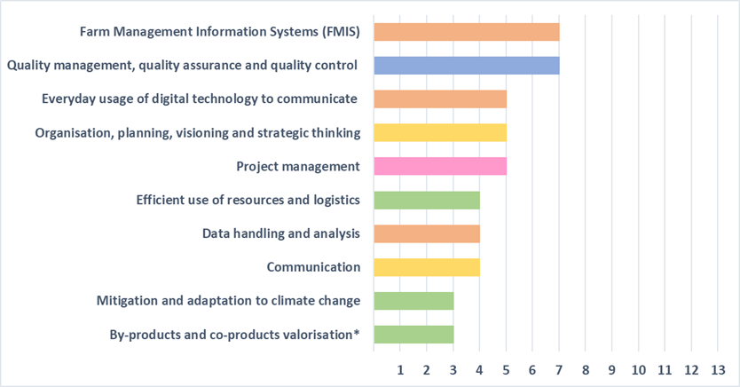
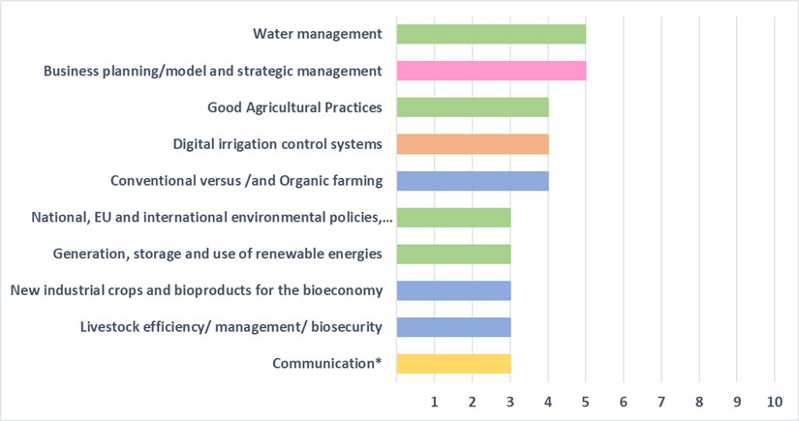
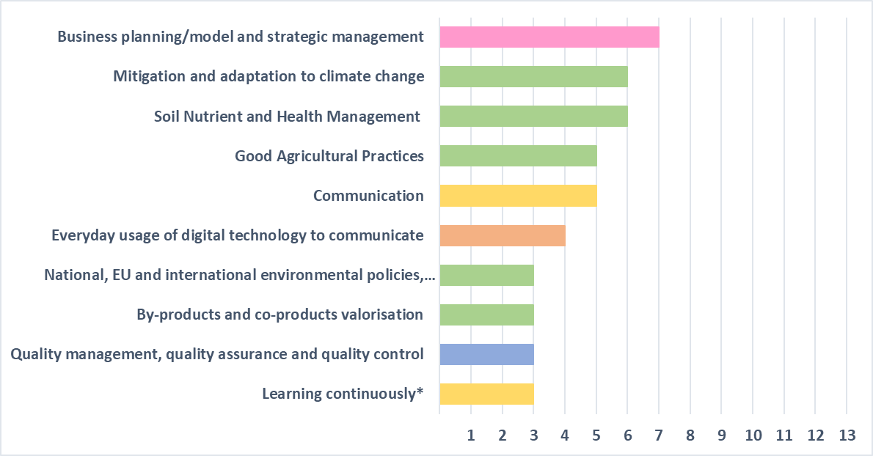
Focus groups. Skill needs assessment, country
Most important skills:
regions/EU
European level
Italy
Ireland
Spain-Portugal

Slide 7
Conclusions of focus groups
The most often selected skill among all participants is business planning /model and strategic management
Everyday usage of digital technology to communicate (digital skill)
communication (soft skill)
skills needs change in response to external factors, however, that especially digital and sustainability skills will gain importance in the near future.
common need to share knowledge and skills across different responsibility levels
Organization planning, visioning and strategic thinking.
knowledge of the entire value chain is essential
water and energy management
For bioeconomy skills, food science & technology
In the EU-policy focus group, it was pointed out that Social Dialogue should be reinforced
Country specific needs of the national education-training systems
certifications can offer a way for providing evidence of the acquisition of specific knowledge and skills, to potential or current employers.

Slide 8
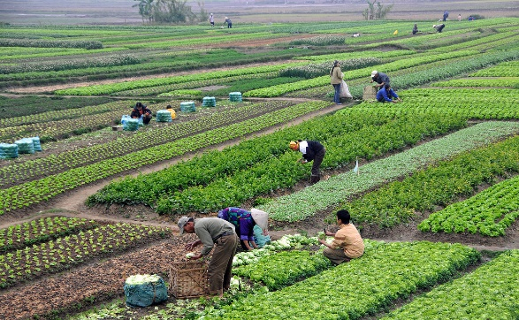
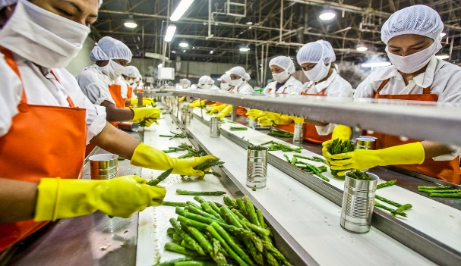
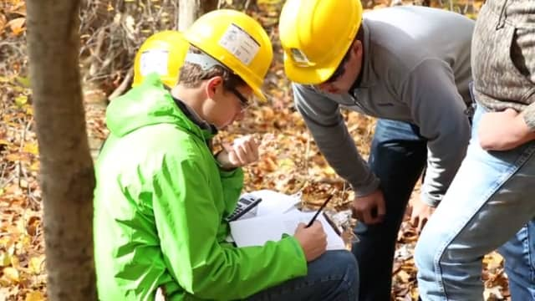
Trends in agriculture, the food industry and Forestry
Agriculture
>ecological production
>emissions
>changes in farm structure
>short food supply chains
>precision farming
>SC information systems
and new customer
relationship
Foodindustry
>co-and by products and
circular production
>new proteins
>clean and ‘’green’’ labels
>new diets
>food supply chain monitoring
>industry 4.0 (robotics, 3D printing etc.)
Forestry
>impact climate change
>illegal logging
>biomass production
>eco-system services
>increasing demands for wood
>urban green spaces

Slide 9
Differences between countries, some examples
 | Netherlands | Ireland | Spain
Sustainable production | -intensive agri-production -nitrogen emission crisis and deteriorating biodiversity -animal sector under pressure | -most agriculture on grass land -increasing grass-based dairy -improving biodiversity | -pressure on water use -(technology in) irrigation -selection of climate resilient crops
Business model | -strong trend towards multifunctional farms | -stable nr of farms and further move to dairy production | -increase of organic farming and increased consumer interaction (also food industry)

Slide 10
Definition of scenarios
We aim at a limited number of scenarios representing different roadmaps in sustainability, bio-economy, digitalisation, business models
One of the scenarios represents furthering on historical socio-economic patterns, an ‘’Established Paths’’ scenario
The elements of the project seem to be best covered by ‘’Sustainable paths’’ and ‘’High Tech paths’’
  Sustainable path scenario reflects environmental awareness, an active public sector, inclusiveness (Globally)
  High-Tech scenario reflects faith in technology, strong role private sector, Globalisation and free trade
Scenarios are described through ‘’narratives’’. The trends identified in the trend study are the elements of the narratives

Slide 11

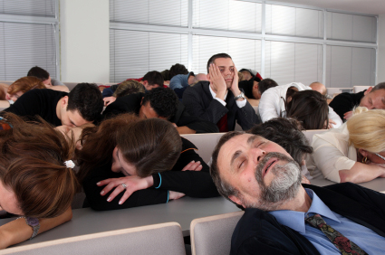
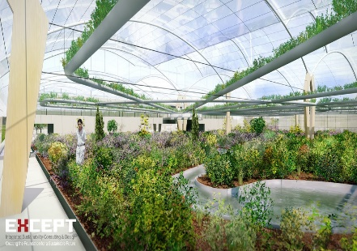
Scenarios for sustainability and bioeconomy: key topics
Scenario Sustainable Paths
Scenario EstablishedPaths
Scenario High Tech Paths
Sustainability
>consumer focus on cost, taste, convenience
>Intensive agricultural production
>focus on resource efficiency
Sustainability
>healthy personalised diets
>technology intensive large scale production (agriculture, food industry and forestry)
Sustainability
>focus plant-based consumption
>diversified cropping systems (sme)
>agroforestry and ecosystem services
Bioeconomy
>fossil fuel based energy markets
>biomass supply by forests
Bioeconomy
>high tech circular production systems
>technology driven biobased industries
Bioeconomy
>decarbonised energy markets
>increasing wood consumption

Slide 12
Scenarios for digitalisation and business models: key topics
Scenario Sustainable Paths
Scenario EstablishedPaths
Scenario High Tech Paths
Digitalisation
>precision farming varies across sectors and regions
>focus on large scale farms and forestry businesses
Digitalisation
>precision farming/ large scale prod.
>integration of systems across FSC
>industry 4.0, precision forestry
Digitalisation
>precision farming for sme sustainable and diverse production
>industry 4.0 (incl. SMEs), precision forestry
Business models
>global markets and long chains
>multinationals focusing on cost efficiency in global chains
>focus on large businesses
Business models
>short, regional, chains
>mixed multinationals and medium size food industries
>multifunctional forestry businesses
Business models
>large specialised corporate farms
>joint ventures food and health industry, for personalised and healthy food
>integration in international value chains

Slide 13
Example Country scenario: France - Bio-economy
Sustainable paths | Established paths | High tech paths
French agriculture has made a strong move towards circular production with optimal use of by-products and waste streams. Farm and household waste is used in livestock production. | There is only moderate development towards circular production in French agriculture. Livestock and crop production are not well connected. | High tech agriculture and precision farming lead to a strong move towards circular production.
100% of the wastes produced in the agrifood industry are transformed into highly added value making way to a new highly-added value specialties business line. | 40% of the wastes produced in the agrifood industry are transformed into highly added value making way to a new highly-added value specialties business line. | New by-products emerging from a novel specialty agrifood industry in which new technological approaches achieve more & more highly added products contributing to diversify the business model.
Agriculture is self sustaining in energy production through production of bio-gas, wind and solar energy. | Agriculture is still for the largest part dependent on fossil based energy sources, only moderately supported by renewable energy sources which are also supplied to some niche markets. | Agriculture is still strongly based on fossil fuel, however supported by cost-effective renewable energy production.
Water consumption and effluents are minimized in agrifood factories by recycling and reusing techniques. | Demands of water are reduced because of recycling. Industrial effluents are treated efficiently before discharge. Technologies can provide cheap reclaimed water | Innovative systems allows to optimize the use of different sources of water and reclaimed wastewater for several applications in industry, agriculture and other uses.
Forest acreage has been increased, the use of forest has been sustainably diversified. Agroforestry and small-scale forestry including so-called ‘’tiny’’ forests are integral part of the rural and urban landscape. Degraded land has been afforested. Forestry strongly contributes to biodiversity. Most forest is ‘’nature forest’’ or regional parc. | Forest acreage has increased very moderately. Planting of trees in urban and rural settings increases slowly albeit steadily. Most forest is ‘’production forest’’. | Forest acreage has increased moderately. Degraded land has been afforested. Forestry and agriculture are functioning separately. Most forest is ‘’production forest’’ with around 50% of the harvested wood used for energy production.
The food industry has moved strongly to circular production supported by new technologies, including the introduction of sustainable packaging materials. | The French food industry is dependent on fossil fuel energy sources but gradually improves its valorisation of by-products and waste streams through research centres. Technology growth is moderate but increasing through French legislations. | The French food industry is moving swiftly to smart factory solutions where use and recycling of resources is based on economic incentives and legal demands. Intelligent packaging lead to lower cost production with less waste.

Slide 14
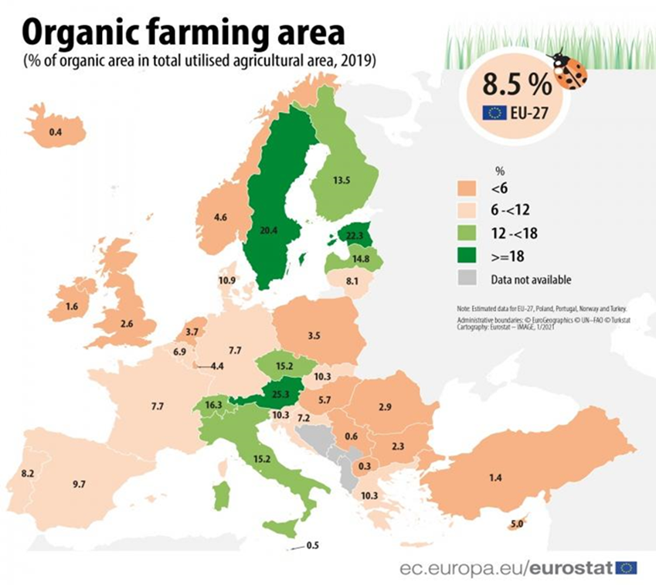
Differences between countries: organic farming

Slide 15
Differences between countries: Example Rural broadband coverage in Europe, 2019
Digital Economy and Society Index (DESI) 2020
(study by IHS Markit, Omdia and Point Topic).

Slide 16
Conclusion: different implications of trends and scenarios throughout Europe
Trend and scenario study support decision making on training and education development
Trends show differences between EU countries
Starting position of countries is also different
Implying that scenarios should also be differently implemented: sustainability, bio-economy, digitalisation and business models
Implying, besides commonalities, different skill and training needs
Challenging the EU Green Deal objectives

Slide 17
Three Scenarios: key topics
Source: FIELDS/Jacques Trienekens, WUR, 2021
Scenario EstablishedPaths
Scenario Sustainable Paths
Scenario High Tech Paths
Sustainability
>consumer focus on cost, taste, convenience
>Intensive agricultural production
>focus on resource efficiency
Sustainability
>focus plant-based consumption
>diversified cropping systems (sme)
>agroforestry and ecosystem services
Sustainability
>healthy personalised diets
>technology intensive large scale production (agriculture, food industry and forestry)
Bioeconomy
>fossil fuel based energy markets
>biomass supply by forests
Bioeconomy
>decarbonised energy markets
>increasing wood consumption
Bioeconomy
>high tech circular production systems
>technology driven biobased industries
Digitalisation
>precision farming/ large scale prod.
>integration of systems across FSC
>industry 4.0, precision forestry
Digitalisation
>precision farming varies across sectors and regions
>focus on large scale farms and forestry businesses
Digitalisation
>precision farming for sme sustainable and diverse production
>industry 4.0 (incl. SMEs), precision forestry

Slide 18
Short overview WP2.3 European Strategy first stage survey results
Challenges and prerequisites for a European agri-food and forestry skills strategy
Adopted from: Jacques Trienekens, Wageningen university

Slide 19
Key requirements for training programs
A key position for management/entrepreneurship and soft skills
  management skills, creative thinking, relational skills!
Training in practice
  real-life problems, troubleshooting, communication skills (mentored)h
Move towards online training
  Covid-19, flipped classroom, basic courses (freely) available
Attention to underprivileged groups and gender issues
  basic skills, decision making functions, (maternity) leave women
Differentiation of (technical) training needs per country
  attention to commonalities, ip ‘’basic’’ courses on EU level

Slide 20
Points of attention in (V)ET development (checklists, some key items)
Timing Schedule courses in off peak time (evening, weekends) or in hybrid mode Design tailor-made fast tracks for business management
Communication Emphasize the meaningfulness of jobs Modules and courses should be certified; micro credentials should be offered
Funding Provide e-learning for free, via e-learning platforms Link subsidies to training certificate requirement

Slide 21
Challenges in the harmonisation of VET systems
Differences in skill needs between countries, due to sector differences, differences in business structure, differences in climate conditions, etc
Differences in skill levels across countries and different competence levels of trainers
Differences in the national education systems
EU regulatory systems not optimal, e.g.
  The European Qualification Framework (EQF) and National Qualifications frameworks (NQF) operate at different levels.
  There is no integral system of degree recognition in the EU yet
  No implementation plan for European Skills Agenda

Slide 22
European skills monitoring system is required, however
Lack of a common methodology for skill needs and monitoring
Limited inclusion of transversal/soft skills in evaluations in most countries
Lack of commitment of member states and stakeholders to provide feedback
Funding and maintenance of the monitoring system
Current organisations, e.g. Eurostat, EU Education and Training monitor, Eurydice, Cedefop, EU projects

Slide 23
Conclusion 1: development of training programs
Key skill needs on EU and country level (10) have been identified
However, lots of differences in skill needs and training availability in different countries
Nevertheless, basic starting points when designing programs/courses include:
  common (basic) needs across countries
  key position of management/entrepreneurship and soft skills
  key position of practical training
  key position for online training
  attention to underprivileged groups
Exchange of best practices throughout Europe needs to be stimulated!

Slide 24
Conclusion 2: Actions for EU level system harmonization
A harmonized qualification and certification system for (VET) courses/programs and (VET) providers
A system of degree recognition, micro credentials and a European catalogue with training/education supply
A supra-national institute responsible for design and maintenance of a monitoring infrastructure for skills and the establishment of KPIs
The newly established Agri-food Pact for Skills can play a central role in the establishment and governance of an ‘’Agri-food Skills Observatory’’.

Slide 25





























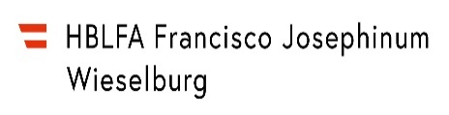
Thank you for your attention!
remigio.berruto@unito.it, patrizia.busato@unito.it
d.rossi@confagricoltura.it

