Slide 1
ENTRECOMP Food MEETING – 26° of January 2023 Grand Sablon, Bruxelles
I-RESTART
Inclusive REskilling and upSkilling Toward competitive Agrifood and veterinary sectoR: European agenda StraTegy
Daniel Rossi (Confagricoltura), co-coordinator
Remigio Berruto (UNITO) Patrizia Busato (POLITO), Coordinators

Slide 2
Lot 2: Alliances for Sectoral Cooperation on Skills (implementing the ‘Blueprint’)
Concept note:
Agri-food: Plant and animal production; Processing of food; Veterinary activities etc.
Duration Project 4 years (Sep 2022 – Aug 2026)
Funding 3,85 M EUR
I-RESTART
Inclusive REskilling and upSkilling Toward competitive Agrifood and veterinary sectoR: European agenda StraTegy
Erasmus+ I-RESTART – EntreComp Food meeting 26/01/2023

Slide 3
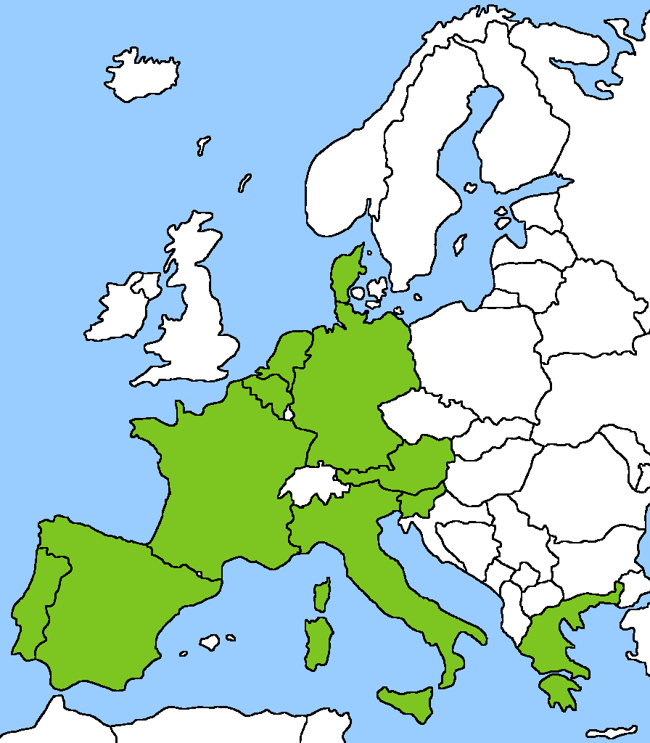
I-RESTART partners & countries
The consortium is composed of 27 full partners and 1 associated partner:
11 Education and training providers (UNITO, WUR, AARHUS, AERES, UNITE, UHOH, UMU, INFOR, LVA, CTAEX, AKMI),
3 Education and trainings network (ISEKI, EFVET and ACEEU)
13 Agri-Food industry representatives (CONFAGRICOLTURA, COPA-COOGECA, FDE, EIT FOOD, LVA, ANIA, FIAB, GZS, SEVT, SCOOP, FEDER, CLITRAVI, CONFAGRI-PT)
1 European Veterinary Specialist (EBVS)
The partners were selected in order to cover all sectors, competences and coverage needed to reach the project’s objectives
1) Food industry and processing, 2) Animal production, 3) Digital technologies for food industry, e-commerce, export, online marketing, logistics, 4) Veterinary activities and 5) Advanced Entrepreneurial skills.
28 partners from 11 countries
training pilots in 8 countries
Erasmus+ I-RESTART

Slide 4
I-RESTART main goals
Provide innovative and inclusive training exploiting also dissemination opportunities – fast track to innovative curricula through the ‘AgriFood Industry Open Days’ with pilot training led by VET providers and Agrifood associations
Reskill/upskill workers of the agrifood industry and veterinary sector (maintenance workforce goal)
Reskill people coming from heavy industry (10%) of laid off (partial absorption of external workforce)
Training students (5%) of the hired workforce (new entry workforce in the agrifood market)
Be the backbone of the Pact for Skills for the Agrifood Sector
Erasmus+ I-RESTART –

Slide 5
I-RESTART Main objectives
O1: Development of a strategy to cooperate on skills
It will encompass various parts, from the presentation of the state of the art, the definition of skill gaps and future needs, to the design of recommendations, best practices, and partnerships in place to support the growth strategy of the sector.
The strategy will be accompanied by national roadmaps for its implementation and a set of education support (curricula, tools, pedagogical approach, training content, train the trainers toolkit, etc).
O2: Define the European core curricula for the sector
O3: Training implementation in 8 countries
During the first year, the project will address urgent skills needs (defined in previous projects) resulting from the Covid-19 and the digital transition. The training will answer the most urgent needs identified in the project and will chose the best methodology for its target groups, providing innovative ways of learning, both for adults (continuous learning) and for students (initial learning) through various set-up (formal, non formal education) and with the appropriate tools (online platform, in-class activities, work-based etc). The training content will be created in response to the needs identified, and have already been classified into 4 different broad topics: 1) Common skills and soft skills, 2) Digitalisation, 3) Commercial and Business economics.
Erasmus+ I-RESTART –

Slide 6
I-RESTART Main objectives
O4: Alliance for cooperation on skills implementation.
An Agri-food and veterinary Alliance will be established during the project to build upon the regulatory frameworks and opportunities at EU and country level, while proposing concrete and practical initiatives to address skills challenges, in particular through offering modular training, free material and resources while guaranteeing mobility of workers within the veterinary and agrifood industry.
Sub-objectives:
SO1: Develop common methodology for skill assessment.
SO2: Identify occupational profiles and prioritise them
SO3: Develop concrete solution to illustrate the strategy, develop mobility
SO4: Promote attractiveness of the sector
SO5: Long term sustainability
Erasmus+ I-RESTART –

Slide 7
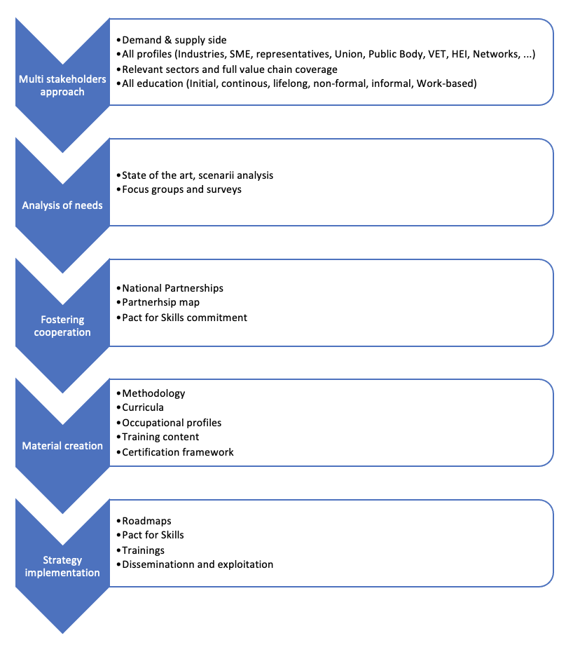
I-RESTART project concept
Compliance with existing EU instruments and tools (EQAVET indicators, EQF, ESCO)
Collaboration with CEDEFOP portal
Adoption of apprenticeship schemes and work based patterns with mentors
Implementation of micro-credentials
Erasmus+ I-RESTART –

Slide 8
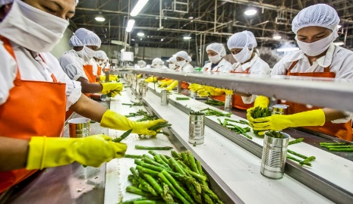
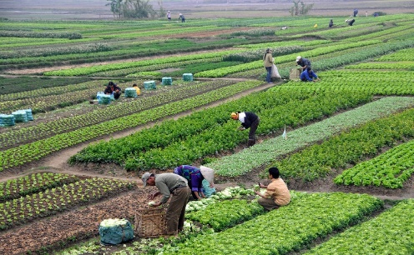
How I-RESTART will foster innovation?
I-RESTART will use a multistakeholder methodology to skills needs identification, relying on different networks and different partners to cover an unexplored part of the sector.
It will provide fast track to innovative curricula with AgriFood Industry Open Days to have both impact and feedback from stakeholders of the sector
I-RESTART will offer the training material in a form of complete certified course or shorter modules (micro-credentials) to tackle the skills gaps as an innovative way to allow rapid upskilling and reskilling as well as increase the uptake of VET in the agri-food and veterinary sector in general. This will provide inclusivity and flexibility for the training.
I-RESTART will facilitate the inter-sectoral and intergenerational skills transfers through the implementation of work-based patterns with mentors while opening the ecosystem also to external workers
I-RESTART will pursue micro-credential certification at national level of the involved countries through dedicated workshops
Erasmus+ I-RESTART –

Slide 9
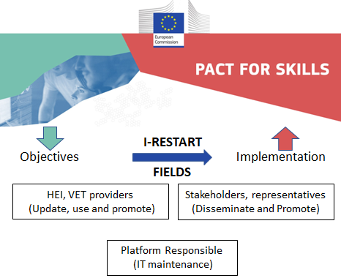
I-RESTART impact
Erasmus+ I-RESTART –

Slide 10
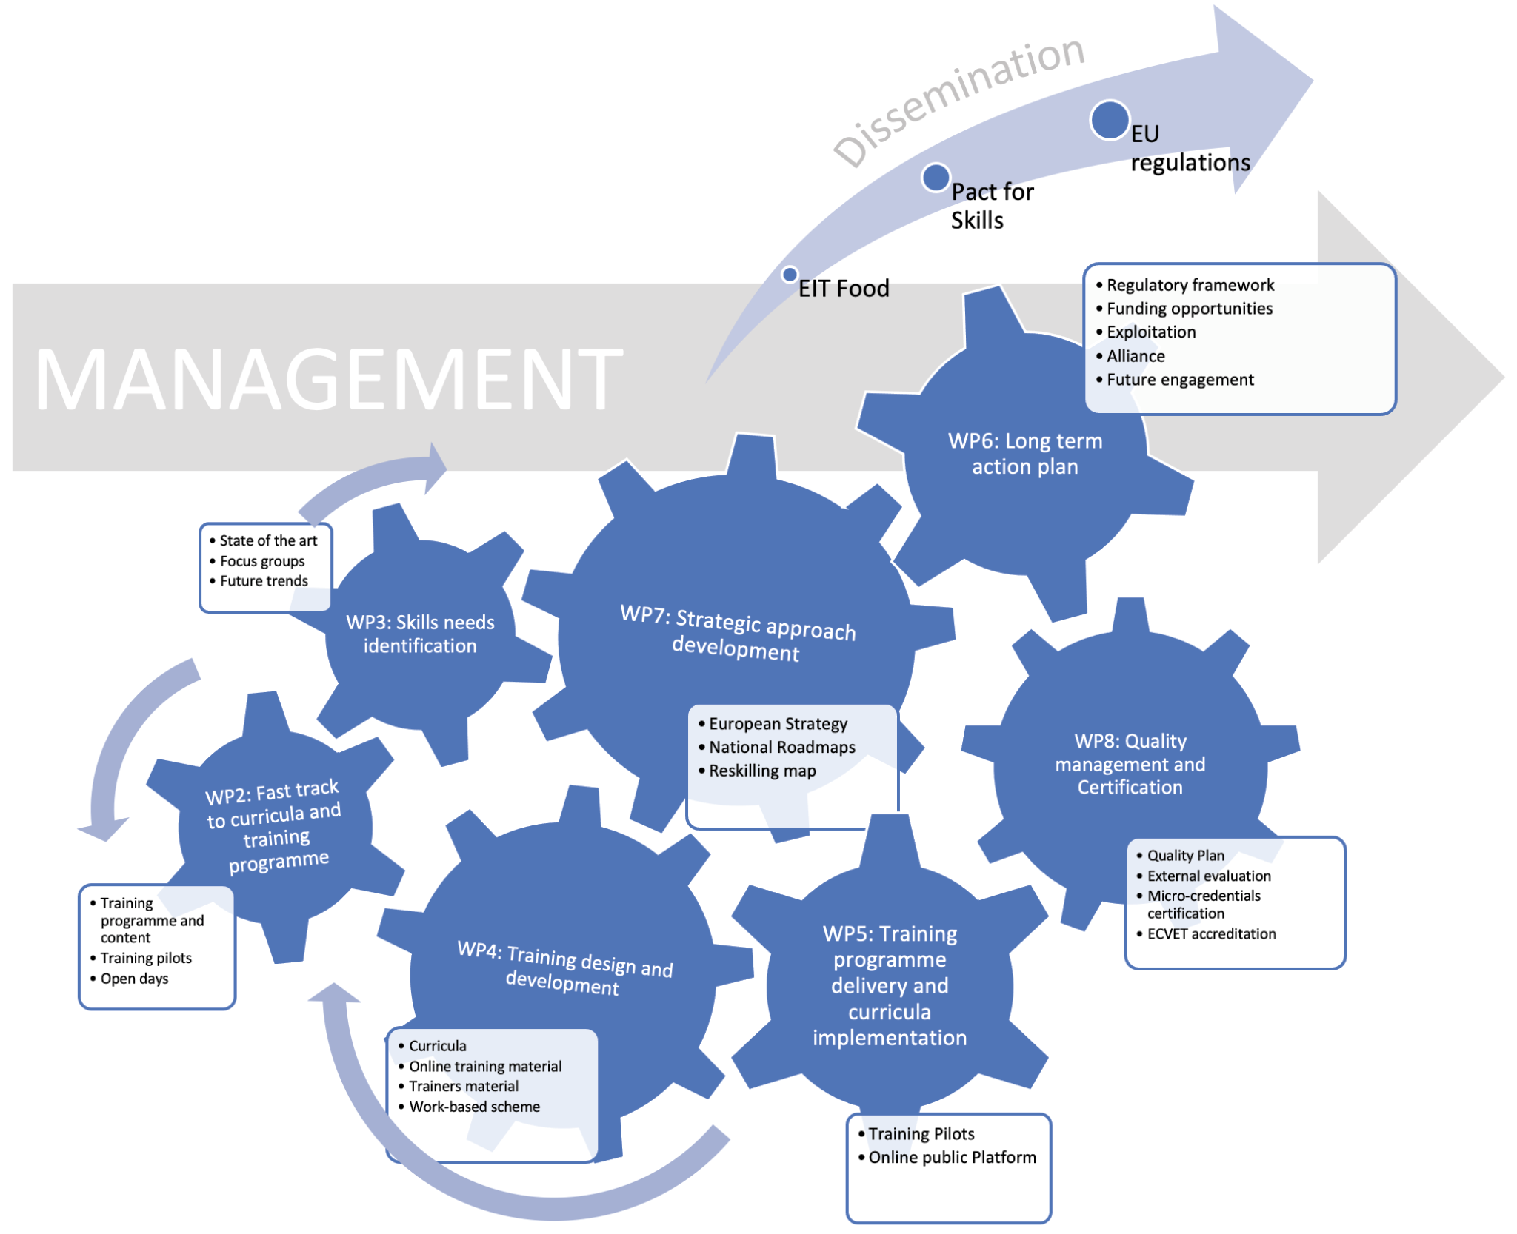
I-RESTART Work Packages
Erasmus+ I-RESTART –

Slide 11
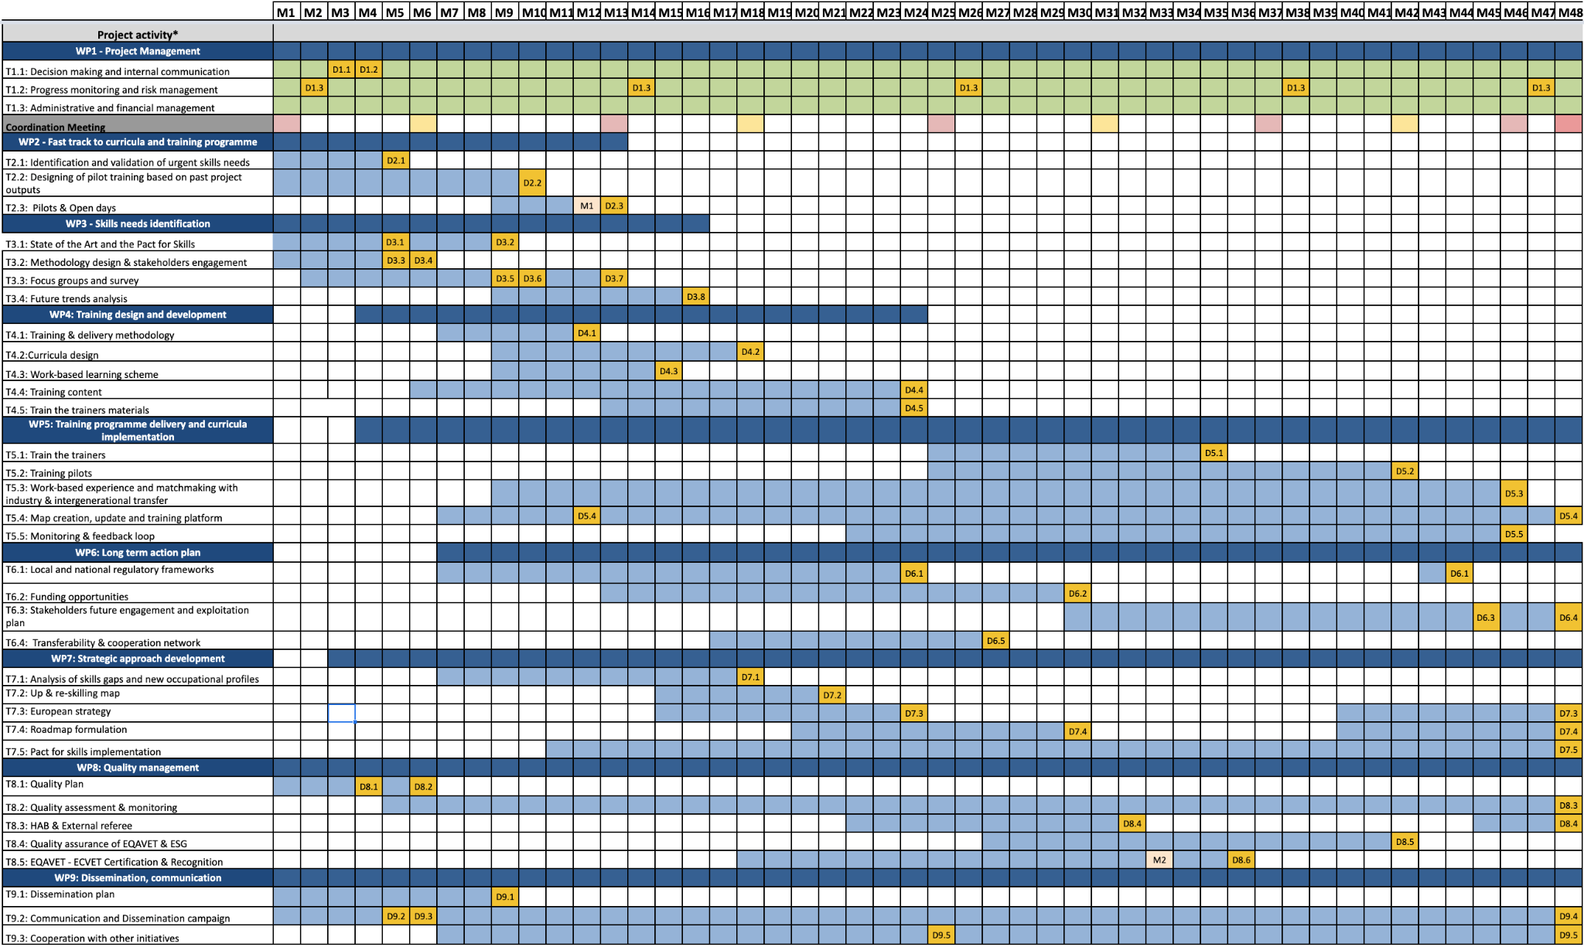

Slide 12
I-RESTART progress activities
WP1: Management portal active
First payment made to all partners
Consortium agreement in preparation
2nd Project meeting in VIENNA M13
Working meetings planned every two weeks to monitor the activities
WP2: Discussion with WP leader on identification and validation urgent skills
WP3: First meeting planned for 19 October 2022
First brainstorming with WP3 Leader about focus group content
WP8: Exchange of email with WP leader about Quality Plan and assessment grid (for deliverables evaluation)
WP9: Dissemination and communication:
Website under construction
Social media account already created (Twitter, Instagram), LinkedIn and YouTube in preparation
Erasmus+ I-RESTART –

Slide 13
I-RESTART contribution to the Pact for Skills
I-RESTART will provide training material and tools developed as resources for signatories of the Pact
I-RESTART will actively contribute through T7.5, by incentivizing the increase of the Pact for Skills signatories as well as providing implementation channels for the outcomes of the project.
Two partner of the I-RESTART project, COPA-COGECA and FDE, umbrella organization at EU level representing Farmers and Agri-food industry, recognize their interdependent role, they establish a common task force for the Pact for Skills and signed a common code of conduct related to the implementation of the Pact for Skill among their organization and stakeholders.
I-RESTART Coordinators constantly participate in pact for skills meetings, both organized from DG-AGRI, DG-EMPL and DG-GROW, and from COPA-COGECA and FDE within the implementation of FIELDS project
Erasmus+ I-RESTART –

Slide 14
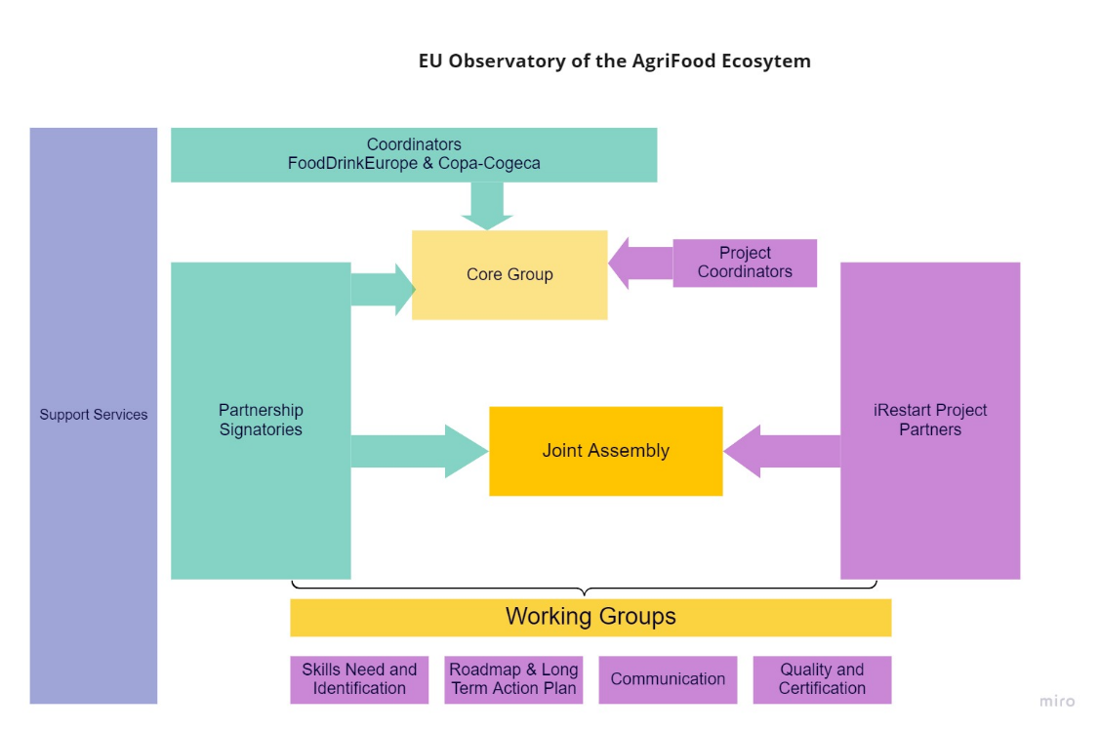
Erasmus+ I-RESTART –

Slide 15
Working groups supported within I-RESTART
For the duration of the I-RESTART project (until 30/08/2026) the following working groups will be supported by the I-RESTART partners:
Communication
Networking
Scenarios and Figures
Repository and Certification
Erasmus+ I-RESTART –

Slide 16
Observatory on Agrifood Job Challenges – OAF Timeline 2023-2025
Roles for Pact for Skills members and partnership (2022-23)
KPIs baseline and kick off (end of 2022: 16° of December)
Staff building (end of 2023)
Data Sources analysis (2023-24)
Scenario modelling (2023-24)
Network for microcredential certification (2023-24)
EU and national policies and tools (2023-24)
KPI monitoring (2024-25)
Training repository (2024-25)
Policy recommendations and funding opportunities/incentives (2024)
Piloting will occur during I-RESTART (2025)
Erasmus+ I-RESTART –

Slide 17
Lot 2: Alliances for Sectoral Cooperation on Skills
Thank you for your attention!
Remigio Berruto (UNITO), Coordinator – remigio.berruto@unito.it
Daniel Rossi (CONFAGRI), Co-coordinator – d.rossi@confagricoltura.it
Patrizia Busato (UNITO), Co-coordinator – patrizia.busato@unito.it
Erasmus+ I-RESTART – EntreComp Food meeting 26/01/2023

