Slide 1
European Final Conference of “EntreCompFood” project 26th of January 2023 NH Collection du Grand Sablon, BRUSSELS
“Importance of innovation and main challenges of the Agri-Food sector”
Eduardo Cotillas
NFTPs Co-chair

Slide 2
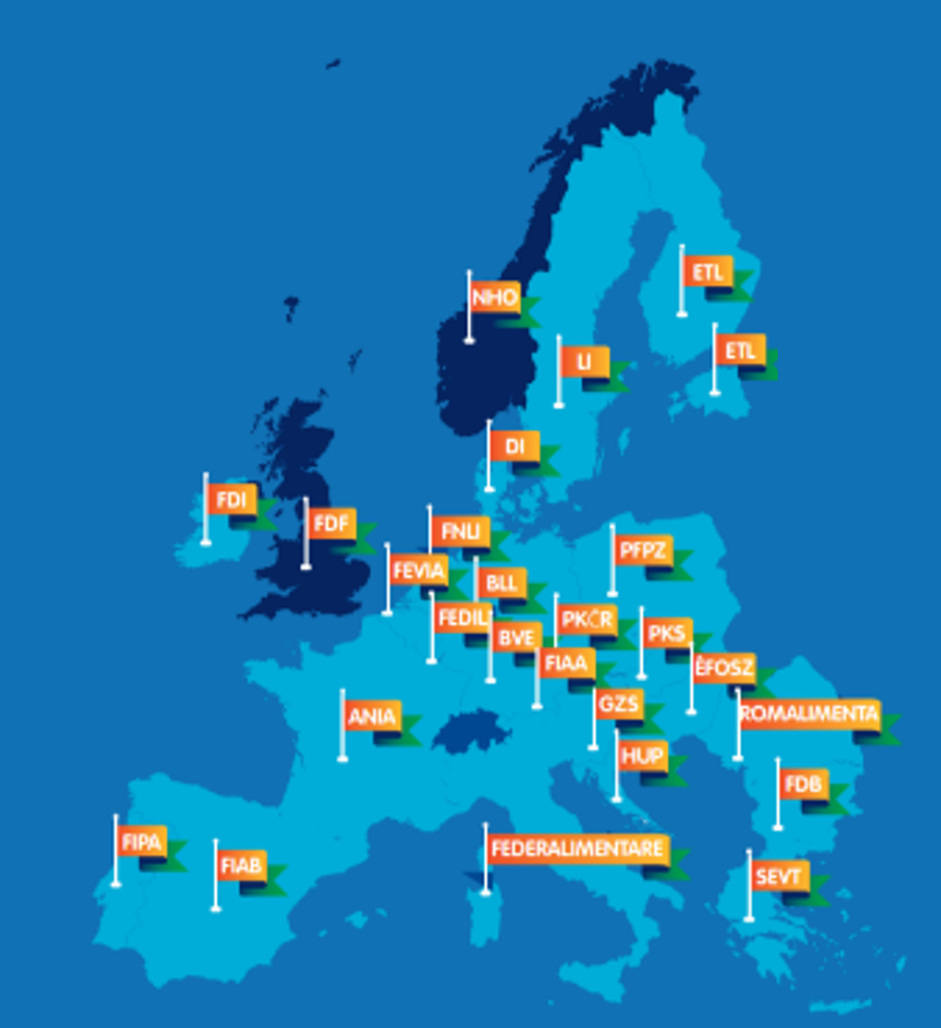
FoodDrinkEurope
27 National Federations
23 Liaison Companies
26 EU Sector Associations

Slide 3
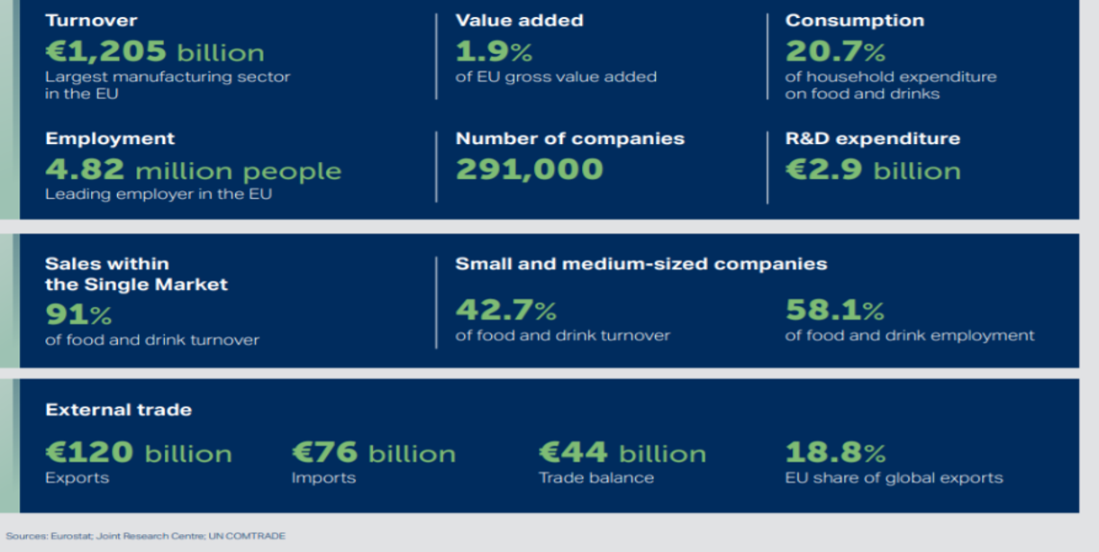
The EU food and drink manufacturing industry

Slide 4
The Food Sector is Under Pressure
Dietary Diseases
Malnutrition
Environmental pollution
Biodiversity loss
Resource scarcity
Climate change
Land-use conflicts
Animal welfare
Food security
Extra UE Competition
Low innovation rate
Companies size
Cause
Effect
Health
Sustainability
Affordability
Accessibility
Diversity
Inclusiveness
Power balance
Competitiveness
Global versus local
International Trade
Affect
Notes:
“Challenges” - the food sector is under pressure on many different fronts.

Slide 5
NFTPS: what are the main Research & Innovation needs?
Ensuring a constant public funding to F&D SMEs investments in R&I, to share the innovation risk
Showing good practices and tools available to all the food and drink Industry, to be more adaptive
Inserting new professions and career paths in the food and drink industry, to be more sexy
Delivering high-level digital, bioeconomy and soft skills in all the food and drink industry, to be more competitive, precise and visible
Re-Organizing research and tech transfer agencies, to be more effective in finding the practical solutions
Re-thinking business models and cooperation/collaborative activities along the different food chains
Sharing knowledge and data on consumer behaviours and trends in the medium/long term
Building platforms and brokerages with advanced input providers (materials, technologies, services…), to benefit and updating
Being more sustainable, without loosing money, competitiveness, volumes, suppliers, and control

Slide 6
What are the ETP and NFTPS actions needed to get them?
Ensuring daily monitors on EU, National and Regional R&I funding programs and plans
Identifying, listing and sharing good practices and tools
Providing to the workforce VET micro and medium modules (levels 4,5,6) on new skills, up-skills and re-skills
Delivering high level cooperative and/or pre competitive services to F&D SMEs
Elaborating scenarios, foresights, propacts (4 skills), position papers and policy recommendations to the main stakeholders, authorities and policy makers, on behalf of all the F&D Industry
Consulting frequently the national networks by NFTPs to inform ETP/FDE, to lobby EU Institutions, and to build a real bottom up approach to EU
Communicating with country based simply messages the results of european and national FTPs activities
Informing and preventing F&D Industry, in particular SMES, on risks and opportunities coming from different sources
Last but not least, building dialogue and strong alliances with the other sectors – in particular the primary and the horeca sectors on common goals and priorities

Slide 7
What are the ETP and NFTPS actions not to do ?
Going separately, sometime against each others
Limiting informations, intelligence, networking, facilities, training, services, solidarity, to a part of the F&D Industry
Giving up on that dialogue with the stakeholders, the other sectors, the academia, the different authorities
Penalizing, “beggar my neighbour” activities, discussing some branch/company reputation, badly speaking on part of the F&D Industry
Consulting and lobby EU Institutions without listening, arbitrating and re-balancing the different F&D Industry positions/approaches;
Communicating only with English based messages to the national federations/nftps associates
Identifying, listing, but not sharing good practices and tools

Slide 8
Thank you
Françoise GORGA
Coordinator of NFTPs
fgorga@ania.net
Eduardo Cotillas
Co-coordinator of NFTPs
e.cotillas@fiab.es

