Slide 2
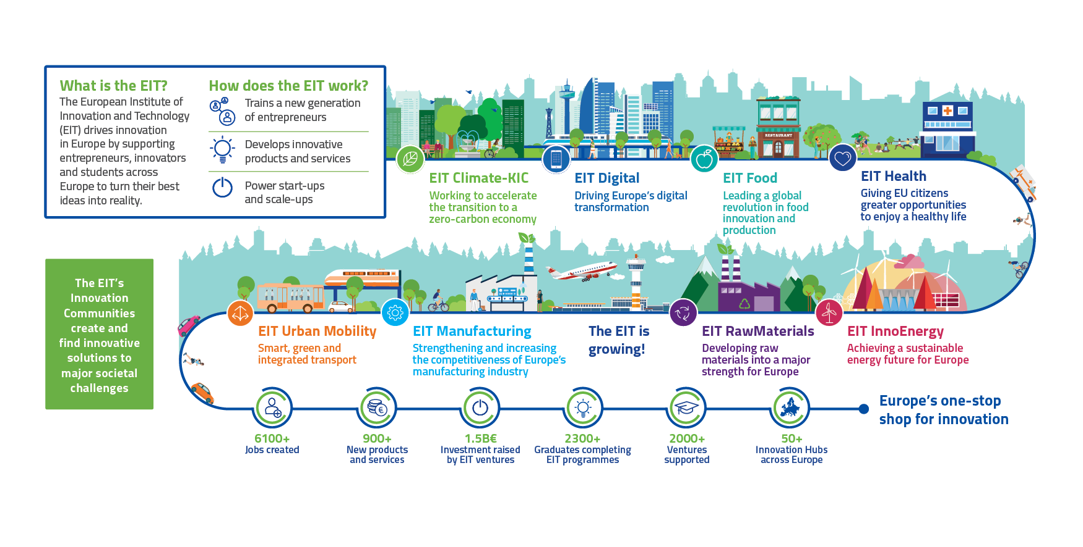
About
EIT Food

Slide 3






IMPROVING FOOD TOGETHER
A MISSIONS-LED APPROACH
HEALTHIER LIVES
THROUGH FOOD
NET-ZERO FOOD
SYSTEMS
A FULLY TRANSPARENT, RESILIENT AND FAIR FOOD SYSTEM
We will make a material difference to health adjusted life years by enabling more consumers to make better choices through access to healthier products and actionable information.
We will be closer to a net zero food system, reducing CO2 equivalent emissions by tackling CO2 hotspots, reducing the footprint of proteins through diversification, and creating new markets for food waste.
We will see the benefits of more resilient, trusted food supply chains with people experiencing greater
food security and safety through widespread digitally enabled food supply chains.
Together with our community, we are addressing the complex and critical challenges of sustainability and climate change, of non-communicable diseases and poor nutrition, and of consumer trust, scarcity and transparency through a missions-led approach.

Slide 4
Organisations
Employers
Training Providers
Individuals
Professional Bodies
We equip the brightest minds all over Europe and beyond with skills and knowledge to drive change in the Food System Industry.
The pan-European skills platform to drive Food Systems transformation

Slide 5
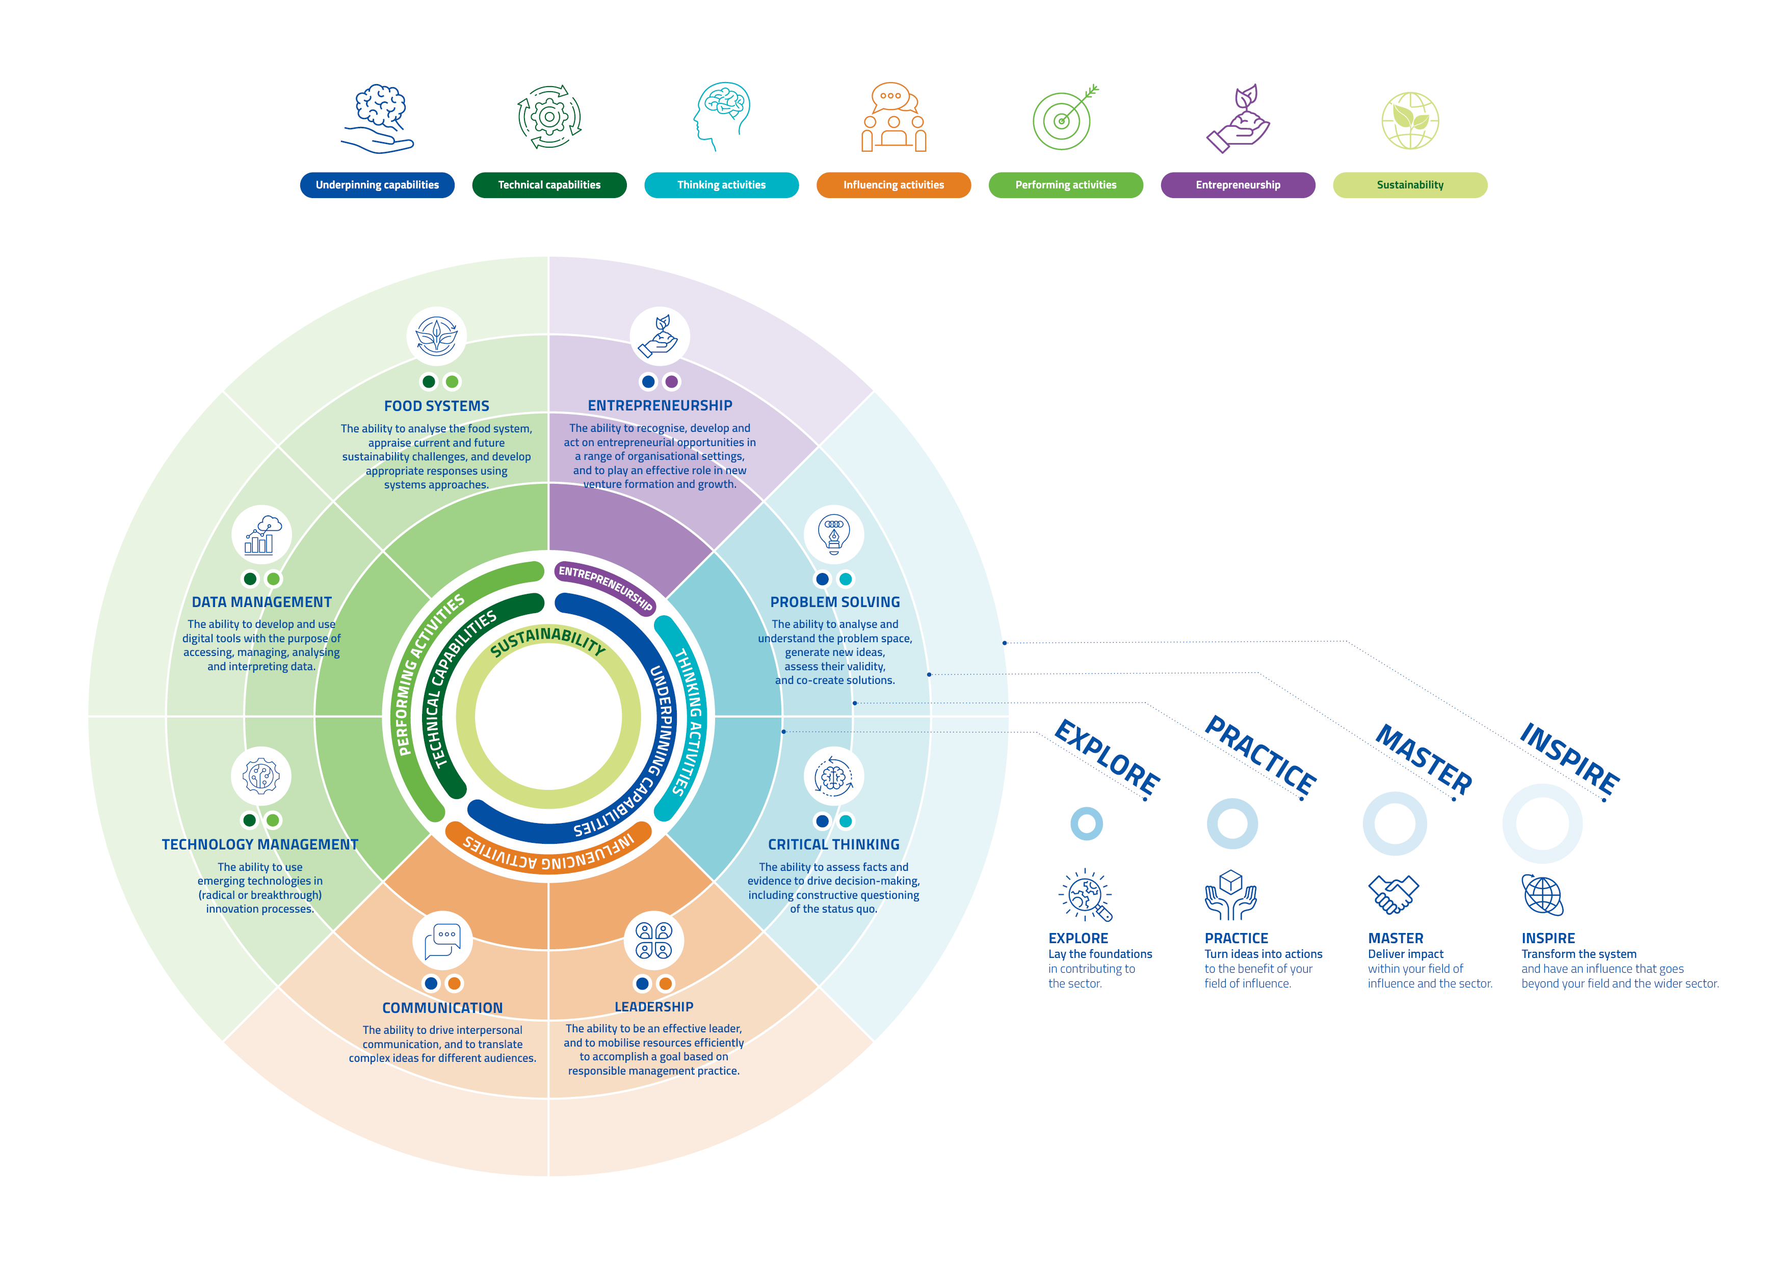
Our Competency Framework

Slide 6



11 000+
130 000+
Learners in our skill-based programmes
Learners in our MOOCs
33
49
Our Impact
Startups created
Entrepreneurs
30+
65+
Innovations
prototyped
Alumni countries
95%+
77%
Retention of talent
for the food system
Net referral score

Slide 7
Ecotrophelia and EIT Food
Objectives:
Strengthen entrepreneurial skills
Enhance entrepreneurial scope for entries
Increase the potential for ventures
Competition rules
Entry in global competition only upon completion of the course
Mentoring for global finalists

Slide 8
Research – needs
Challenge statement
Value and product proposition – including testing
Impact – how to articulate it
Business strategy
Market analysis and segmentation according to needs
Route to market – channels
Protecting the idea
Finance – realistic planning and assumptions
Teams
Scaling

Slide 9
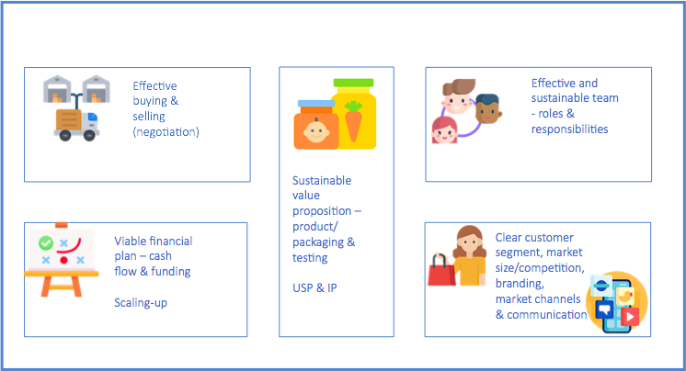
Entrepreneurship Framework

Slide 10
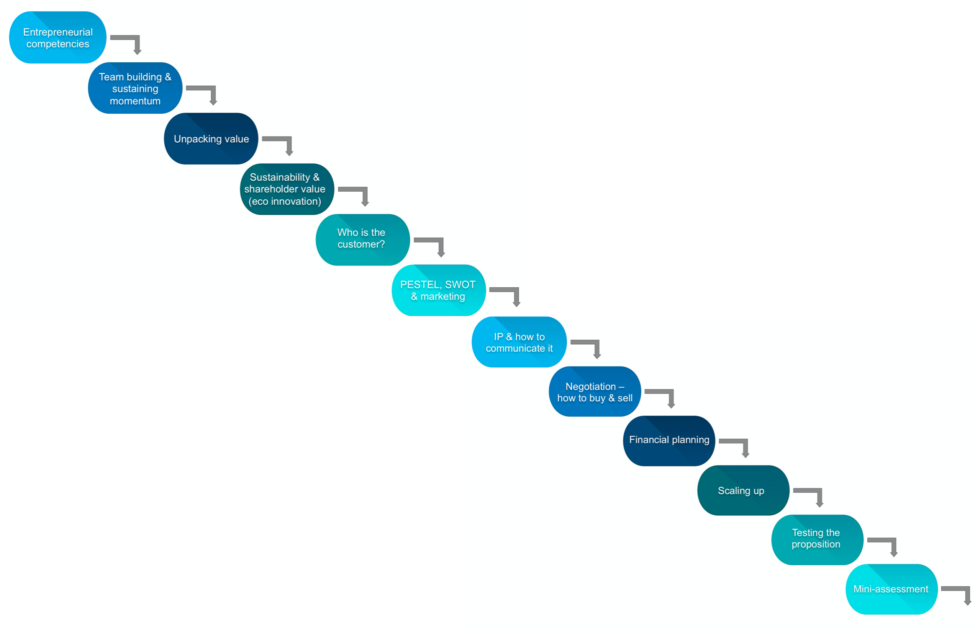
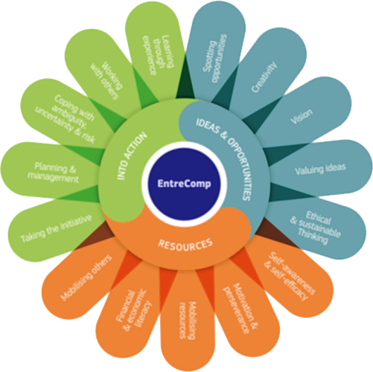
Module structure of 12 blocks on Canvas
= 12 hours approx
Mentoring

Slide 11
Incorporation approach
Standalone Pick ‘n’ Mix Integrated
Feedback on pitch elements
Pitch performance

Slide 12
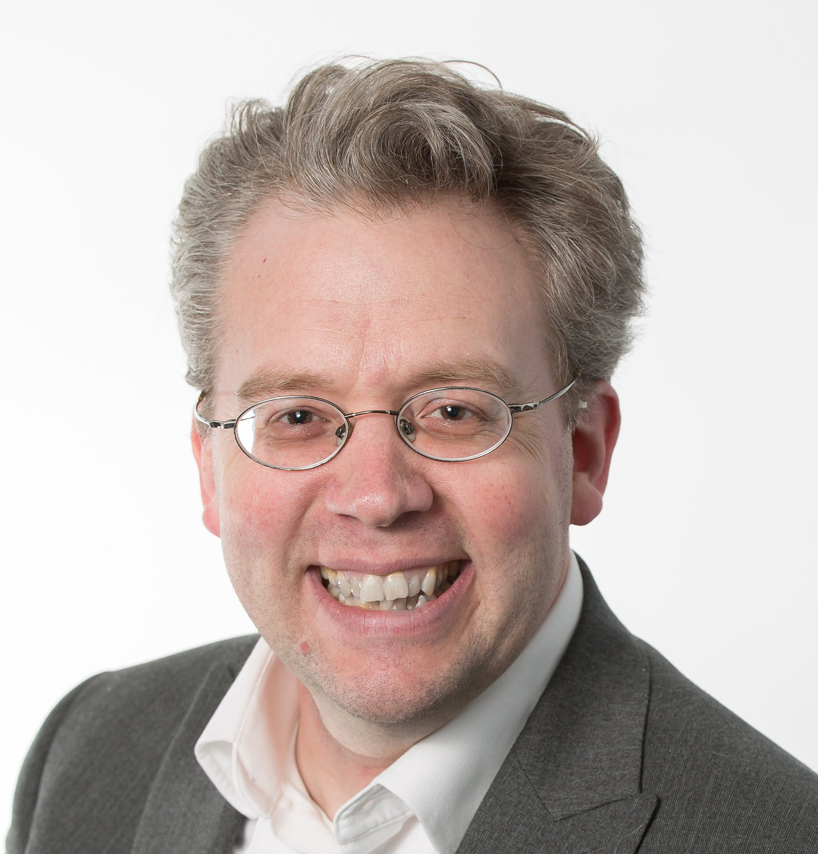
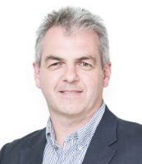
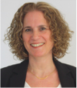
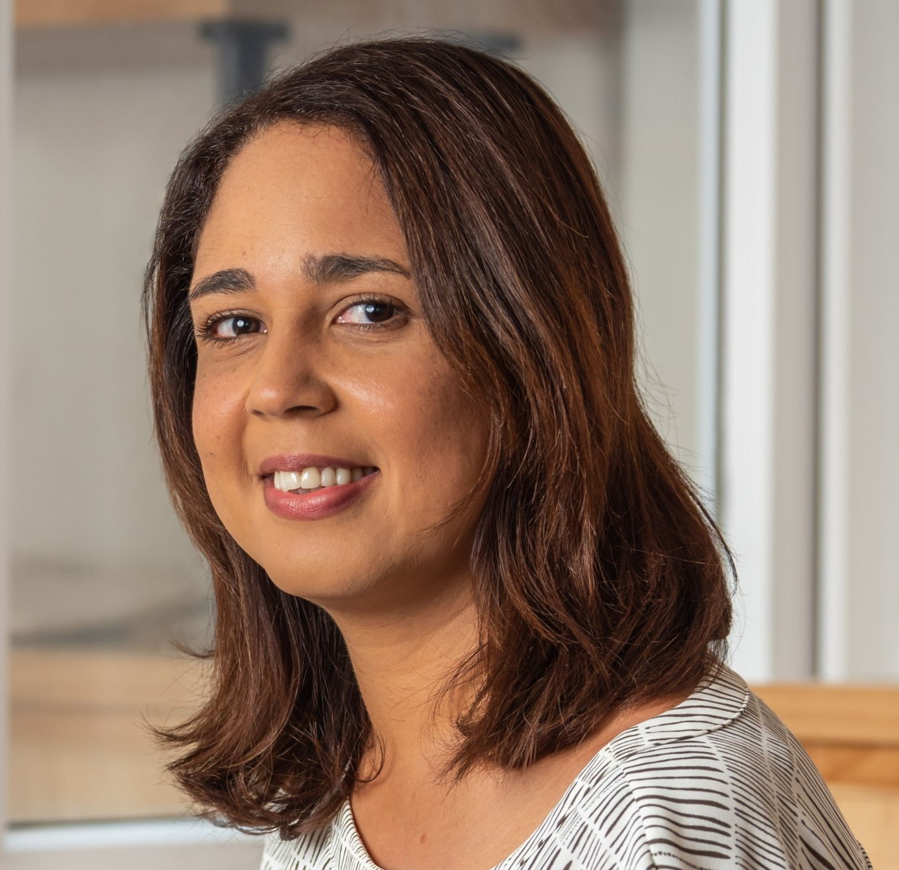

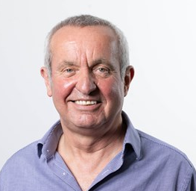

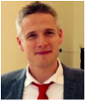

Team
Dr Maarten van der Kamp
Andrew Hatcher
Dr Sharon Tal-Itzkovitch
Natalie Selwood
Dr Rajiv Vaid Basaiawmoit
Jonathan Tait
Jack Oughtred
Dr Claus Thrane
Dr Shima Barakat

Slide 13
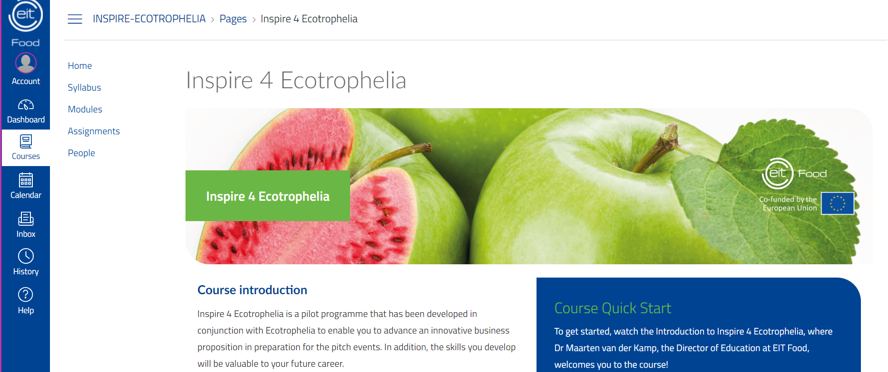
Canvas LMS

Slide 14
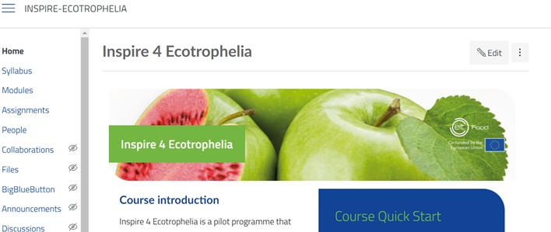

EIT Food Certificate

Slide 15
Furthermore…
EntreComp Synergies Community of Practice
Scaling to other audiences
Consolidating content

Slide 16
Q & A

Slide 17


Follow us on

