Slide 1




Promote education, training and skills across the bioeconomy
Research findings for entrepreneurship education
Stefan Lilischkis, empirica
EntreComp Food Conference, 26 January 2022

Slide 2
The project
Promote education, training and skills across the bioeconomy
Client: DG RTD
Duration: 6/2021 – 9/2022
Partners: Deloitte, empirica, FGB
Task on entrepreneurship education
Objective: Availability of EE in bioeconomy-relevant study programmes (10 countries)
⇨ Curricula, extra-curricular activities, other means

Slide 3
Findings from mapping
bioeconomy-relevant
higher education
programmes
Notes:
empirica

Slide 4
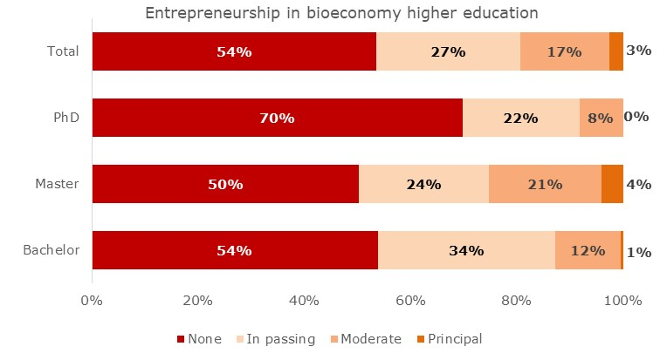
Entrepreneurship education in bioeconomy higher education - by study level
Half have none – mostly in passing
n = 640 study programmes
Notes:
empirica

Slide 5
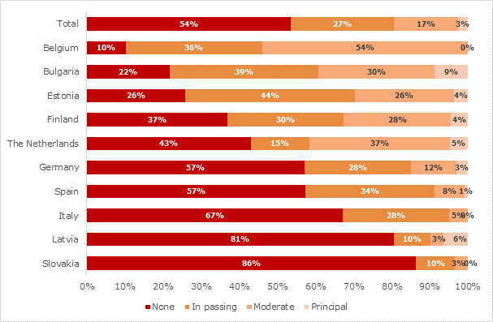
Entrepreneurship education in bioeconomy higher education - by country
Vast differences – no clear West/East gap
n = 640 study programmes
Notes:
empirica

Slide 6
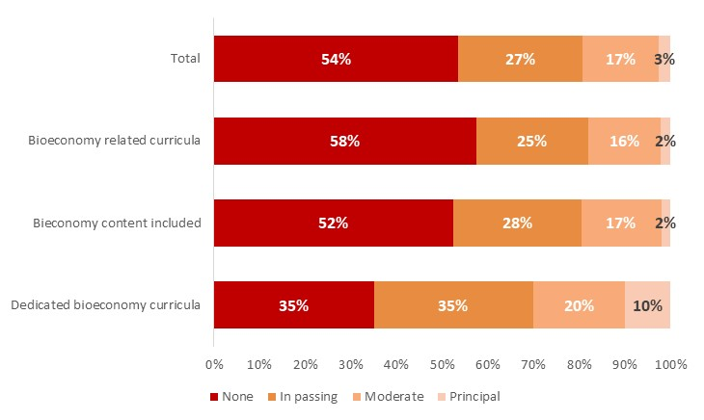
Entrepreneurship in higher education - by depth of bioeconomy content
Mostly in dedicated bioeconomy programmes
n = 640 study programmes
Notes:
empirica

Slide 7
Extra-curricular offers in entrepreneurship for bioeconomy students
Important to motivate entrepreneurial thinking and acting
Typical:
  Events (Start-up days/weeks)
  Encounters with entrepreneurs
  Personal advice (consulting, mentoring, coaching how to turn ideas into practice)
Bundling and branding helpful
  Examples:
  Wageningen StartHub
  Hohenheim InnoGreenhouse
  Vienna BOKU:BASE
Notes:
empirica

Slide 8
Other means and networks in bioeconomy entrepreneurship education
Important indirect factors
Multiple other means to foster entrepreneurial mindsets:
  Student challenges (competitions)
  Makerspaces
  Inspirational outreach events (e.g. city of the future)
  Shared research facilities
  Accompanied story writing
  Service matching (researchers/students provide services to business via platform)
  IP protection services to students
Networks:
  Association for European Life Science Universities (ICA) - Special Interest Group
  Sustainable Entrepreneurship Education
  INTRINSIC project: Connected Educator Platform to exchange practices
Notes:
empirica

Slide 9
Entrepreneurship education for bioeconomy
Three cogwheels to turn together
Curricula
Extra-curricular activities
Other means
Entrepreneurial knowledge, skills and mindset
Notes:
empirica

Slide 10
Findings from mapping
vocational education
programmes
Notes:
empirica

Slide 11
Entrepreneurship education in bioeconomy-relevant vocational education
Clearly available in a quarter of VET programmes
n = 295 study programmes in 10 countries
Notes:
empirica

Slide 12
Entrepreneurship in vocational education – by country
Vast differences, no clear West-East gap (as in HE)
n = 295 study programmes
Notes:
empirica

Slide 13
Case studies
Notes:
empirica

Slide 14



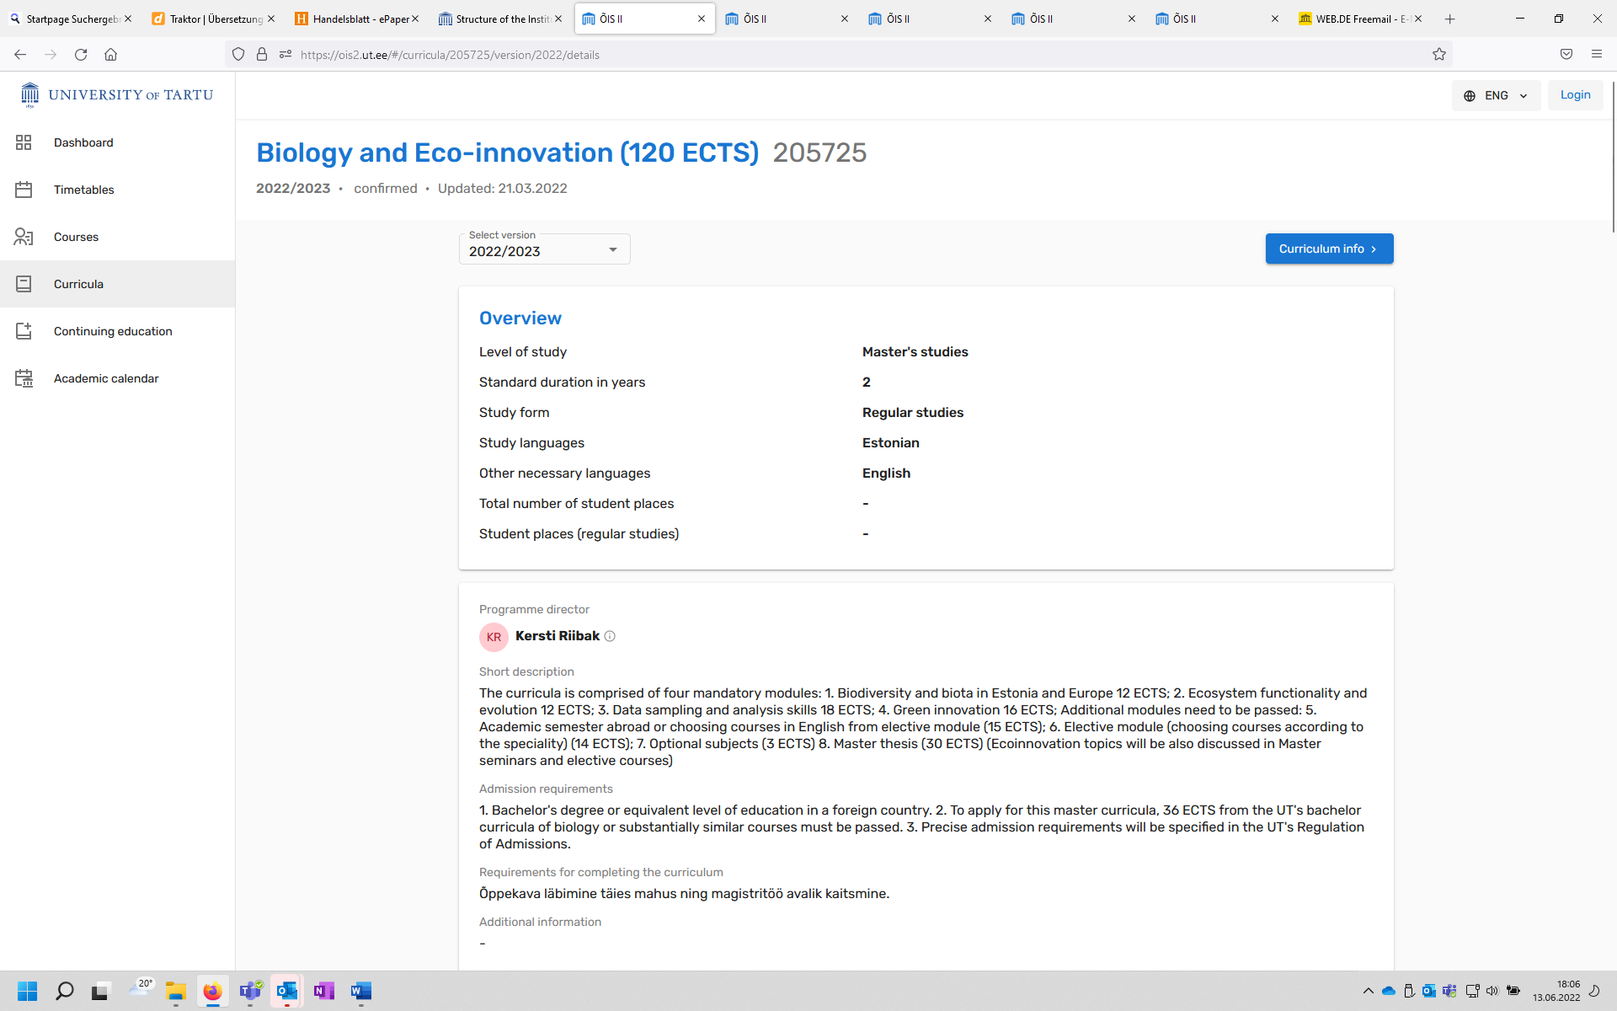
Wageningen University & Research, the Netherlands: Tracks in entrepreneurship.
Tracks for bachelor and master students as well as courses for PhD students. Plus extra-curricular events, mentoring, coaching, student challenges, makerspace, ...
EIT Food: Master’s in Food Systems.
All-encompassing approach, considering entrepreneurial thinking and action from selection of participants via learning objectives, methods, study content through to master’s thesis.
Technician School and High School for Agriculture Triesdorf, Germany.
Training for running a farm, conventional and ecological. Education very practice-oriented, including writing a business plan on a real-life case.
University of Sofia, Bulgaria: Master’s in Sustainable and Responsible Governance.
Trains a new type of specialist in sustainable business development and corporate social responsibility for public and private sectors.
University of Tartu, Estonia: Master’s in Biology and Eco-innovation.
The curriculum combines knowledge about nature, society and the economy and trains young people to become green entrepreneurs or advisors.
Notes:
empirica

Slide 15
Recommendations
to decision makers
Notes:
empirica

Slide 16
Recommendations to decision makers
– On European, national, regional, local level
– In governments, education institutions, civil society organisations
– Overall objective: every bioeconomy student should encounter entrepreneurship
Guidance: Include entrepreneurship education in bioeconomy strategies and roadmaps
Teaching: Assure more and high-quality entrepreneurship teaching in bioeconomy studies
Extra-curricular offers: Assure support to entrepreneurial bioeconomy students
Networking: Encourage cooperation on entrepreneurship education in bioeconomy studies
Raise awareness: Communicate benefits of entrepreneurship education for bioeconomy
Research: Monitor and compare entrepreneurship education in bioeconomy across Europe
Notes:
empirica

Slide 17
Get back for more details:
Stefan.Lilischkis@empirica.com
Notes:
empirica

