Slide 1








European Qualifications & Competences for the Vegan Food Industry
621581-EPP-1-2020-1-PT-EPPKA2-SSA
Rui Costa
26 Jan 2023
Applying Entrepreneurship Competences to Attract Young People to the 1st European Manufacturing Sector: the Agri-Food Industry

Slide 2
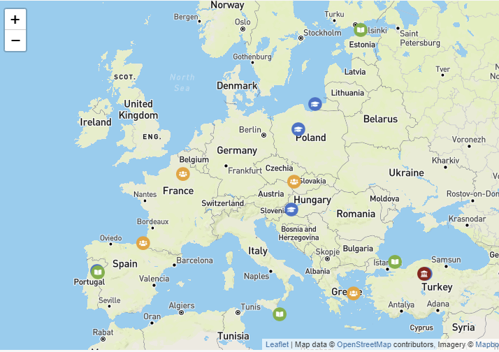



Partnership
1 Ministry
1 Qualifications agency
2 University applied sciences
3 Universities
1 Sec. educ – university
1 Secondary education school
1 Training organization
2 Industry federations
2 Associations of professionals
11 countries
Prof. Dr Rui Costa January 26, 2023 EntreCompFood, Brussels

Slide 3


















Prof. Dr Rui Costa January 26, 2023 EntreCompFood, Brussels

Slide 4

01
Driving forces for change of the training of food industry professionals
THIS PRESENTATION
02
EQVEGAN trainings
03
EQVEGAN certification and work-based learning
Prof. Dr Rui Costa January 26, 2023 EntreCompFood, Brussels

Slide 5


Driving forces for change of the training of food industry professionals
Plant based
Sustainability
Soft skills
Mobility/valorization of professionals
Work-based learning
Automation

Slide 6
Plant based
Prof. Dr Rui Costa January 26, 2023 EntreCompFood, Brussels

Slide 7
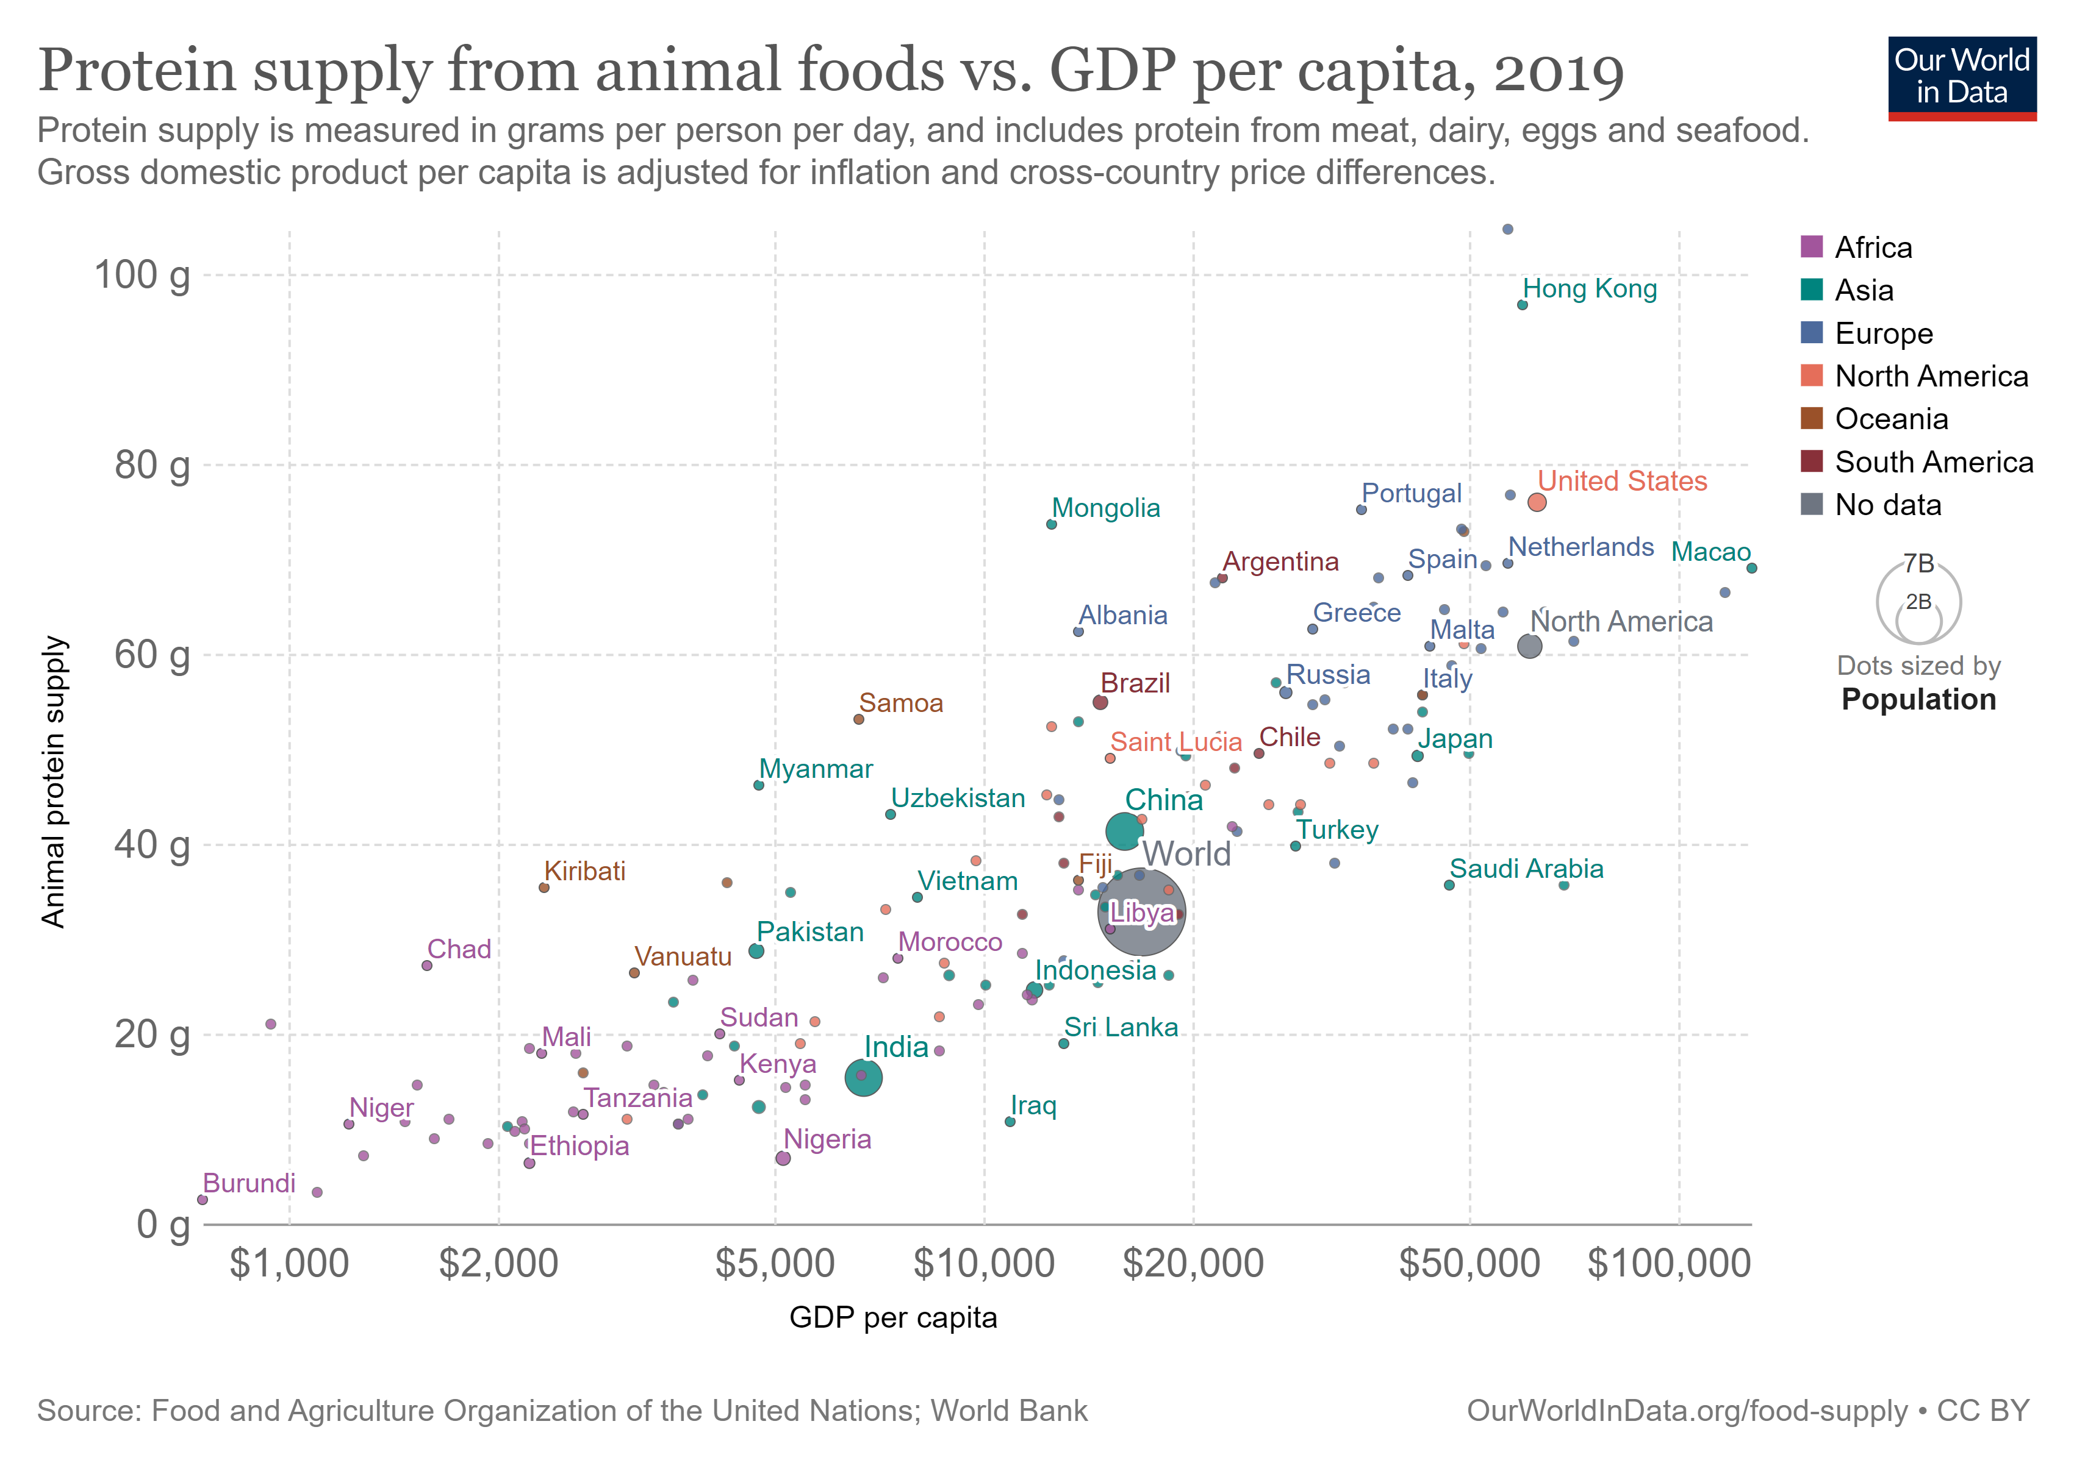
Prof. Dr Rui Costa January 26, 2023 EntreCompFood, Brussels

Slide 8
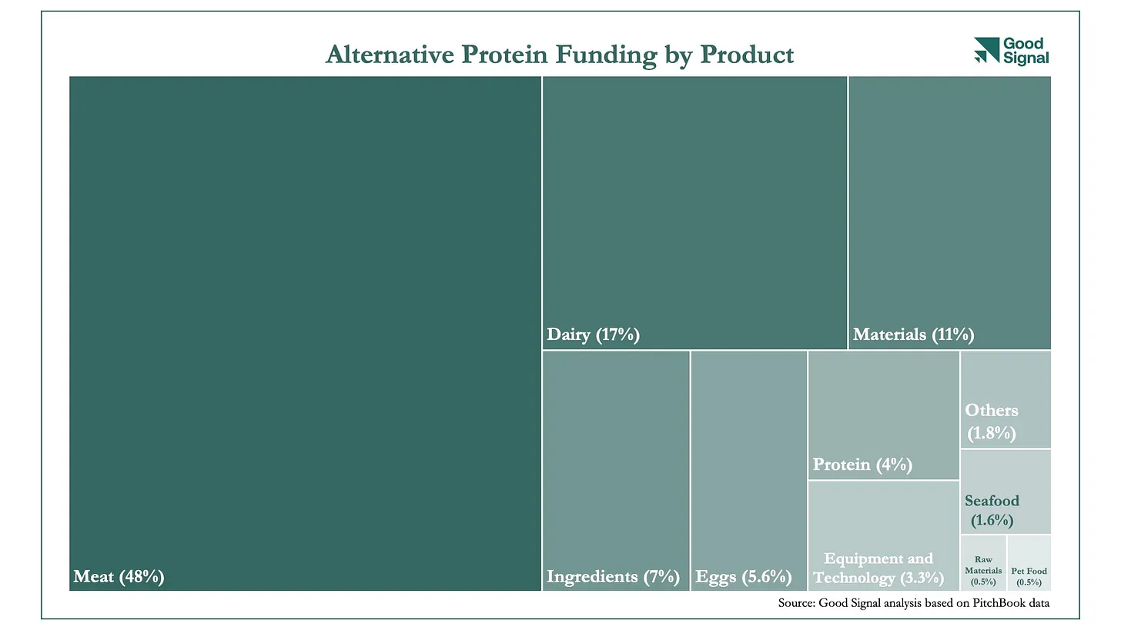
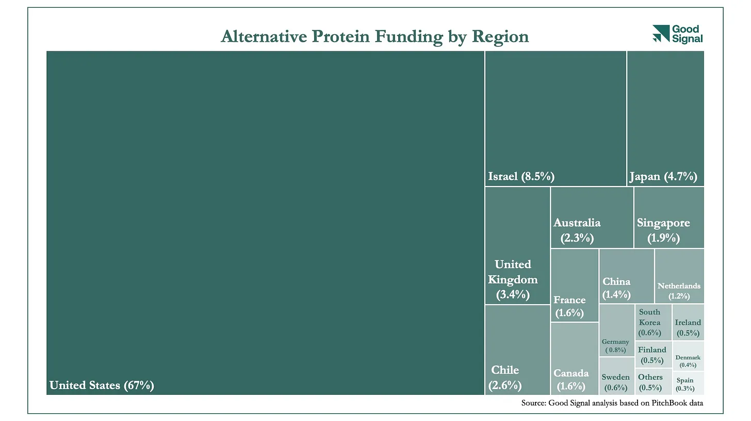
FUNDING
$14.2 billion in funding to date (Nov 2022) (from a total of venture capital of $290 billion; decline from 2021)
Plant-based technology 45%
Fermentation at 39%
Cultivated meat at 16%
B2C 82%
B2B 18%
Prof. Dr Rui Costa January 26, 2023 EntreCompFood, Brussels
Funding

Slide 9

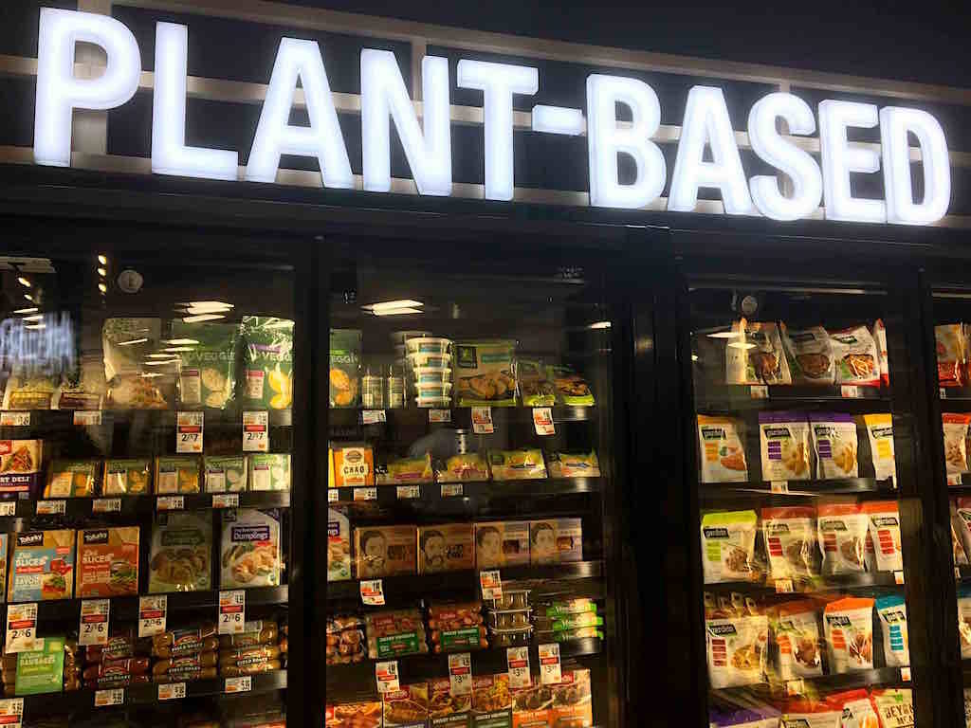
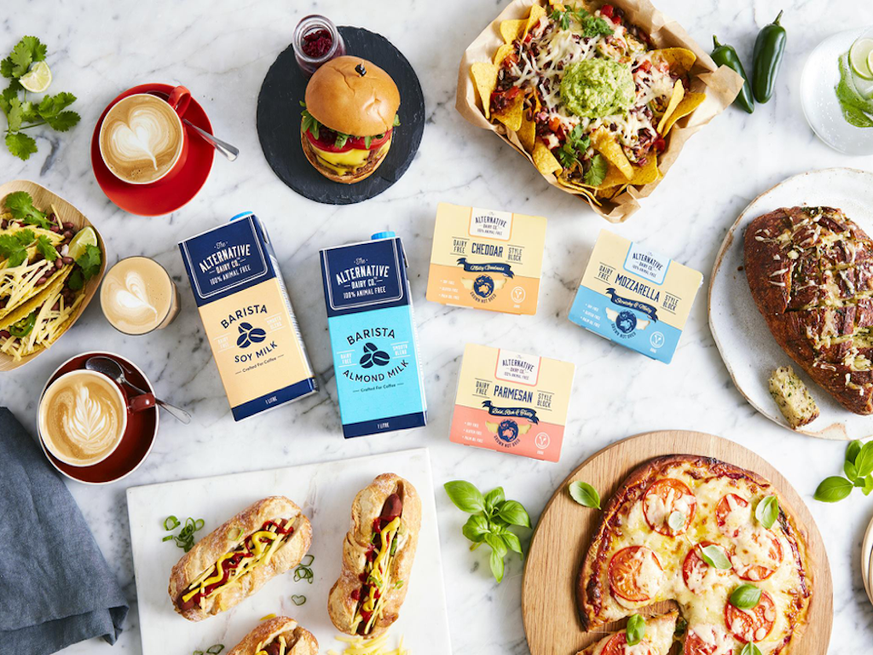
https://www.greenqueen.com.hk/10-stats-that-prove-that-plant-based-is-the-future-of-food/

Slide 10
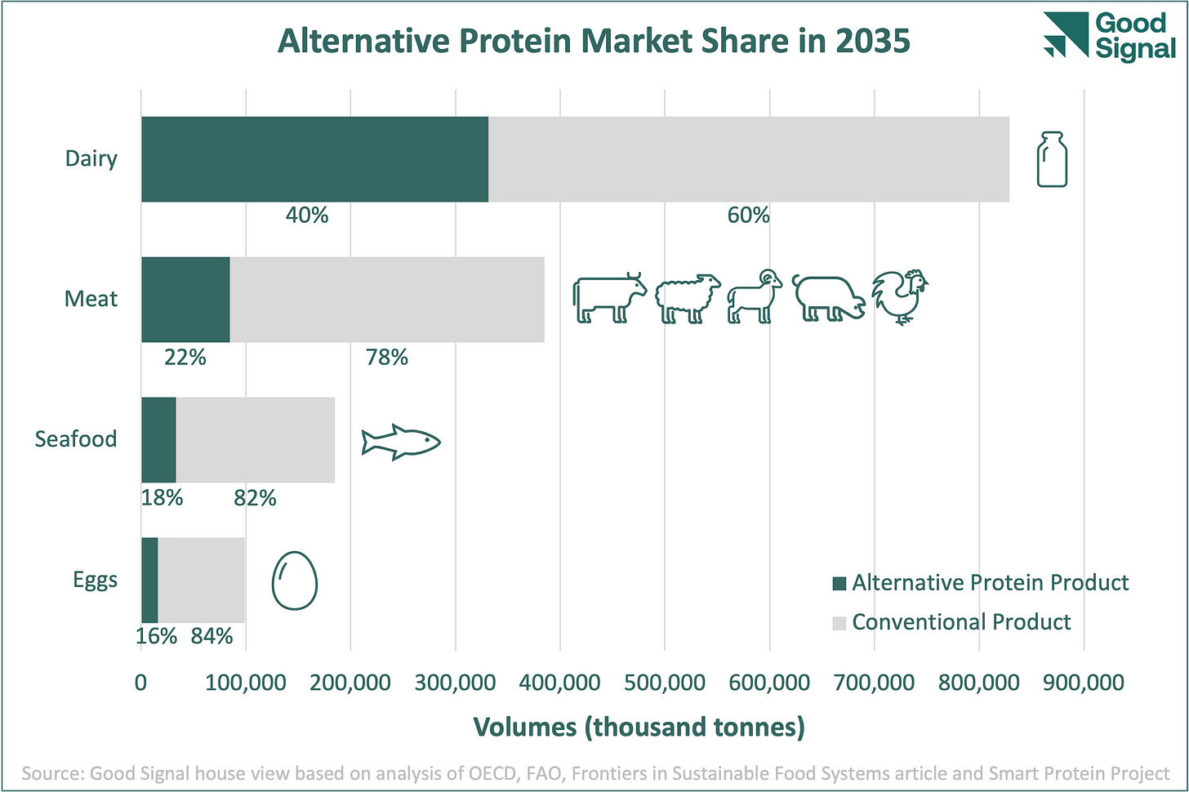
Prof. Dr Rui Costa January 26, 2023 EntreCompFood, Brussels

Slide 11
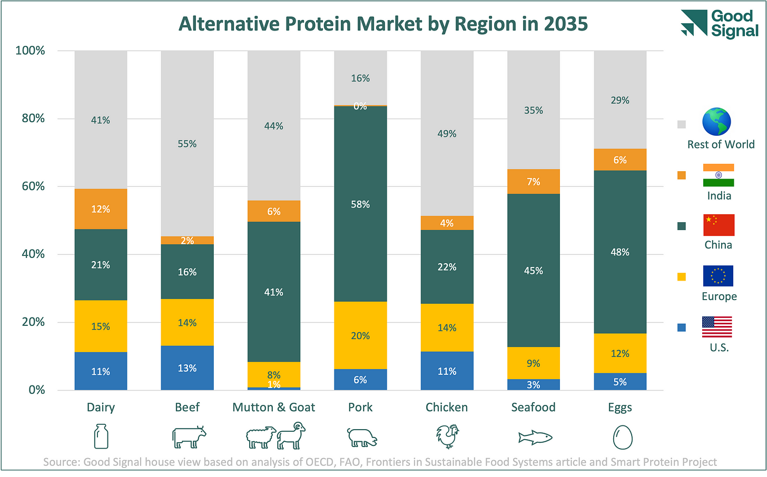
Prof. Dr Rui Costa January 26, 2023 EntreCompFood, Brussels

Slide 12
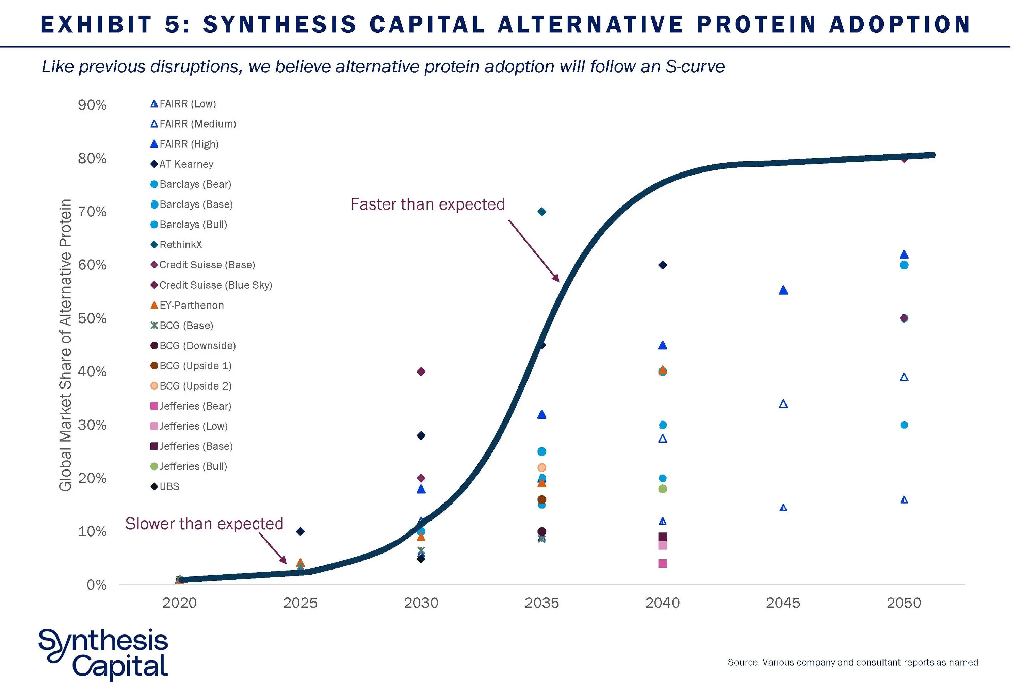
Prof. Dr Rui Costa January 26, 2023 EntreCompFood, Brussels

Slide 13
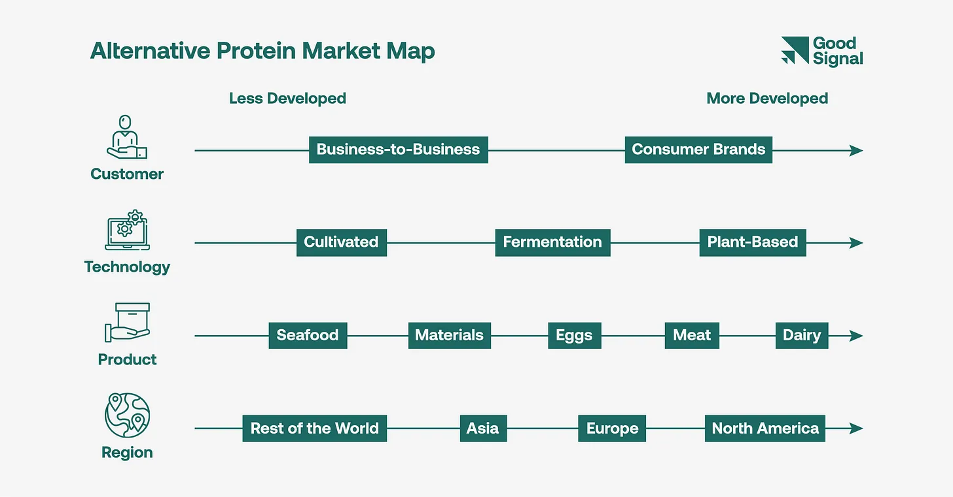
Prof. Dr Rui Costa January 26, 2023 EntreCompFood, Brussels

Slide 14


Plant based processing
Technology of…
Meat analogues
Fish analogues
Dairy analogues
Egg analogues
Vegetable drinks
Mycoprotein
Seaweeds
Nutrition (diets)
Food safety issues
Food product development insights (trends, shelf life, law)

Slide 15
Sustainability
Prof. Dr Rui Costa January 26, 2023 EntreCompFood, Brussels

Slide 16
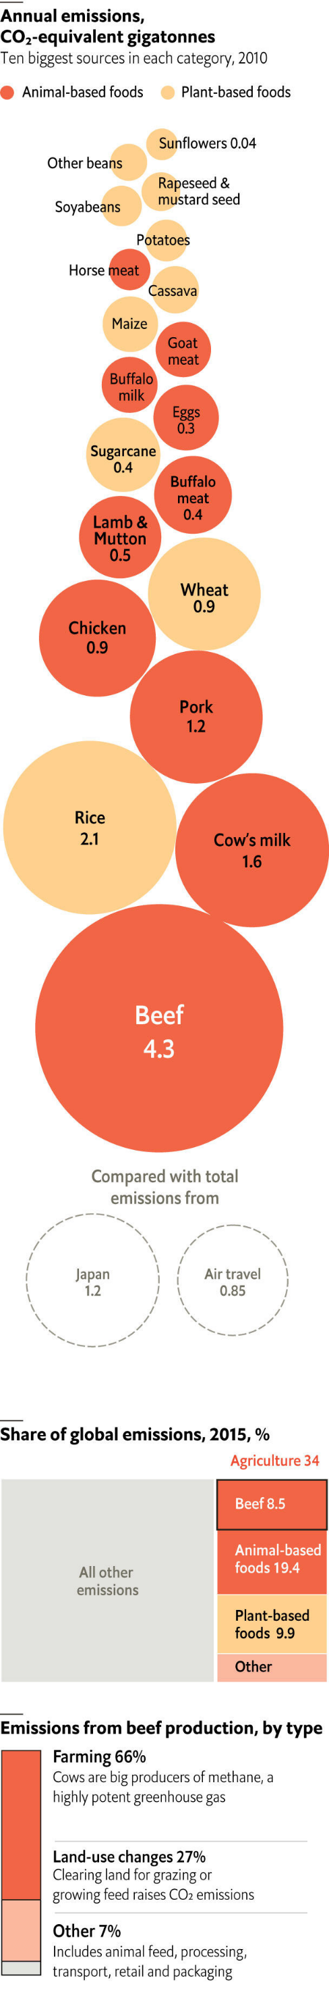
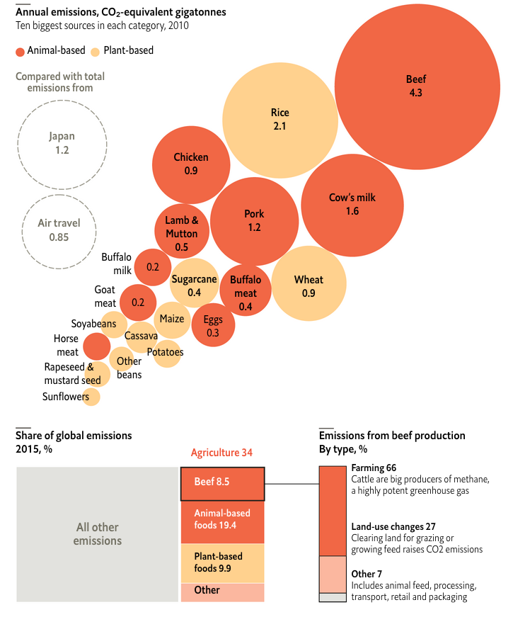
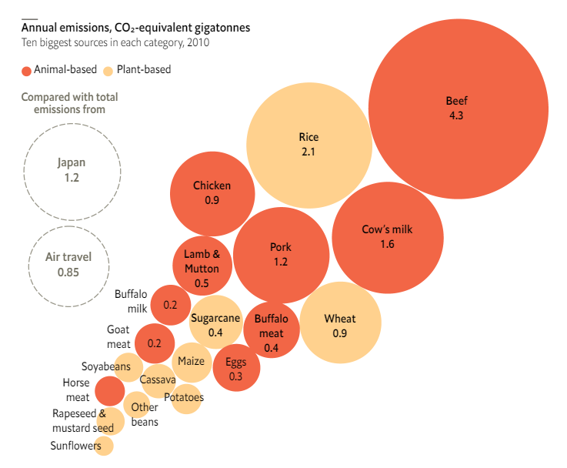

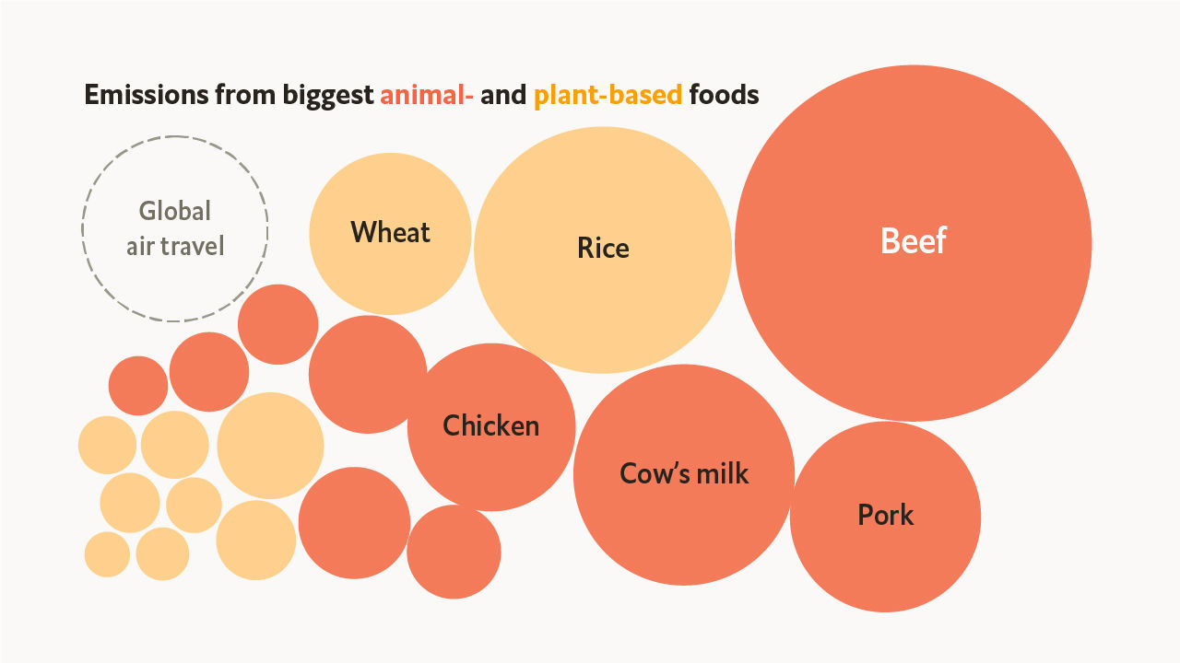
Prof. Dr Rui Costa January 26, 2023 EntreCompFood, Brussels

Slide 17

Climate change
GoodSignal: Changing The Climate: The Role of Alternative Proteins
Global temperatures have risen by 1.1°C as compared to 1850 levels
UN Environment Programme (UNEP), just a week before COP27, stated that there were no longer any viable pathways available to achieve the 1.5°C threshold by 2030.
To meet the 1.5°C threshold, a 44% reduction in current emissions will be needed to achieve the targets.
Our food system emits a third of global emissions. Animal agriculture amounts to a significant component at 14.5% of total global emissions.
Prof. Dr Rui Costa January 26, 2023 EntreCompFood, Brussels

Slide 18


Green skills
Energy/water/waste critical points
Food waste – targeting consumers
Waste management
Food by-products
Circular economy
Green economy
Environmental footprints

Slide 19
Automation
Prof. Dr Rui Costa January 26, 2023 EntreCompFood, Brussels

Slide 20
Analytics, Automation, and Artificial intelligence AAA advanced skill clusters
Digital delivery
Data Science
Data engineering
Automation & robotics
  Web development
  User interface design
  Data visualization
  Automated testing technics
  Application programming interface
  Mathematical modeling
  Big data analytics
  AI and machine learning
  Web analytics
  Simulation
  Data wrangling
  Cloud computing
  Cloud security architecture
  Data mining
  Data techniques
  Robotics
  Automated testing
  Automation
  Computer-aided manufacturing
  Industrial automation
https://www2.deloitte.com/us/en/insights/industry/retail-distribution/digital-skills-food-industry.html (2019)
Prof. Dr Rui Costa January 26, 2023 EntreCompFood, Brussels

Slide 21
AAA advanced skill clusters
Automation & robotics
  Robotics
  Automated testing
  Automation
  Computer-aided manufacturing
  Industrial automation
https://www2.deloitte.com/us/en/insights/industry/retail-distribution/digital-skills-food-industry.html (2019)
Prof. Dr Rui Costa January 26, 2023 EntreCompFood, Brussels

Slide 22

Digitalization and automatization skills
ICT
  operate with basic ICT, working with human-machine interface; use different software, like traceability, IoT)
Automation
  operate effective cooperation with automation specialists, basic understanding of automated systems, identify common sensors in the automation of components and use cases for sensors, etc
Robotics
  identify various types of robots, operate fault diagnostic of robots, select devices for the automatic handling of products, etc.
Electives
  additive manufacturing technologies, machine vision, artificiaI intelligence and machine learning
Prof. Dr Rui Costa January 26, 2023 EntreCompFood, Brussels

Slide 23
Soft skills
Prof. Dr Rui Costa December 16, 2022 The Agri-Food Pact for Skills – Update and upcoming activities

Slide 24

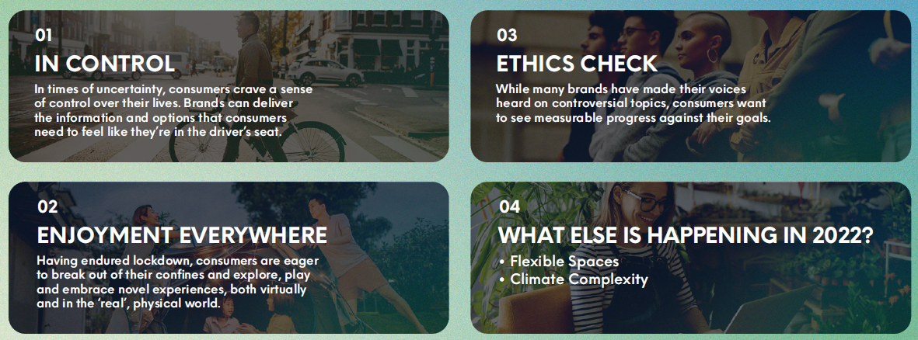

Slide 25

Domains | Skills
Critical and innovative thinking | Problem solving Critical thinking
Interpersonal skills | Active listening
 | Optional knowledge (Project management) Planning and organization
 | Leadership Team building management Team working
Intrapersonal skills | Self-management (time, stress, organization)
 | Self-awareness
Other | Ethical understanding
Most relevant soft skills for the food industry
Prof. Dr Rui Costa January 26, 2023 EntreCompFood, Brussels

Slide 26
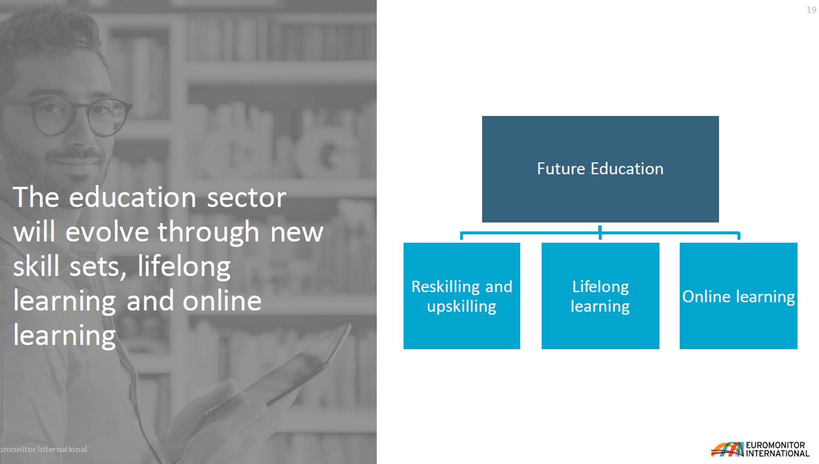
Training aligned with education trends
Prof. Dr Rui Costa January 26, 2023 EntreCompFood, Brussels
https://www2.deloitte.com/us/en/insights/industry/retail-distribution/digital-skills-food-industry.html

Slide 27

Training
eqvegan.eu
Plant based processing
Green skills
Digitalization and automation skills
Soft skills
01
Plant based processing
02
Green skills
03
Digital and automatization skills
04
Soft skills

Slide 28







Food operator
EQF 4 (vocational secondary education)
Food technician
EQF 5 (short cycle)
Food technologist/engineer
EQF 6 (bachelor)
EQF 7 (master)
Occupations in the food industry

Slide 29
EQVEGAN certification and WBL
Prof. Dr Rui Costa January 26, 2023 EntreCompFood, Brussels

Slide 30




certification and WBL
Work-based learning database
Guidelines for work-based learning and recognition of prior learning
Occupational profiles of food professionals, ready to be incorporated in ESCO
Certification of job profiles
Prof. Dr Rui Costa January 26, 2023 EntreCompFood, Brussels

Slide 31
Certification of job profiles
prof certification
skills certification
degree certification
microcredentials
paper credentials
digital credentials
Prof. Dr Rui Costa January 26, 2023 EntreCompFood, Brussels

Slide 32

Prof. Dr Rui Costa January 26, 2023 EntreCompFood, Brussels

Slide 33


Slide 34


Slide 35

ruicosta@esac.pt
CONTACT
Instituto Politécnico de Coimbra
rui.costa@iseki-food.net
ISEKI Food Association
EQVEGAN.EU
FOOD-SKILLS.EU
Thank you for your attention!
ERASMUS+ Sector Skills Alliance EQVEGAN
European Qualifications & Competences for the Vegan Food Industry.
621581-EPP-1-2020-1-PT-EPPKA2-SSA-EQVEGAN.
Polytechnic Institute of Coimbra.
This project has been funded with support from the European Commission. This document reflects the views only of the author, and the Commission cannot be held responsible for any use which may be made of the information contained therein.

