Slide 1
Bantani Education
Transforming learning. Developing mindsets.
Elin McCallum
www.bantani.com
Notes:
Introduction to Bantani and its focus on entrepreneurial learning

Slide 2
Opportunity 2
View & download this presentation:
https://bit.ly/EntreCompStarter
www.entrecomp.com
Notes:
So we established – with MANY MANY partners – the EntreComp Community

Slide 3
Founding partners:
Involving:
National Stakeholders
Youth workers
Educators and teachers
Employment support Universities
Enterprise support
Employers
Networks
EU institutions
Notes:
So many people involved
Needed a community – to communicate the broader opportunity of entrepreneurial learning, under the common language of EntreComp, bringing together the many actioons and actors involved.

Slide 4
Network
Monthly challenges and activities
Events calendar
Networking tool
Community groups
Learn
Digital library
Bitesize learning
MOOCs
Share
Your ideas
Your expertise
Your projects and resources
Be recognised
Digital Credentials
EntreComp Champions Awards – supported by EU
Learn
Share
Network
Recognise

Slide 6
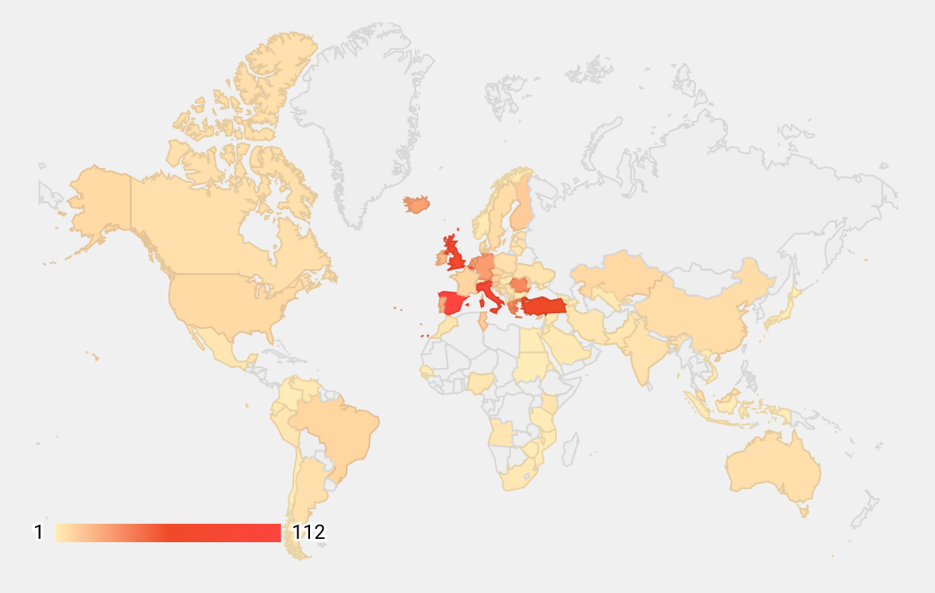
Where do members come from?
Current includes 83 countries

Slide 7
Network
Monthly challenges and activities
Events calendar
Networking tool
Community groups
Learn
Digital library
Bitesize learning
MOOCs
Share
Your ideas
Your expertise
Your projects and resources
Be recognised
Digital Credentials
EntreComp Champions Awards – supported by EU
Learn
Share
Network
Recognise

Slide 8
Notes:
The SDGs provide a blueprint and global joint action plan to achieve a better future for all
Entrepreneurial actions impact on one or more of these – certainly all.
Entrepreneurial citizens drive this forward to create SDG value.
Sustainable entrepreneurship acts a powerful driver for sustainable change.

Slide 9
Communities of Practice
National communities are being established…
Thematic communities… hosted by Bantani, EIT Food, EIT Raw Materials, All Digital and others
Digital
Women and Girls
Circular Economy
Social and creative
Food systems
Entrepreneurial Mindsets
EntreComp Champions
Group discussions
Group learning
Group networking
Group event announcements
Notes:
As the name shows, the Communities, or groups, are an important part of The EntreComp Community. Start by selecting the ‘Communities’ tab from the App menu, then click the ‘Discover’ tab to see all public communities, or the ‘My communities’ tab to see communities you are a member of.

Slide 10
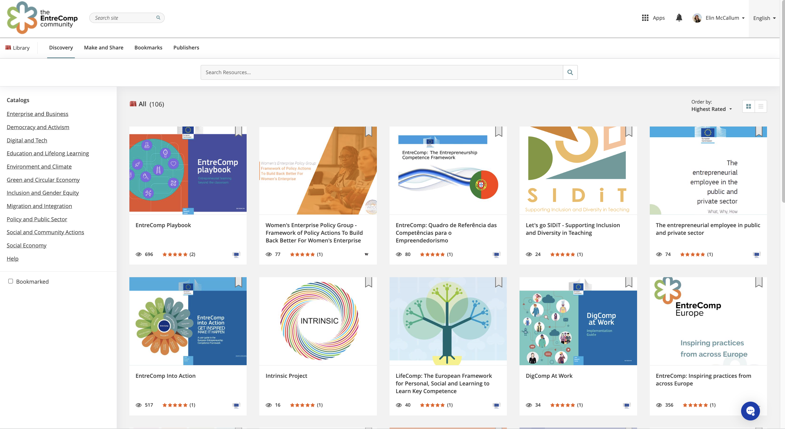
Digital Library
Notes:
Shareable – you can see link in chat now!
We are proud of the EntreComp Library, as it represent the first step in creating a one-stop-shop for EntreComp. We hope that as the library continues to grow, it will become the go-to page for finding all resources linked to EntreComp and entrepreneurial learning. We are also including resources linked to other European frameworks such as LifeComp and DigComp, and the United Nations Sustainable Development Goals.
If you are already familiar with EntreComp you will see some familiar resources here, but we hope you will also discover something new as we are always updating the library.
To find resources, either browse the Library homepage, use the search box, or filter using the catalogue. You can also use the ‘Publishers’ tab to find resources by a specific author or organisation. If you think something is missing, or is not where it should be, please contact us. As an open access learning platform, we believe in resource sharing so if you have something to share, let us know.

Slide 11
Search by….
Enterprise and Business
Democracy and Activism
Digital and Tech
Education and Lifelong Learning
Environment and Climate
Green and Circular Economy
Inclusion and Gender Equity
Migration and Integration
Policy and Public Sector
Social and Community Actions
Social Economy
Language
Learning sectors
Practice areas
Types of resource
Sustainable Development Goals
Publisher

Slide 12
Events

Slide 13
Communities of Practice
National communities are being established…
Thematic communities… hosted by Bantani, EIT Food, EIT Raw Materials, All Digital and others
Digital
Women and Girls
Circular Economy
Social and creative
Food systems
Entrepreneurial Mindsets
EntreComp Champions
Group discussions
Group learning
Group networking
Group event announcements
Notes:
As the name shows, the Communities, or groups, are an important part of The EntreComp Community. Start by selecting the ‘Communities’ tab from the App menu, then click the ‘Discover’ tab to see all public communities, or the ‘My communities’ tab to see communities you are a member of.

Slide 14
Learning – from bitesize to MOOCs
Learn about entrepreneurial learning:
For you - your personal profile
For educators - pedagogy, assessment
For themes – subjects, citizenship, digital, circular economy, employability
Track your own learner record
Earn digital credentials
User-paced – open access
Example https://entrecomp.thinqi.com/go/6k9of9
Notes:
As an entrepreneurial learning community, we look to present learning opportunities in innovative and interesting ways. The first step in this is playlists. To the user viewing the playlist, it looks similar to a PowerPoint presentation that can be viewed at their own pace by clicking through the arrows. We intend to use Playlists as bite-sized learning, which can present key focus topics, or introduce a community concept.
Various media types and presentation styles are available, and you can embed other resources from the EntreComp Library. You can also add quizzes to the playlists, to test learners' knowledge at a glance, these quizzes don’t count towards any formal record or badges, unless included as part of an assignment.

Slide 15
Get involved!
Free to access
Open to all practitioners and organisations interested in
EntreComp
entrepreneurial competences
entrepreneurial learning
connecting with the community
Join monthly challenges and events –shared on the community platform
Apply to be an EntreComp Champion - awards and recognition from June 2022, supported by the European Commission
Notes:
The EntreComp Community is open to all and is free to access. All you need is an internet connection and an email address. While the Community is available on both mobile and desktop devices, we suggest using a computer to access the site and ensure you have the best user experience.
We encourage anyone interested in EntreComp, entrepreneurial competences, entrepreneurial learning, or connecting with the entrepreneurial learning community to register for an account. Many resources are accessible without an account, but in order to see the whole community, join community groups, register for classes and more you must have an account. Users are welcome from all regions, and while the platform interface is currently only available in English, we are actively working on enabling new languages, content in the Library and Communities can be shared in any language and you will already find some non-English resources uploaded.
We also welcome members at all levels of understanding of the EntreComp framework, you don’t need to be an expert to join, but we hope you will become one with us! As we believe that entrepreneurial competences are applicable to all aspects of personal development and continued learning, our members come from a variety of background such as formal and non-formal education, public services, the business sector, and pretty much everywhere in-between. You do not need to be actively involved in an EntreComp project to join the Community, and we encourage you to share access with your colleagues and peers.

Slide 16
Thanks to…
Sponsored by Thinqi, a Welsh edtech company.
Powered by EntreComp Europe collaborative communities – co-funded by the COSME programme.
Content development by EntreComp360 – co-funded by Erasmus+
Support through an initiative of the European Union – to develop communities of practice, events and the EntreComp Champions awards

Slide 17
View & download this presentation:
https://bit.ly/EntreCompStarter
Register now!
Join us!
www.entrecomp.com

Slide 18
Elin McCallum
Executive Director
www.bantani.com
elin@bantani.com

