Slide 1


ENTRECOMPFOOD
BRUSSELS – 23/01/26

Slide 2
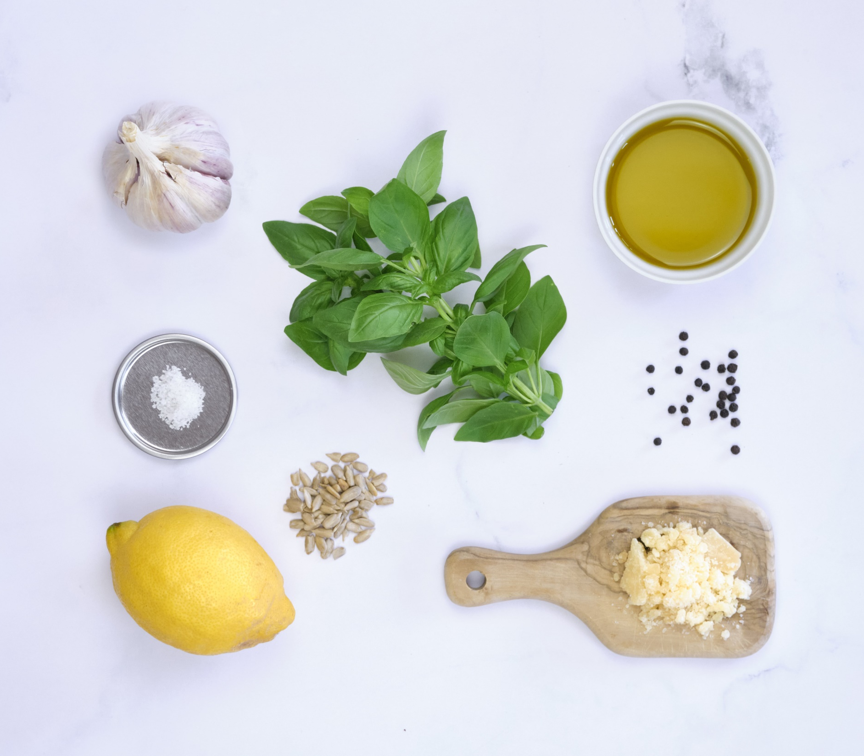
01
A FEW WORDS ABOUT SAUCES PAPILLON

Slide 3

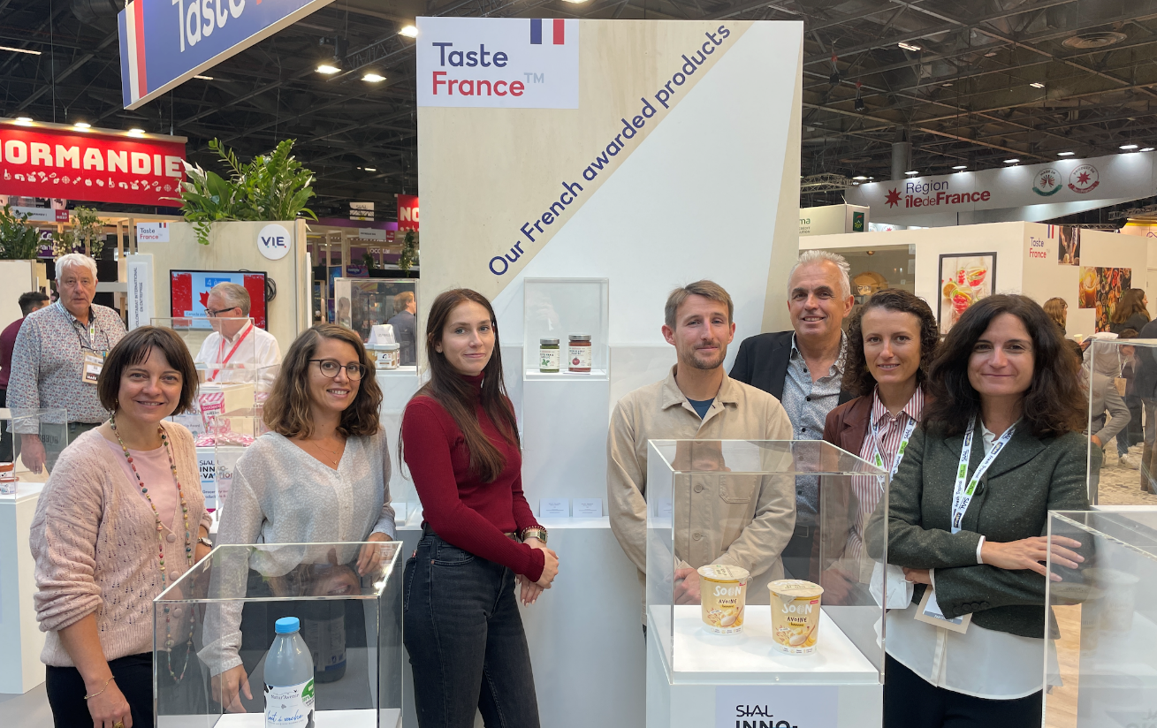

Sauces Papillon / ENTRECOMPFOOD
A PROJECT BORN WITH EcotrOPHELIA
Ecotrophelia France – DIJON
June 2022
Ecotrophelia France : 1st prize
Entrepreneurship prize
Fruits & Vegetables prize
Ecotrophelia Europe – SIAL PARIS
October 2022
Entrepreneurship price
3/A

Slide 4


Sauces Papillon / ENTRECOMPFOOD
AND TURNED INTO REALITY
MATHIS
Co-founder of Sauces Papillon
In charge of :
Production
Marketing & Communication
Logistics
MARGOT
R&D Apprentice at La Picorée
Worked for Sauces Papillon on:
Supply
R&D
Sales
4/A

Slide 5


Sauces Papillon / ENTRECOMPFOOD
OUR CONCEPT
The 1st brand in France making fresh sauces for pastas
Promoting seasonal vegetables through seasonal recipies
5/A
Notes:
Fresh sauces : not at all developed in France (compared with Italy or Scandinavian countries, USA)
Not a lot of variety
Our goal : promote vegetables sauces, not damaged by heating process

Slide 6
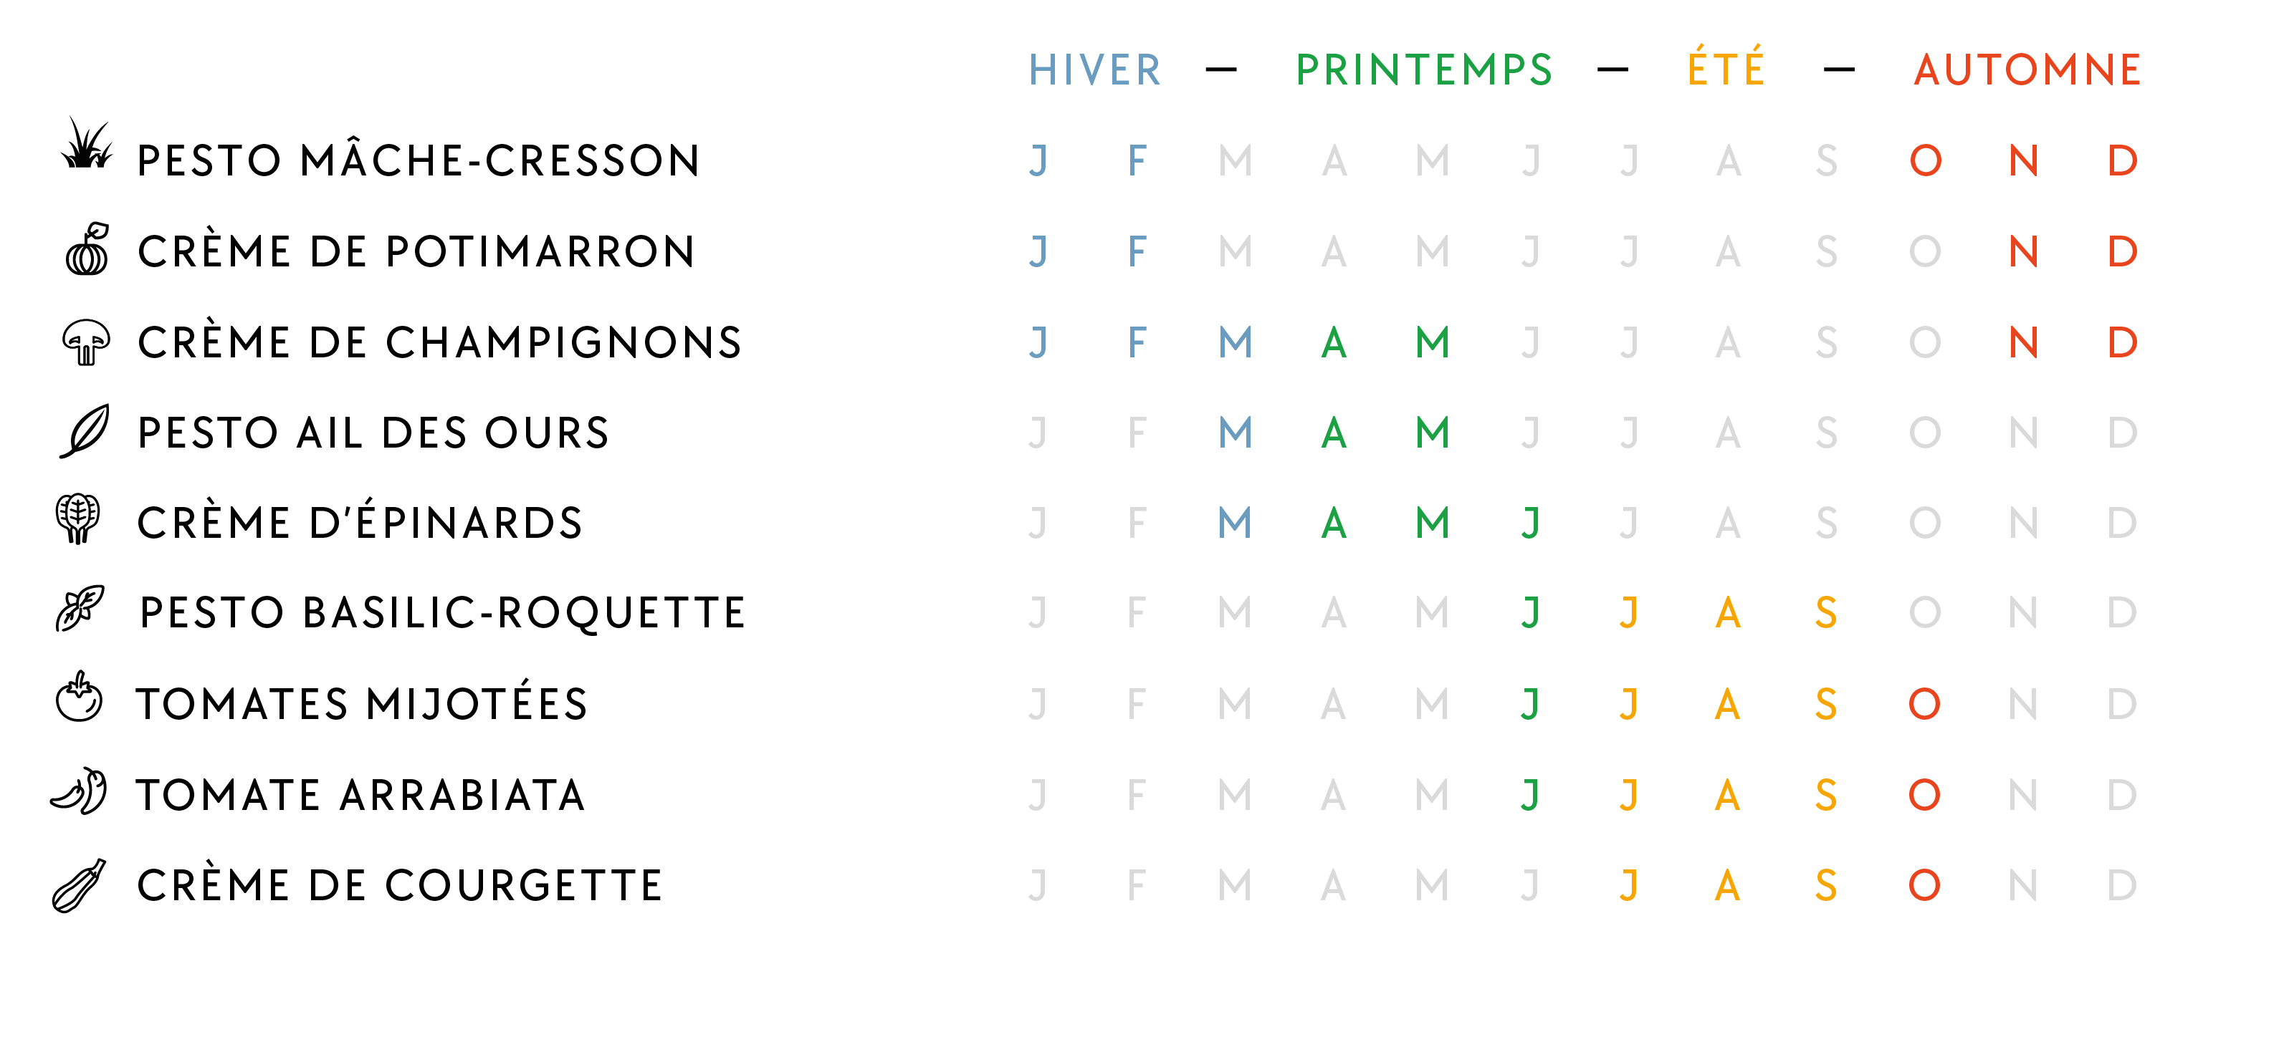
Sauces Papillon / ENTRECOMPFOOD
AN ORIGINAL SEASONAL APPROACH IN THE FOOD INDUSTRY
OUR RECiPies CALENDAR
WINTER
SPRING
SUMMER
AUTUMN
LAMB’S LETTUCE/WATERCRESS PESTO
BUTTERNUT CREAM
MUSHROOM CREAM
WILD GARLIC PESTO
SPINACH CREAM
BASILIC/ROCKET PESTO
COOKED TOMATOES
ARRABIATA TOMATOES
ZUCCHINI CREAM
6/A

Slide 7

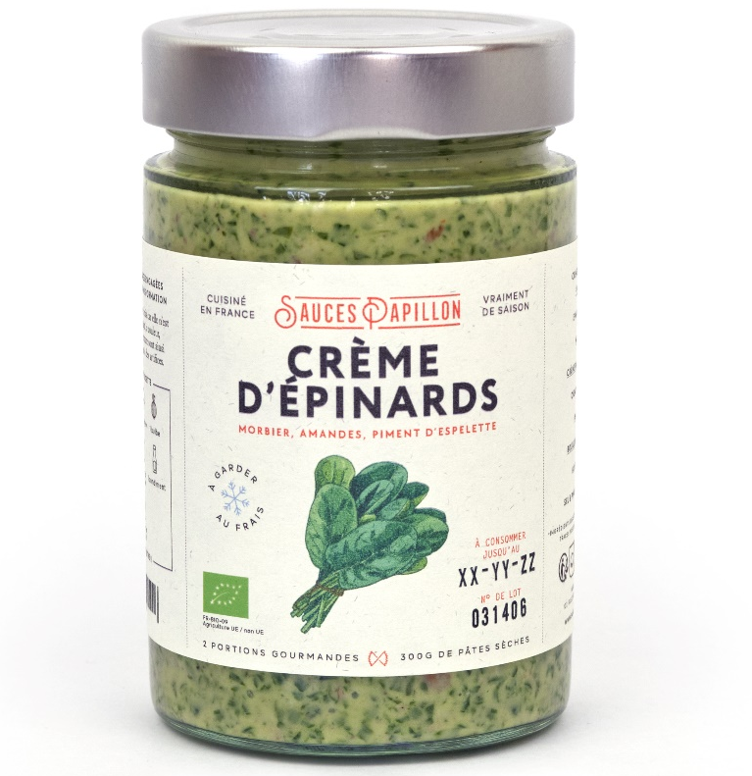
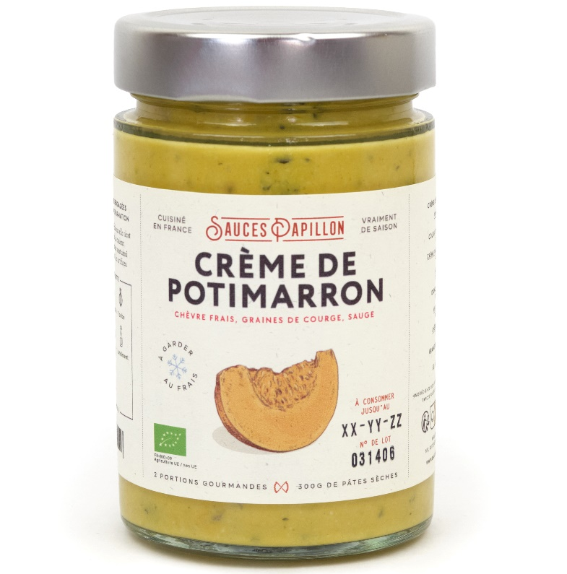
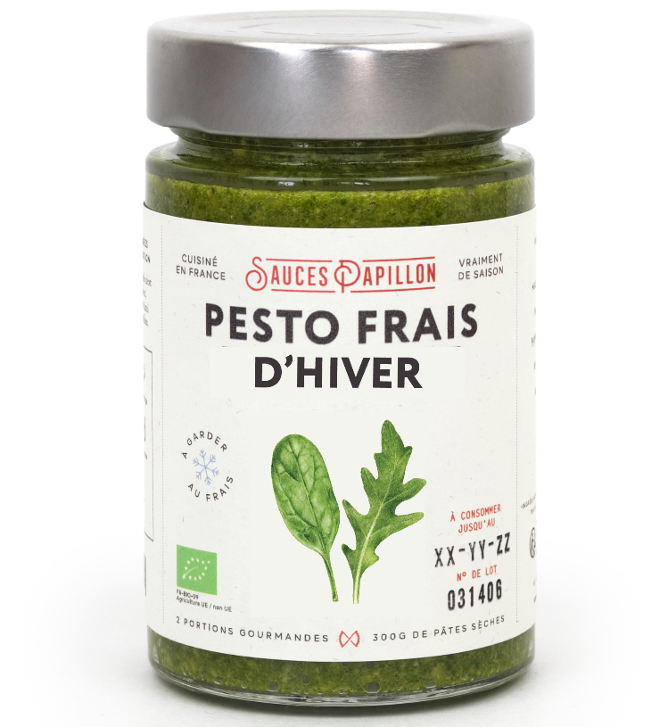
Sauces Papillon / ENTRECOMPFOOD
OUR WINTER RECIPIES
7/A
Notes:
Paris mushroom with goat cheese, chesnut and shallot
Spinach cream with toasted almonds and local French Pepper
Pumpkin sauce with a sage infusion
A winter pesto based on Aragula and parsley herbs

Slide 8




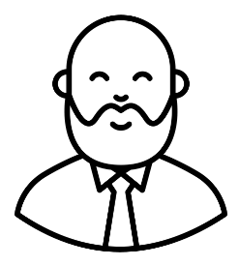
Sauces Papillon / ENTRECOMPFOOD
OUR DISTRIBUTORS
The market
Cheese mongers
delicatessen
organic groceries
Well-off
Final client :
City dwellers
Food lover
8/A

Slide 9







Sauces Papillon / ENTRECOMPFOOD
OUR DISTRIBUTORS
40 RESAILERS IN PARIS
Epicerie Maison M
9/A

Slide 10
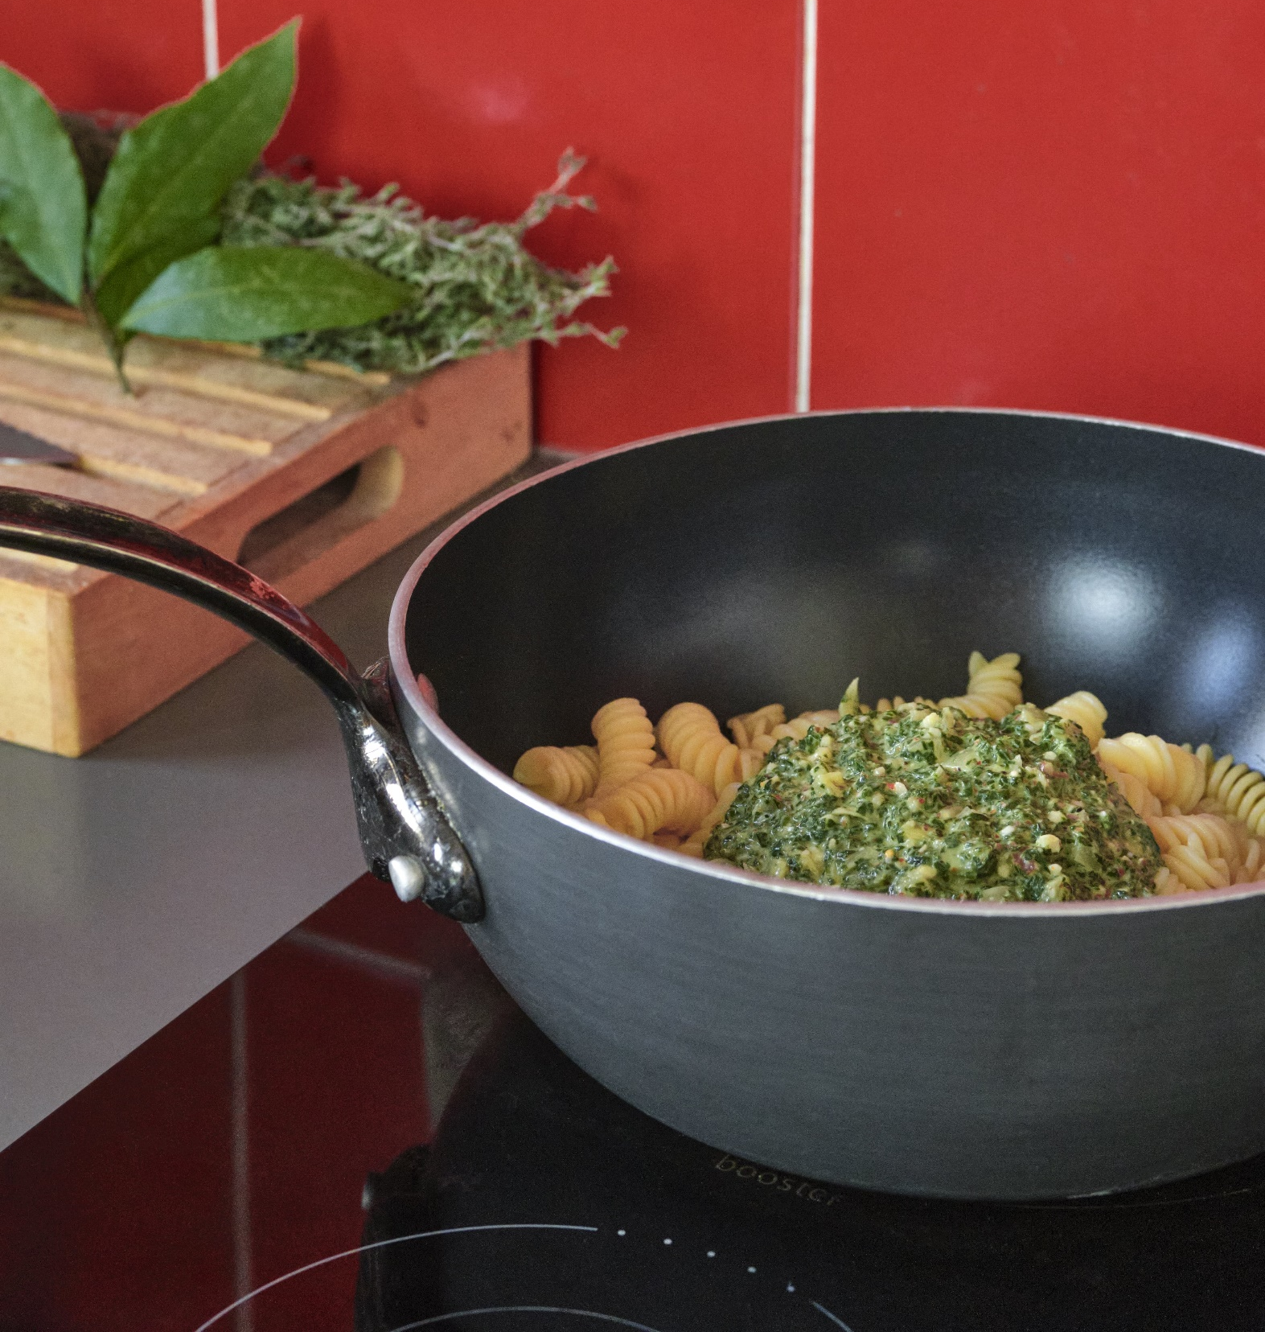
02
Beginning in the food industry :
Which difficulties ?

Slide 11
Sauces Papillon / ENTRECOMPFOOD
AN APPROACH WITH THE Porter's 5 Forces
Potential of
new entrants
Power of
suppliers
Competition
Power of
clients
Threat of
substitute products
11/A
Notes:
Weakness position on each of these forces

Slide 12
Sauces Papillon / ENTRECOMPFOOD
AN APPROACH WITH THE Porter's 5 Forces
Potential of
new entrants
Strong
Small volumes
No economies of scale
Makes you more expensive than your rivals
Power of
suppliers
Competition
Power of
clients
Threat of
substitute products
12/A
Notes:
cost price : coût de revient
Won’t make an effort on their prices

Slide 13
Sauces Papillon / ENTRECOMPFOOD
AN APPROACH WITH THE Porter's 5 Forces
Potential of
new entrants
Strong
No brand image
No one knows your product
Hard to convince distributors
Justify the price
Power of
suppliers
Competition
Power of
clients
Threat of
substitute products
13/A
Notes:
Finished product with a good packaging or very tasty / With quality certifications
Won’t welcome you with open arms
Treasury

Slide 14
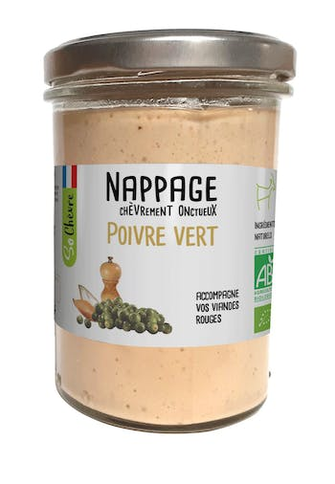
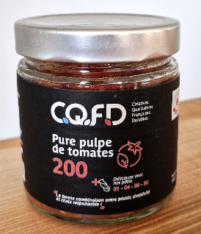
Sauces Papillon / ENTRECOMPFOOD
AN APPROACH WITH THE Porter's 5 Forces
Potential of
new entrants
Low to middle
We are the the new entrant
As soon as…
Power of
suppliers
Competition
Power of
clients
Threat of
substitute products
14/A

Slide 15




Sauces Papillon / ENTRECOMPFOOD
The factor x : FUNDINGS
Launching a food product : which minimal cost ?
LEGAL START
2 000€
R & D
3 000€
marketing
5 000 €
FIRST PRODUCTION
5 000€
15 000€
15/A

Slide 16



Sauces Papillon / ENTRECOMPFOOD
FINDING FUNDS
ALLWAYS A DIFFICULT COMPROMISE
BANKS
ASK FOR SURETY/Guarantees
GRANTS
1 YEAR TO GET IT
BUSINESS ANGELS
WAIT FOR SOLID PROOFS
CHOOSE THE 3 OPTIONS
16/A

Slide 17
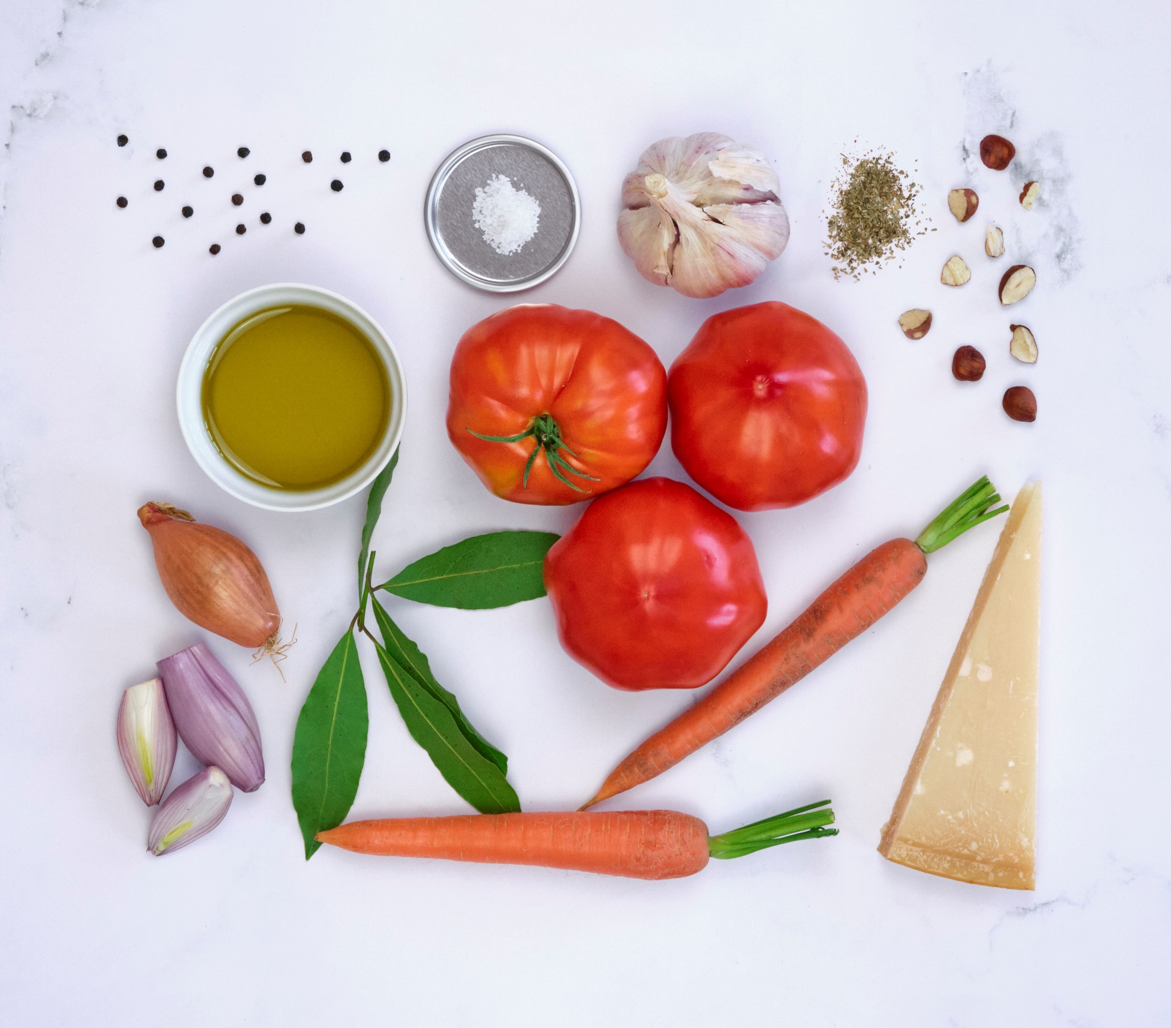
03
Were we well prepared ?

Slide 18

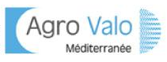

Sauces Papillon / ENTRECOMPFOOD
IN OUR SCHOOL
Ressources AT DISPOSAL
Food innovation
contest
START-UP INCUBATOR
Entrepreneurial contest
NETWORK FOR STUDENT/ENTREPRENEUR
+
AGRO-MANAGER PROGRAM in 3rd year specialisation
17/A
Notes:
Their principal added value is to give you an office and the egibility to public grants
An ecosystem
We noticed that it is very often not well-used and that only a few students know and benefit from it
On the 3 last promotion, no one integrate the incubator

Slide 19



Sauces Papillon / ENTRECOMPFOOD
What can be improved
THE TOOLS AT DISPOSAL
SPECIFIC CONTENT FOR FUTURE ENTREPRENEURS
Entrepreneurs network and testimonies
INTRAPRENEURSHIP & FUNDINGS
Ecotrophelia : after the contest, what’s next
18/A
Notes:
Business plan construction, how to create a company, legal obligations, coaching on loans and subventions
Help of well-established companies to promote the rise of food start-up and mutualise supply and production lines

Slide 20


THANKS
Sauces_papillon
Sauces Papillon
www.saucespapillon.com

