Slide 1









European Final Conference of EntreCompFood project
Brussels, 26. 1. 2023
Applying EntreComp to attract young people to the 1st European manufacturing sector: the agrifood industry
Practices to promote entrepreneurship in Slovenian higher education institutions The case of the Biotechnical Faculty, UL
Mojca Korošec and Aleš Kuhar
Biotechnical Faculty, University of Ljubljana

Slide 2
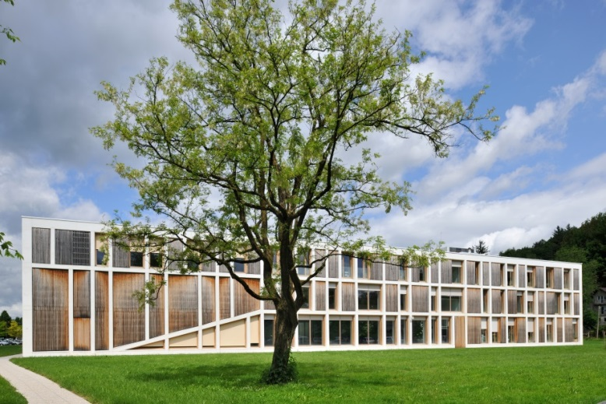
Biotechnical Faculty, UL
Departments
Agronomy
Animal Science
Food Science and Technology
Microbiology
Biology
Forestry and Renewable Forest Resources
Landscape Architecture
Wood Science and Technology
Study programmes
4 professional
9 academic (BSc)
14 master (MSc)
Interdisciplinary PhD study programme in Biosciences (18 scientific fields)
Notes:
Practices to promote entrepreneurship in Slovenian higher education institutions

Slide 3
Biotechnical Faculty, UL in EntreCompFood
Courses
  Sensory analysis
  Food safety
  Food hygiene
  Unit operations in food industry
  Winemaking / Wine technology
Challenge Labs
  The challenge of nutritional care for the elderly
Stakeholders’ local/national workshop
Approaches / Methods
  Seminars
  Laboratory practice
  Field visits
  Mentoring
  Peer reviewing
  Common co-designed (online) workshop methodology
Tools
  online platforms
  shared whiteboard
  interaction apps (e.g. Mentimeter)
  information and study materials
VISION
CREATIVITY
DESIGN THINKING
LEARNING BY DOING
WORKING WITH OTHERS
ETHICS & SUSTAINABILITY
Notes:
Practices to promote entrepreneurship in Slovenian higher education institutions

Slide 4
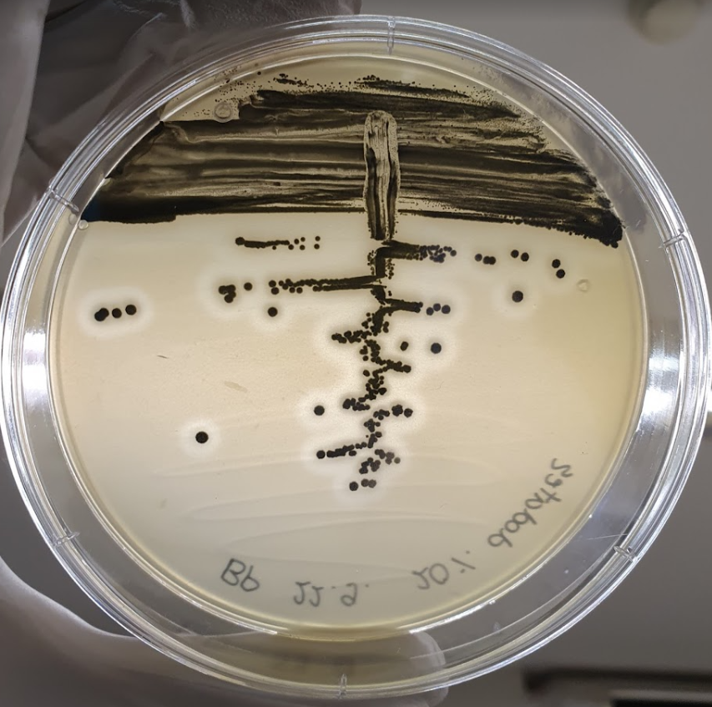
Revised curriculum ex. 1
Food safety course
Study programmes: MSc Food science; MSc Nutrition (1st year)
Course structure: Lectures, Seminars, Field visit, Seminar works, Laboratory practice (9 ECTS)
Duration: 7 weeks
Student activity: Seminar works, Laboratory practice
Student task: Individual analysis and evaluation of results, literature review, and concluding remarks
EntreComp competences promoted: creativity, vision, ethical & sustainable thinking, motivation & preservance, working with others
Final outcome: Laboratory research analysis, discussion, pitch with ppt presentation

Slide 5
Revised curriculum ex. 1: Food safety course
AIM: to update the course in the context of entrepreneurial thinking and digitalization
  To strengthen the cooperation and dialogue between students
  Increase motivation and focus thinking
  Development of learning opportunities / support with programmes
      1. Moodle - online classroom
      2. MS teams
      3. Excel - MS teams
      4. Power Point - MS teams
  Change the didactic approach, prepare a data transmission system
  Learn more independent study of scientific add literature
  Add critical thinking and discussion

Slide 6
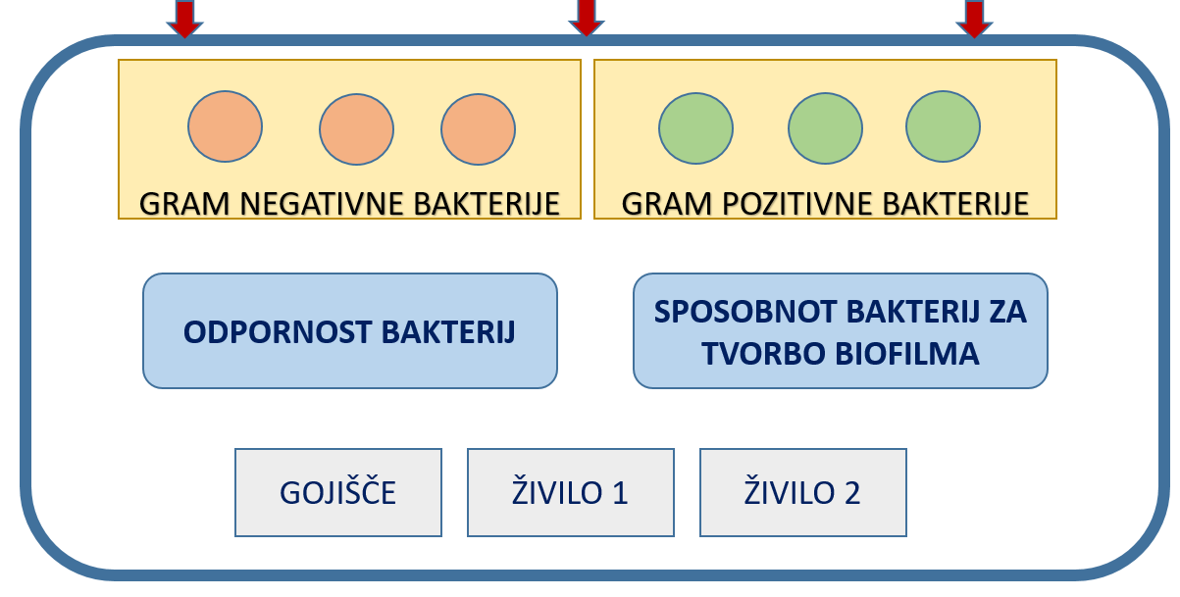
Revised curriculum ex. 1: Food safety course
Challenge in every year
  That the student collects data from his group and also from all other groups
  That the student performs the entire processing of the results of all three exercises
  To statistically analyze the results
  To evaluate / discuss the results with the help of literature or knowledge acquired in tutorials and independently
  To present the pitch (problem, results, conclusions) in a group with others
RESULTS COLLECTING
LITERATURE DATA FROM SCIENTIFIC MANUSCRIPTS
ANALYSIS OF LITERATURE
EXPERIMENTAL DATA ANALYSIS
CONLUSIONS

Slide 7
Revised curriculum ex. 2:
Sensory analysis course
Study programmes: MSc Food science; MSc Nutrition (1st year)
Course structure: Lectures, Seminars, Lab exercise (4 ECTS)
Duration: 7 weeks
Student activity: Seminars (modified curricula)
Student task: Conceptual design of an innovative food product relying on SDGs
EntreComp competences promoted creativity, vision, ethical & sustainable thinking, motivation & preservance, working with others
Final outcome: Written report, pitch with ppt presentation

Slide 8
Jamboard online session
Main information shared with peers
Comments/questions
Peer review
Project presentation
Group comments / questions shared on Jamboard
Brainstorming
Research
45 min
Final discussion
Answers to peer review
Justification, explanation
Possible upgrades
Written on Jamboard

Slide 9
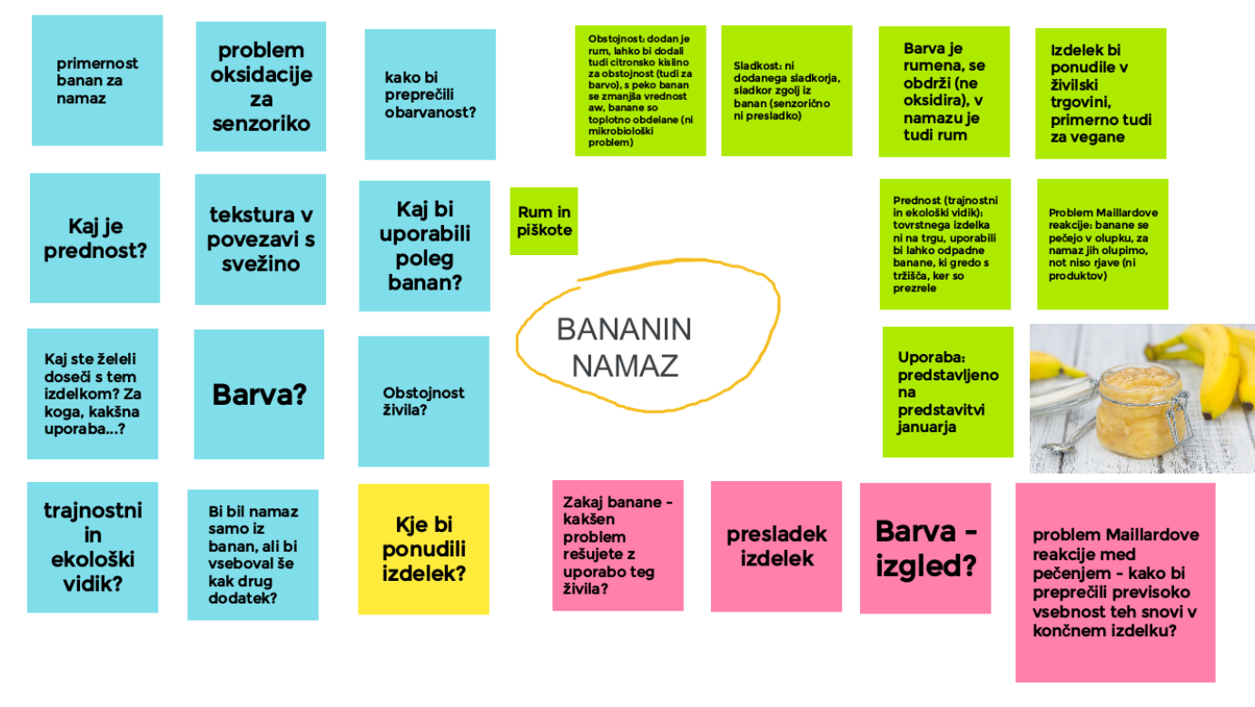
Discussions result: Jamboard example
Group: answers and justification
Peer review: questions and comments

Slide 10



Pitching
Groups, in person, 5 minutes
Convince us that your product is the best to buy / invest in!
External “evaluator”: dr. Urška Pivk Kupirovič (CCIS-CAFE)
  Students also had to submit a written report.

Slide 11
Selection of the best 3 ideas & Statements
External evaluator = challenging & great
Peer reviewing helped us to improve our product idea.
We were highly motivated for work as it seemed to be a real-life challenge.
Due to the limited time, we divided the tasks, set up a virtual space and had regular progress meets.
I liked that we made a schedule to be aligned with the deadlines
Notes:
Students decided to develop their ideas further and applied to Ecotrophelia Slovenia 2022

Slide 12
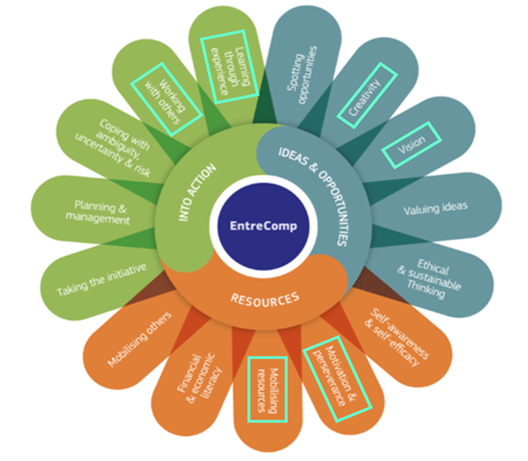
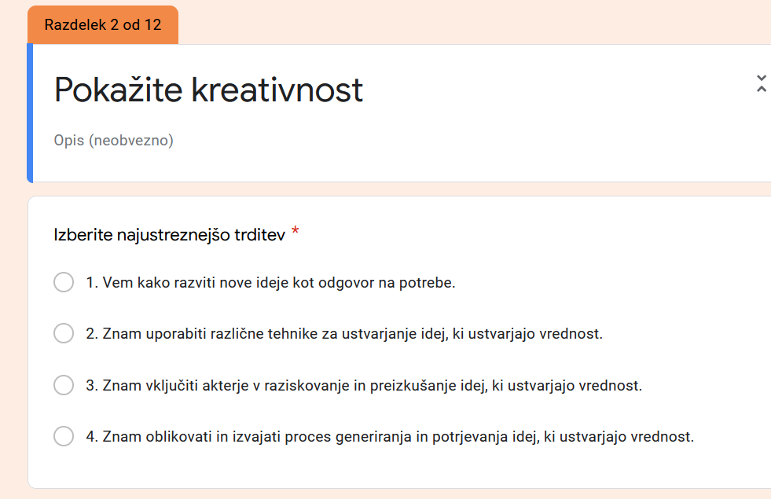
Self-evaluation
Google form questionnaire. Based on EntreComp competences and APT q.
Which statements describes you best?

Slide 13
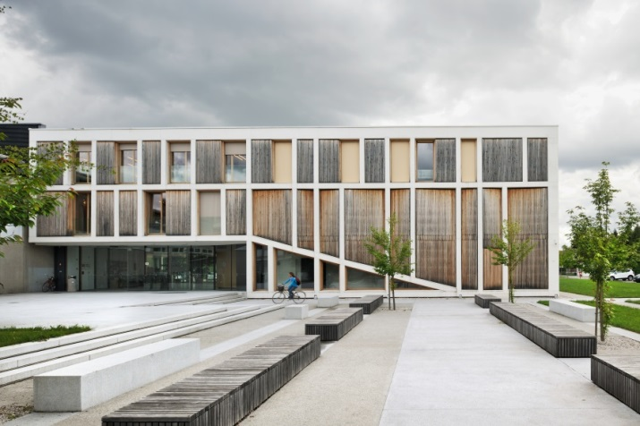
Biotechnical Faculty, UL in EntreCompFood Key achievements
Pedagogical staff:
  Raised awareness of the availability and possibilities of different teaching methods and tools
    Transfer into practice
    Distance learning was additional driver for changes in pedagogical practices
  Greater focus on teaching methods to promote/develop certain entrepreneurial competencies in students
Students:
  Better understanding of what competencies are
  Raised awareness of entrepreneurial competencies
  Open to explore and search for resources
  Nothing is impossible attitude
Notes:
Practices to promote entrepreneurship in Slovenian higher education institutions

Slide 14

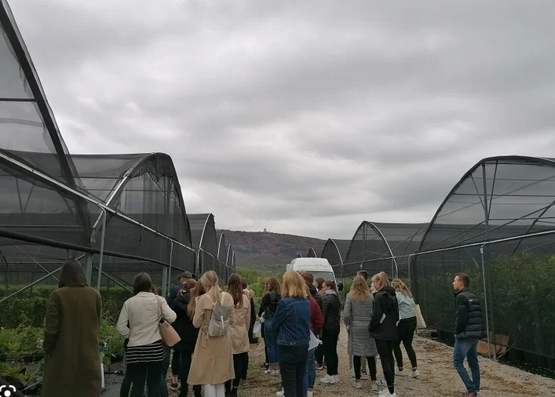
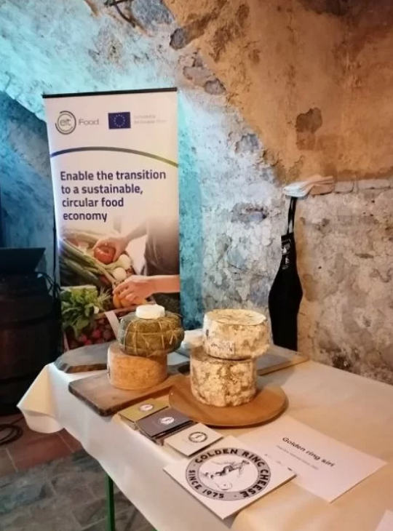
BF-UL Supportive environment to promote entrepreneurship
Stimulating dialogue with start-ups and fodd companies in Slovenia and abroad

Slide 15
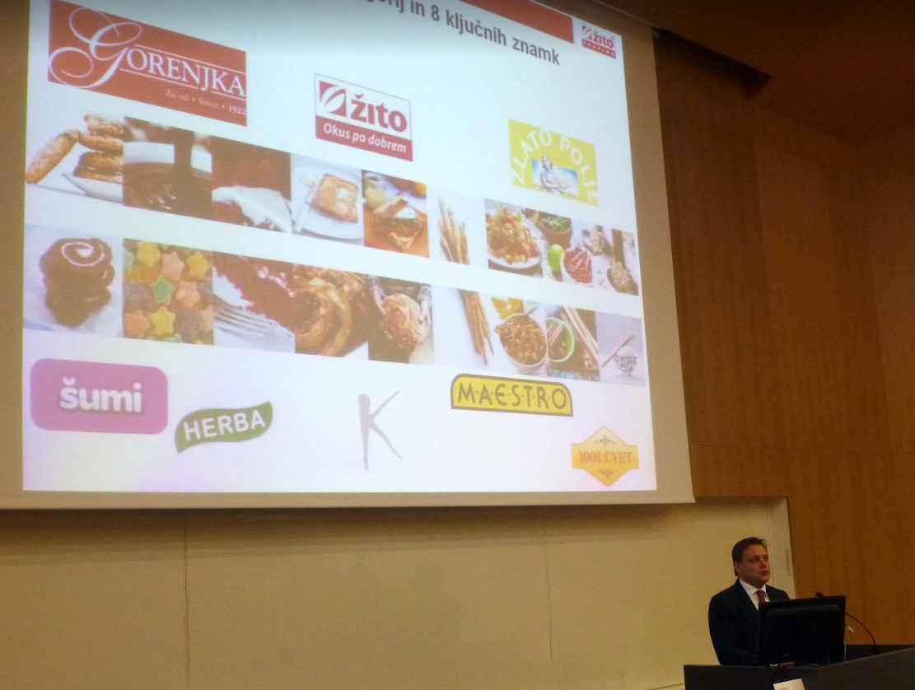
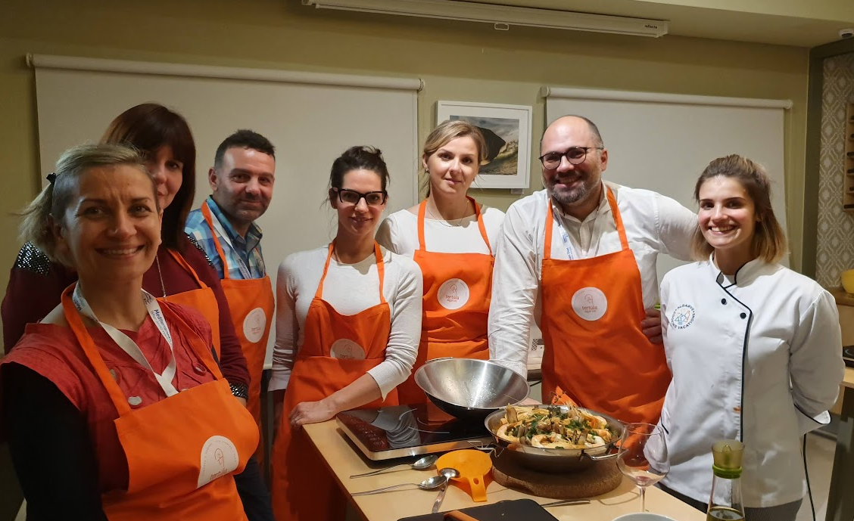
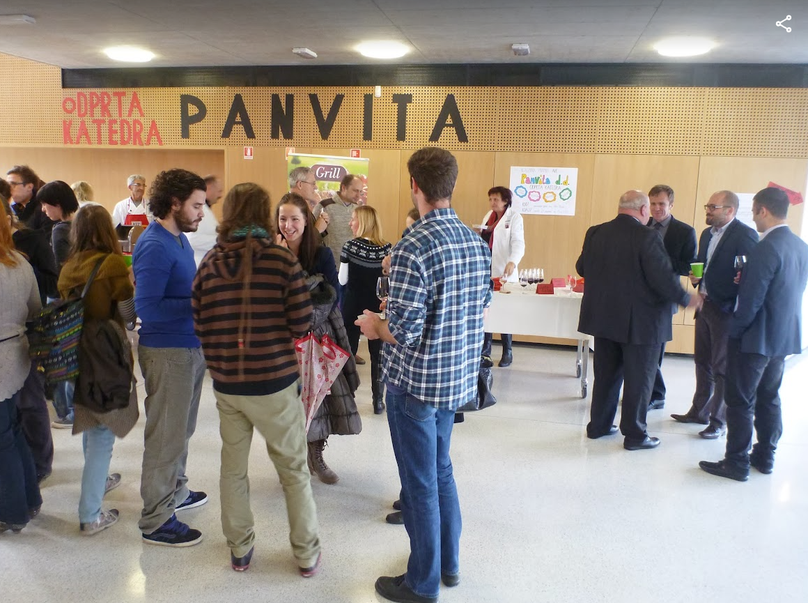
BF-UL Supportive environment to promote entrepreneurship
Stimulating dialogue with start-ups and fodd companies in Slovenia and abroad

Slide 16




BF-UL Supportive environment to promote entrepreneurship
EIT FOOD HUB

Slide 17
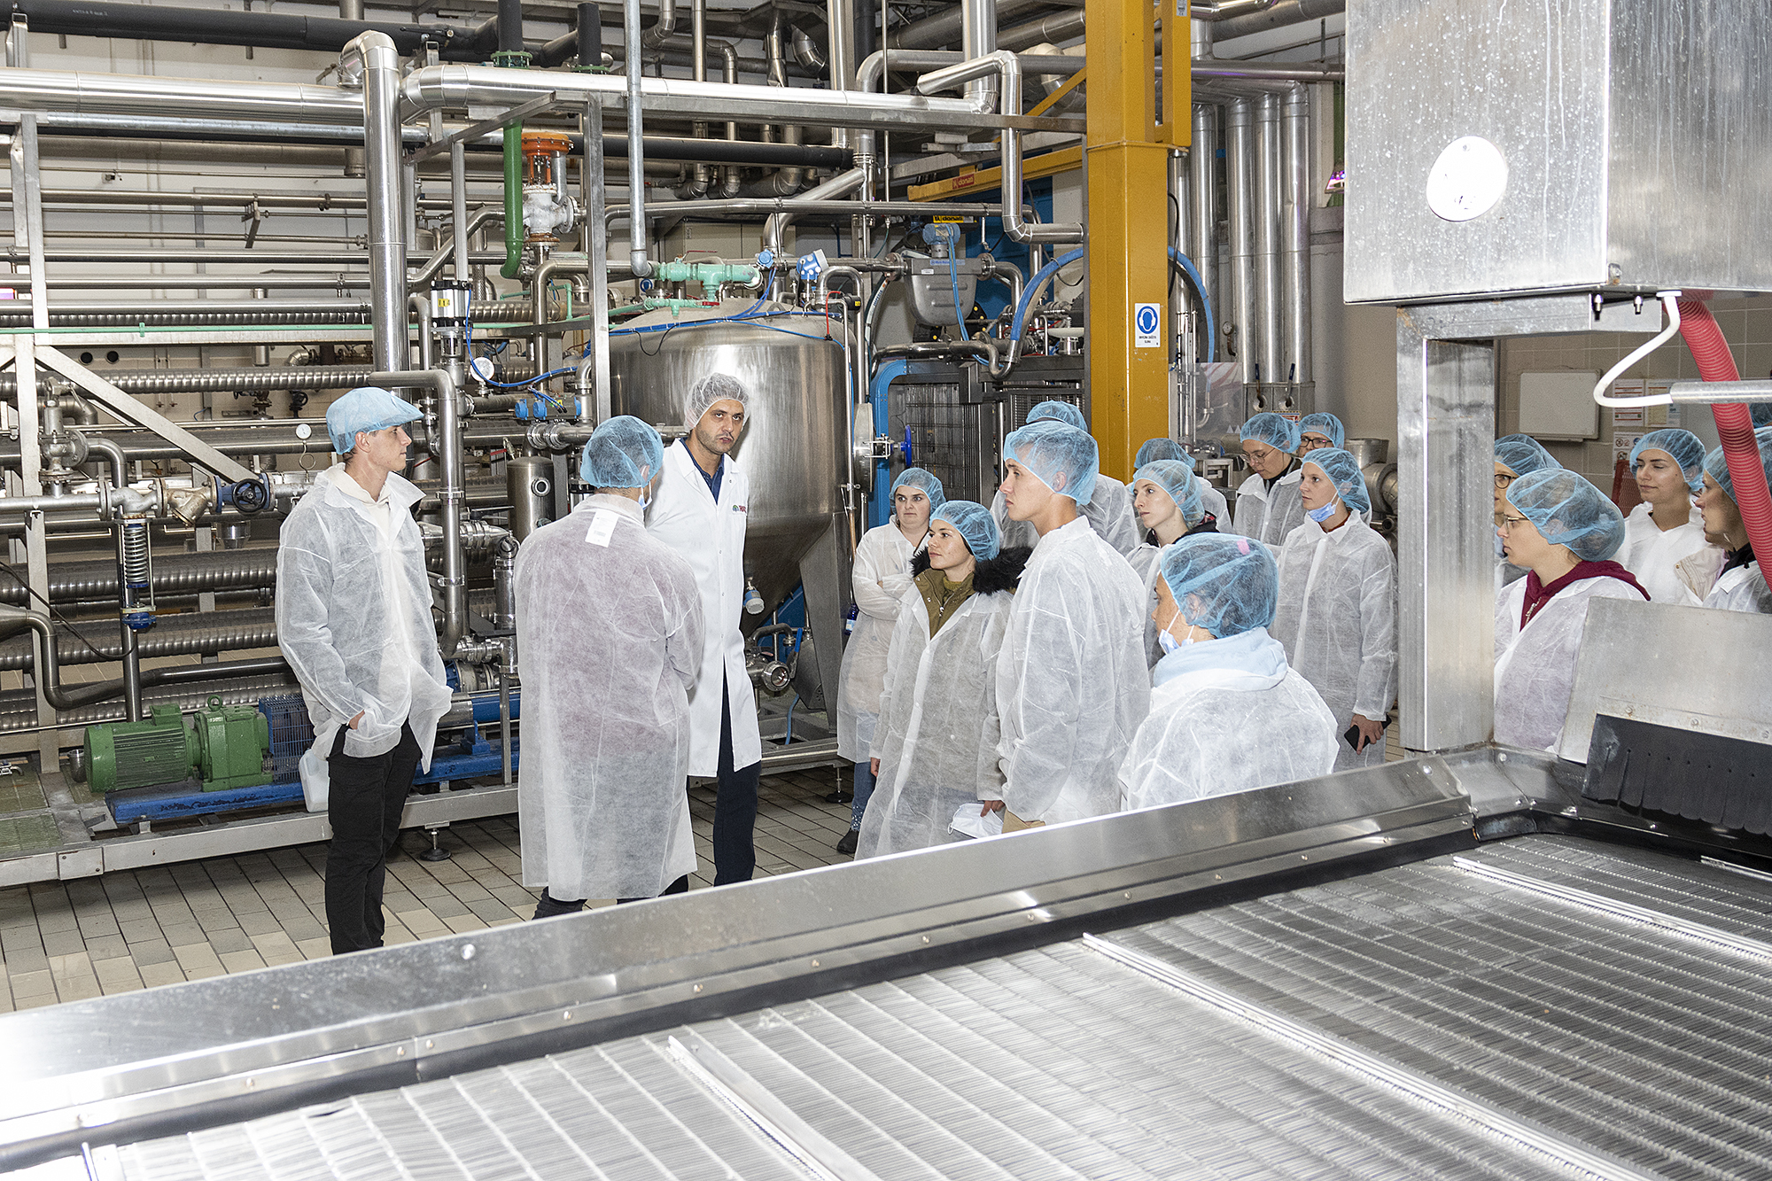
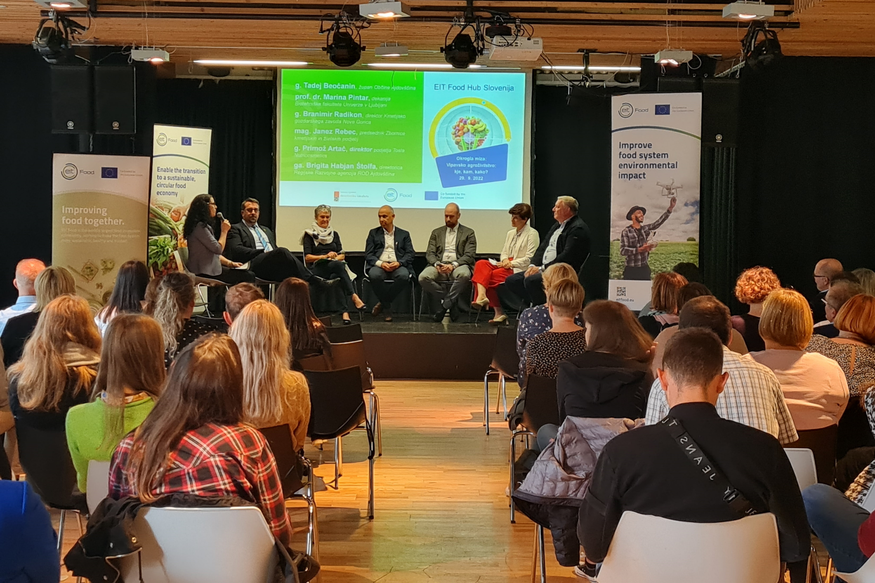
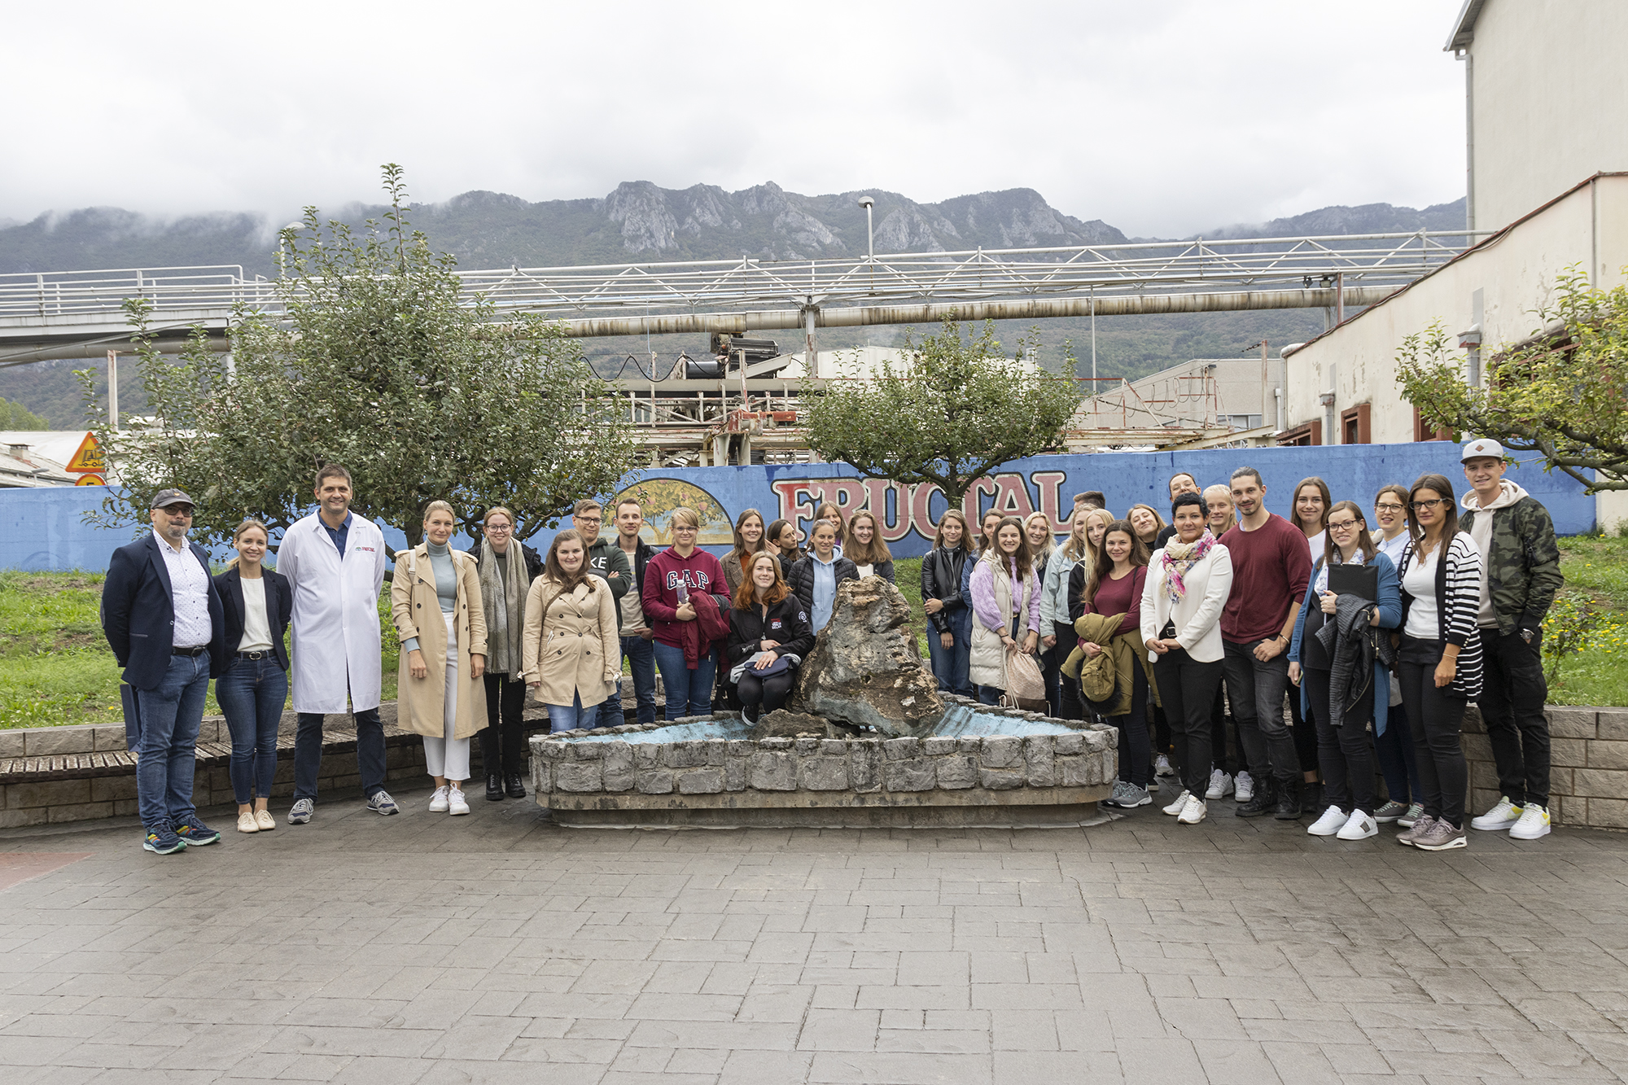
BF-UL Supportive environment to promote entrepreneurship
EIT FOOD HUB

Slide 18
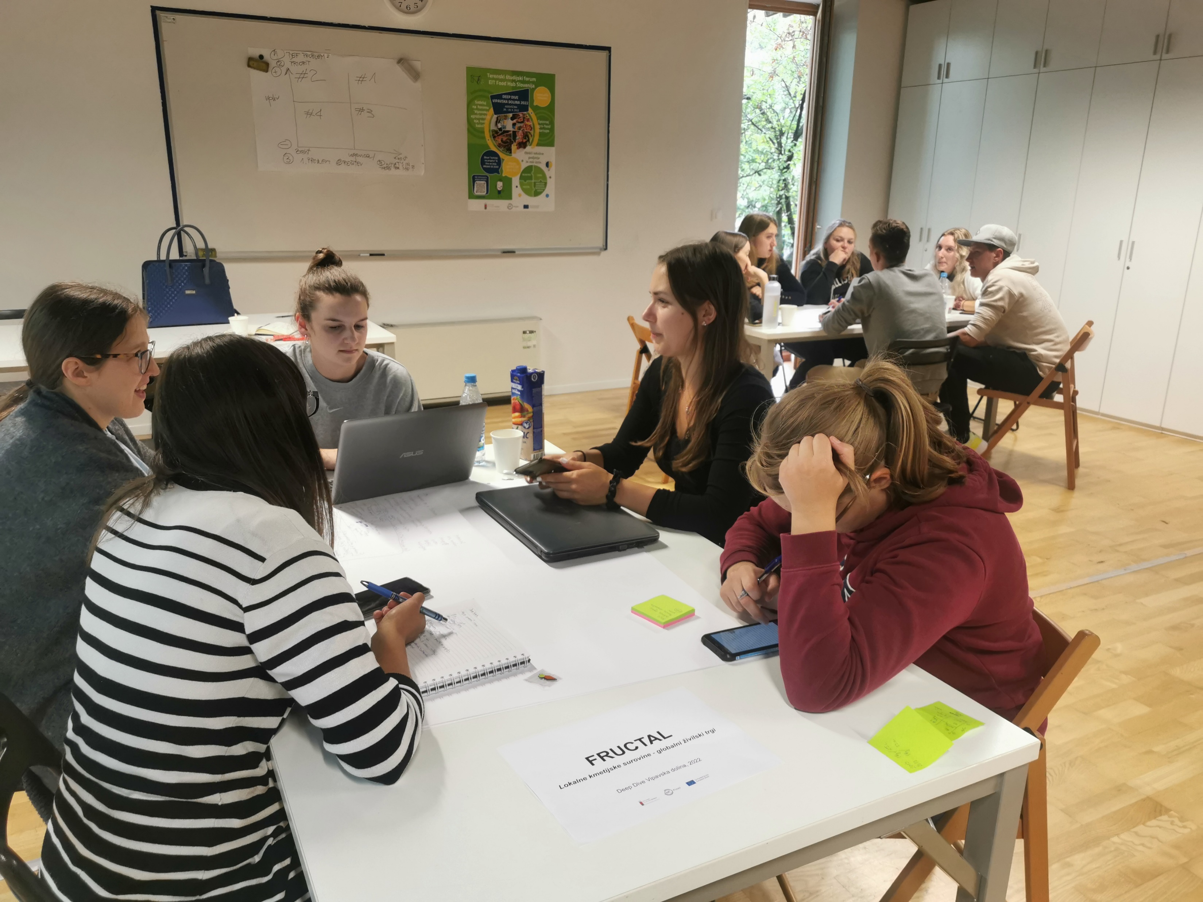
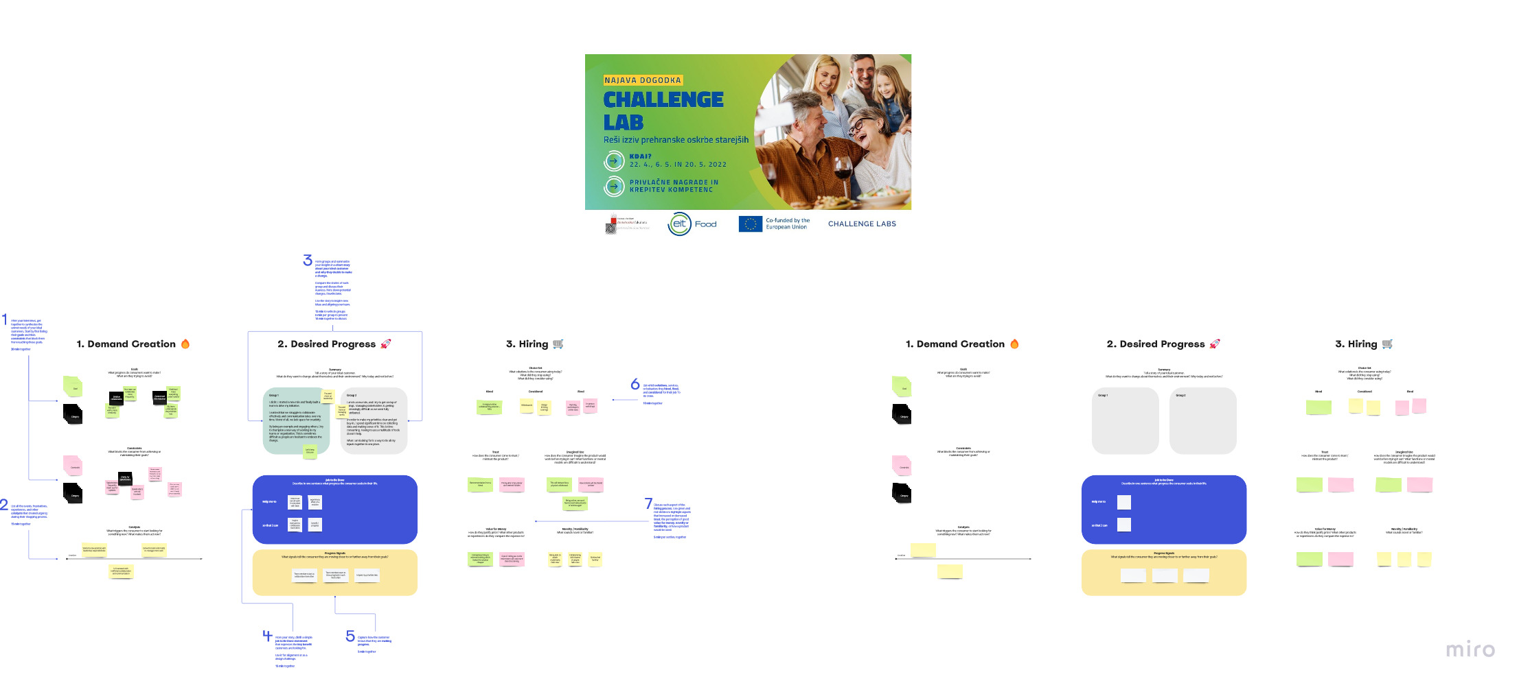
BF-UL Supportive environment to promote entrepreneurship
Carier days
UL-RSF – Talented students

Slide 19




Thank you!
Contacts
mojca.korosec@bf.uni-lj.si
ales.kuhar@bf.uni-lj.si

