Slide 1
Applying EntreComp to attract young people to the 1st European manufacturing sector: the agrifood industry
Applying EntreComp
to attract young people to the 1st European manufacturing sector: the agrifood industry
Urška Pivk Kupirovič, PhD
Chamber of Commerce and Industry of Slovenia - Chamber of Agricultural and Food Enterprises Urska.Pivk.Kupirovic@gzs.si

Slide 2
The European agri-food industry is not attracting enough young people to the sector, but entrepreneurship has the potential
- notably due to unappealing salaries,
- lack of notoriety of companies and
- establishment of sites in rural areas.
- flexible working time,
- home office,
- income independance.

Slide 3
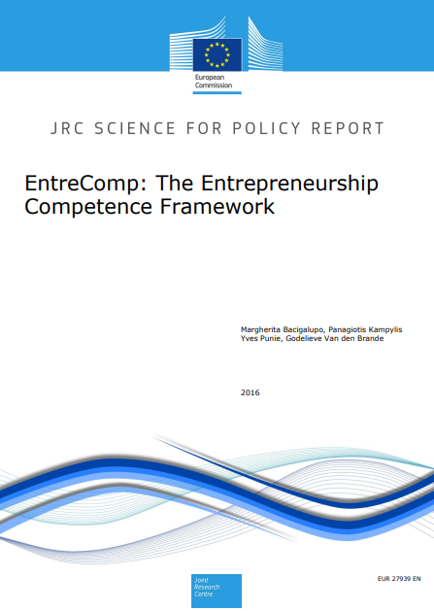
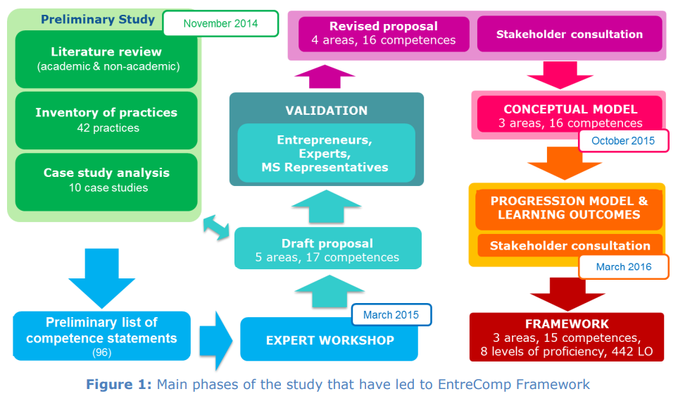
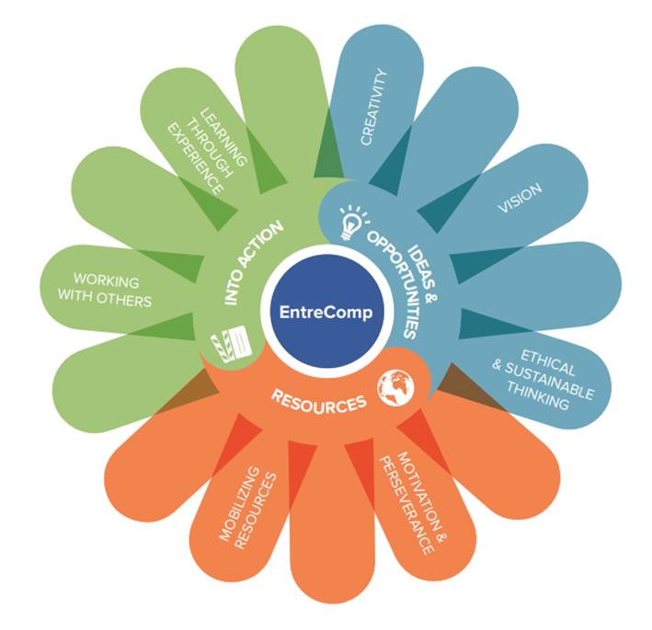
Entrepreneurship is a competence anyone can learn.

Slide 4
We are on a cross-road to choose our future….
OLD WAYS
NEW WAYS
Notes:
https://greenliving.lovetoknow.com/Seven_Biggest_Environmental_Threats
https://www.life.lk/article/travel/Save-Earth/58/19090

Slide 5
Are we ready to innovate?
1000 x NO
SAY: YES.

Slide 6
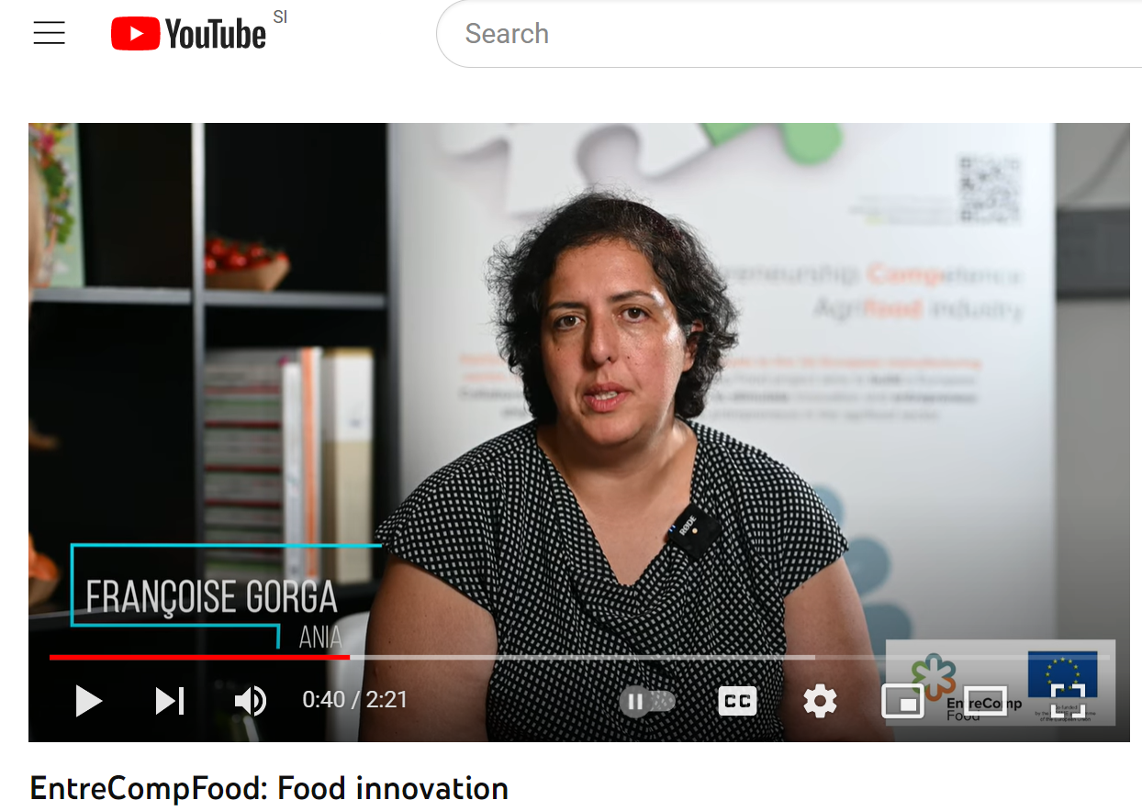
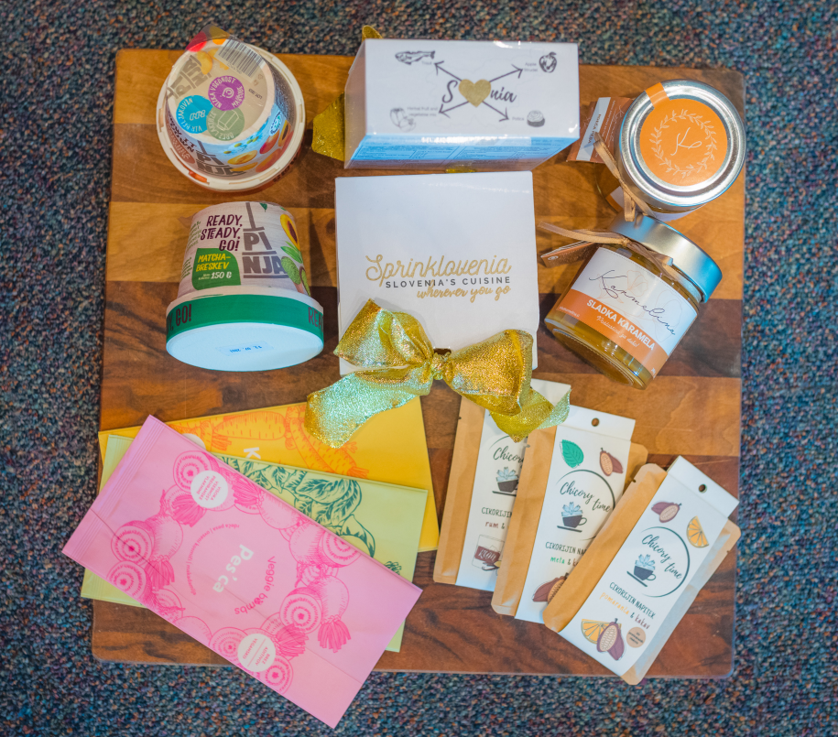
with long tradition
TODAY is ABOUT PEOPLE
First it was about food innovation

Slide 7
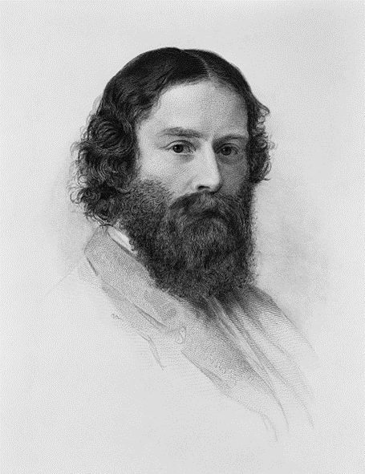
Project based learning
Learn how to
give & receive feedback
“A thorn of experience is worth more than a forest of warnings.„
James Russell Lowell

Slide 8
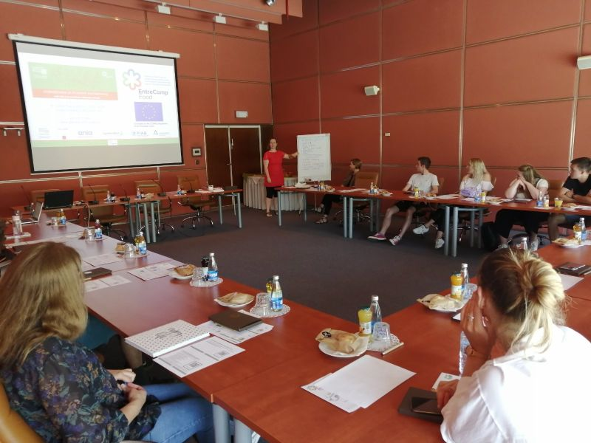
TO WIN is not a priority for students joining Ecotrophelia competition, but:
💡 to design food product
💡 to learn
💡 to create added value
🌍 to follow passion and ambition
🌍 to have fun
🎬 be with friends
🎬 to get experience

Slide 9
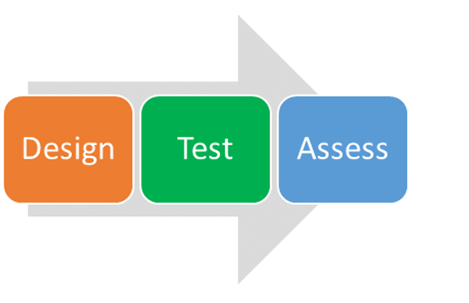
EntreCompFood Project objective:
is to design, test and asses
the training opportunities
based on EntreComp framework
to best stimulate innovation and entrepreneurship
among students and young entrepreneurs
in the agrifood sector.

Slide 10
OUR OBSERVATION of Ecotrophelia students
ARE VERY GOOD IN:
The food product
The product's innovation and eco-innovative aspects;
The marketing, sales and business plan;
The communication strategy
COULD IMPROVE IN:
Creativity
Vision
Motivation and perseverance
Mobilising resources
Working with other
Learning through experience

Slide 11
Building entrepreneurial mindset already during education is important to bridge the gap.

Slide 12
The dream team
Follow us:
www.gzs.si/EntreCompFood
#EntreCompFood
Duration:
February 2020 – January 2023

Slide 14
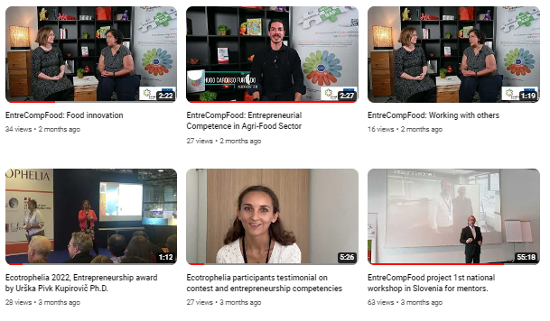
More information
Check out the project website for Project Deliverables and Publications / Newsletters.
www.gzs.si/EntreCompFood
#EntreCompFood

