Slide 1

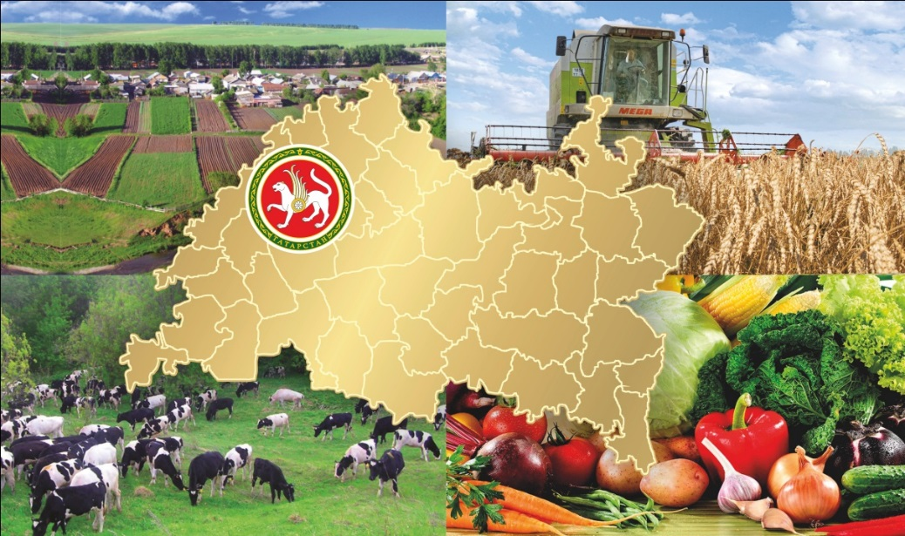
the Republic
of Tatarstan
AGRO-INDUSTRIAL COMPLEX
Kazan, December, 2014.

Slide 2
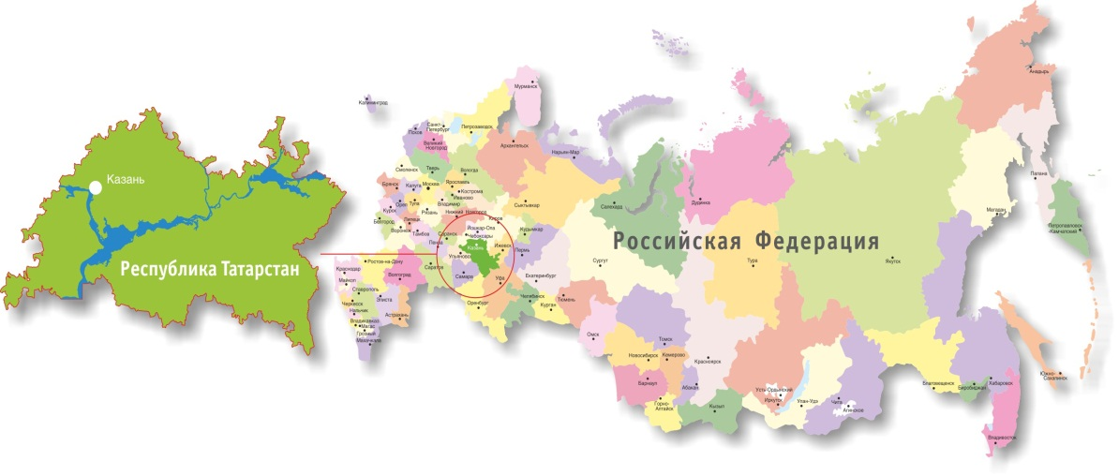
AGRO-INDUSTRIAL COMPLEX of the Republic of Tatarstan
Total area: 67836.2 km2
farmland - 4,5 million hectares
including arable land - 3,4 million hectares
Population - 3838 people
Including rural population - 931 people (24%)
Gross output of
agriculture
(billion rubles.)
Specific weight in the Russian Federation :
farmland - 2,4%
gross product - 4,3%
100%
107%
117%
Municipalities - 956
Municipal areas - 43
1

Slide 3
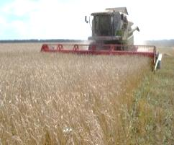
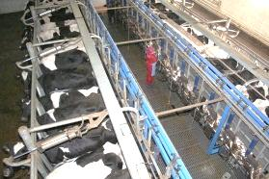
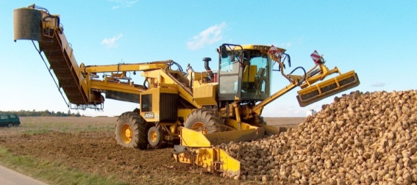
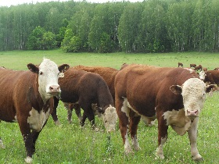
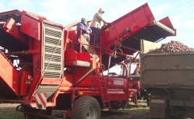
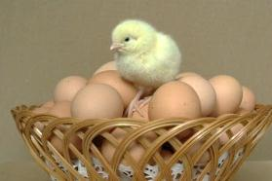
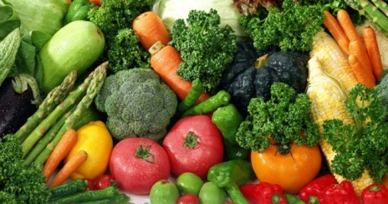
AGRO-INDUSTRIAL COMPLEX of the Republic of Tatarstan
Agricultural produce (forecast for 2014)
crop production
animal husbandry
poultry
Grain
3,37 million tons
Milk
1,75 million tons
Sugar beet
1,5 million tons
Cattle and poultry
485 thousand tons
net weight
Potato
1,3 million tons
Eggs
1,1 billion
Vegetables
369 thousand tons
2

Slide 4
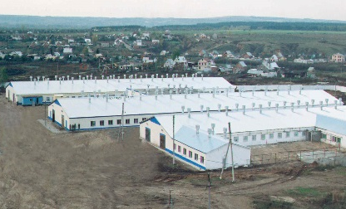
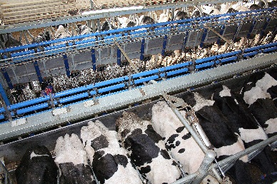
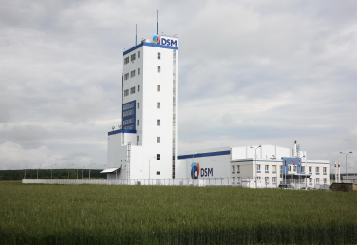
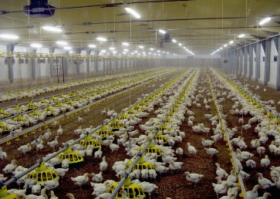
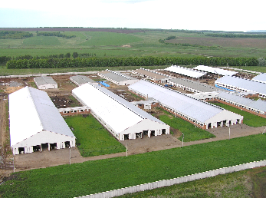
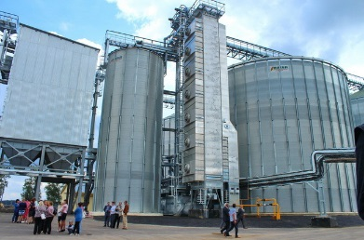
AGRO-INDUSTRIAL COMPLEX of the Republic of Tatarstan
Financial provision for agricultural project and State program
(billion rubles)
Bank credits
for 01/10/2014
Investments for AIC of the Republic of Tatarstan
Volume of investments for 2008-2014 –
126,7 billion rubles
Subsidized,
in total
Including invested
3

Slide 5
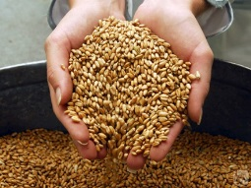
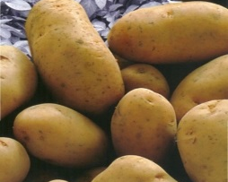
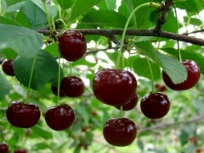
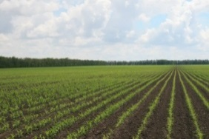
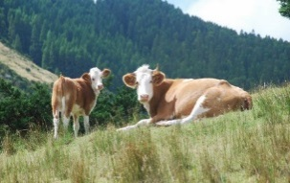
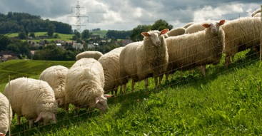
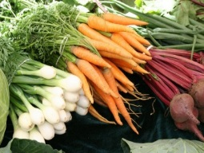
The possibility of letting of lands to farm
Baltasinskiy
Allocation of land
Atninskiy
Arskiy
Kukmorskiy
Agryzskiy
Vysokogorskiy
Zelenodolskiy
Sabinskiy
Mendeleyevskiy
Kazan
Tyulyachinskiy
Elabuzhskiy
Pestrechinskiy
Mamadyshskiy
Aktanyshskiy
Verkhneuslonskiy
Rybno-Slobodskiy
Tukayevskiy
Menzelinskiy
Laishevskiy
Kaibitskiy
Nizhnekamskiy
Apastovskiy
Kamsko-Ust’inskiy
Chistopol’skiy
Zainskiy
Muslyumovskiy
Alekseyevskiy
Sarmanovskiy
Novosheshminskiy
Tetyushskiy
Al’met’yevskiy
Buinskiy
Spasskiy
Aksubayevskiy
Aznakayevskiy
Drozhzhanovskiy
Al’keyevskiy
Cheremshanskiy
Yutazinskiy
Nurlatskiy
Leninigorskiy
Bugul’minskiy
Bavlinskiy
4

Slide 6
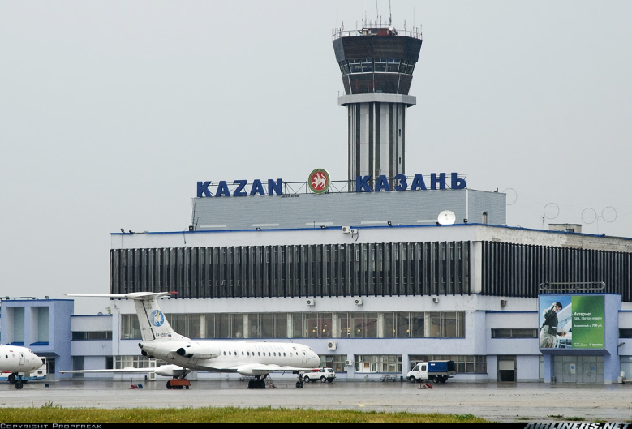
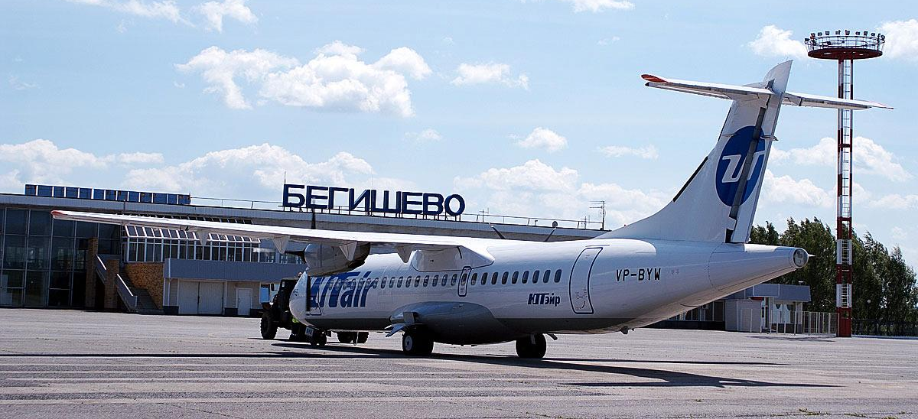
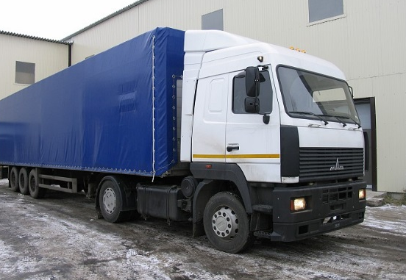
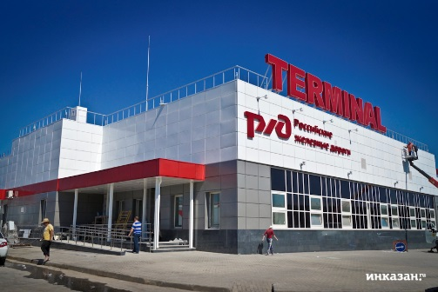
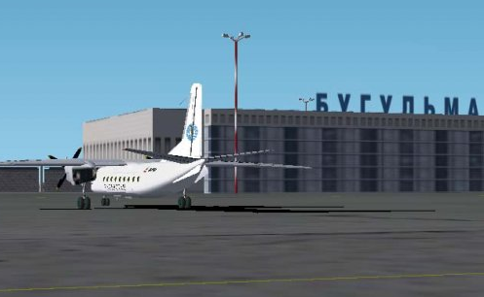
Tatarstan has well-developed transport infrastructure
5

Slide 7
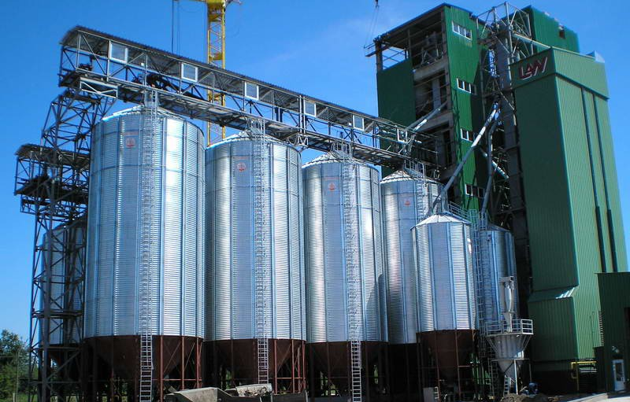
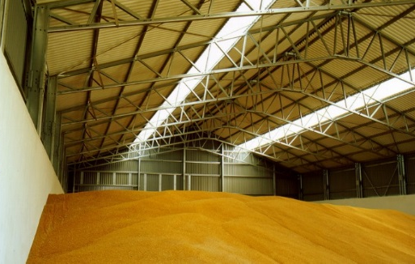
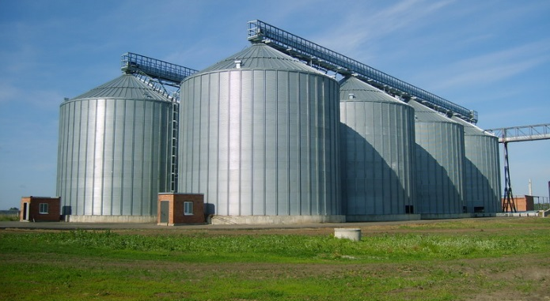
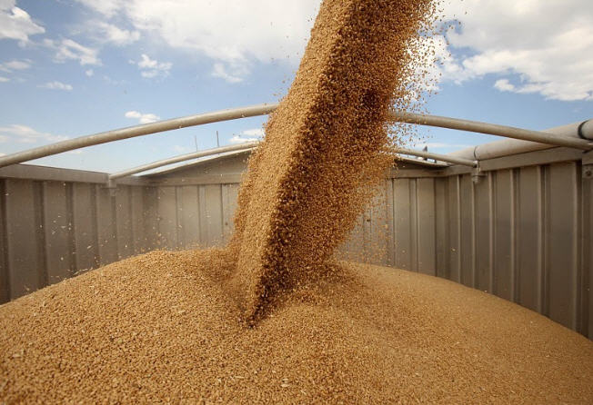
Construction of two grain-elevators with a storage capacity of 200 thousand tons of grain.
The estimated cost of the elevator –
2 billion rubles.
Shipment by water is possible.
6

Slide 8
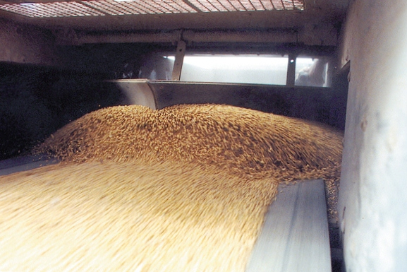
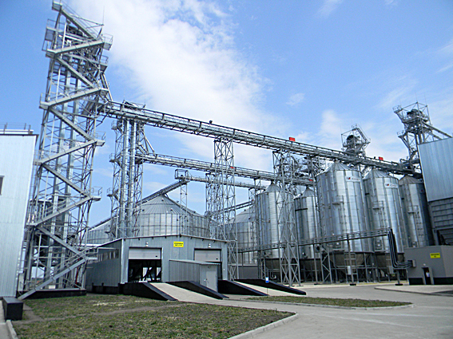
Complex for deep processing of 200 thousand tons
of grain per year
Estimated cost– 10 billion rubles
Finished goods :
gluten
maltose and glucose-fructose syrups
starch
feed compound
7

Slide 9
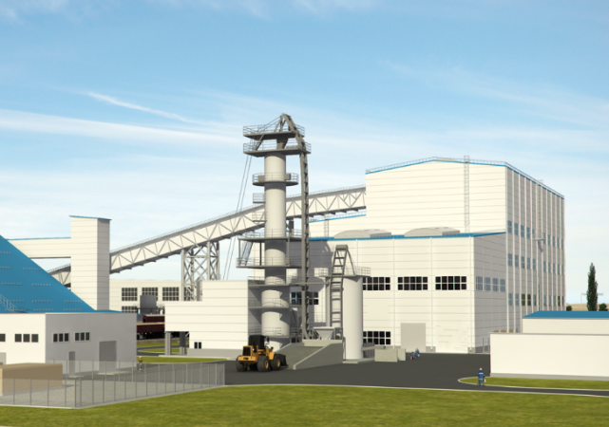
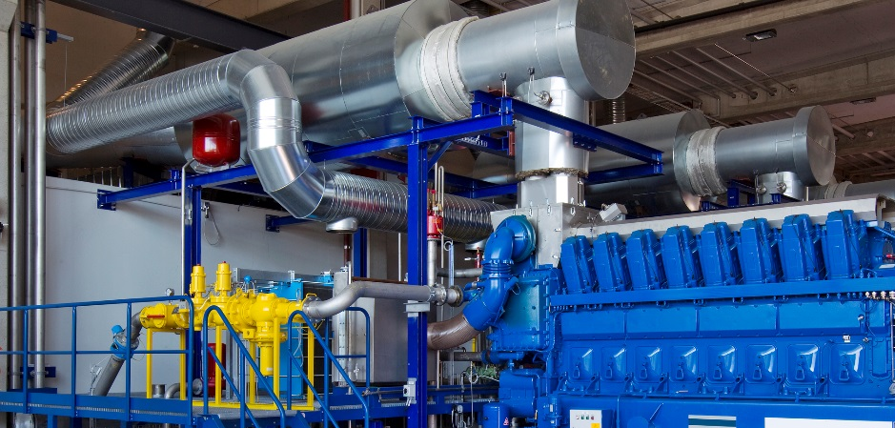
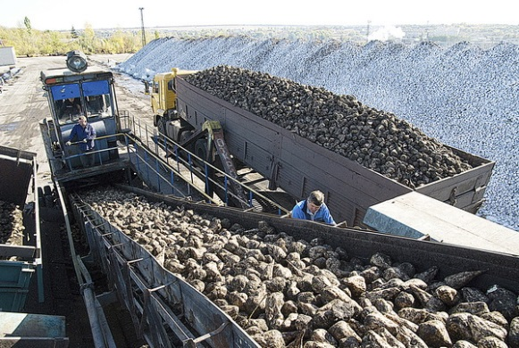
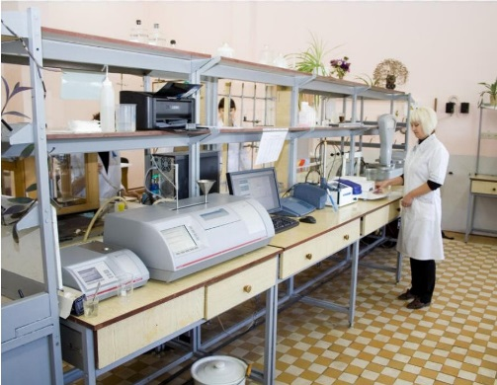
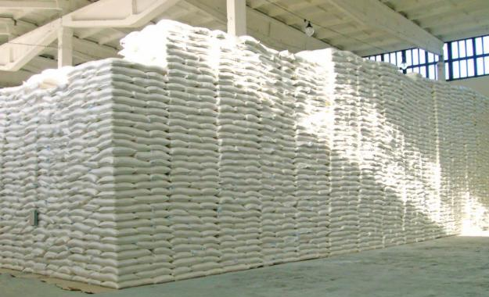
Sugar mill construction
8

Slide 10
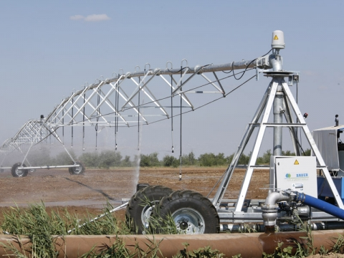
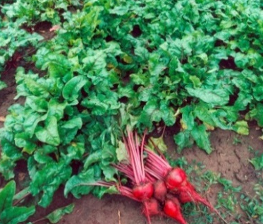
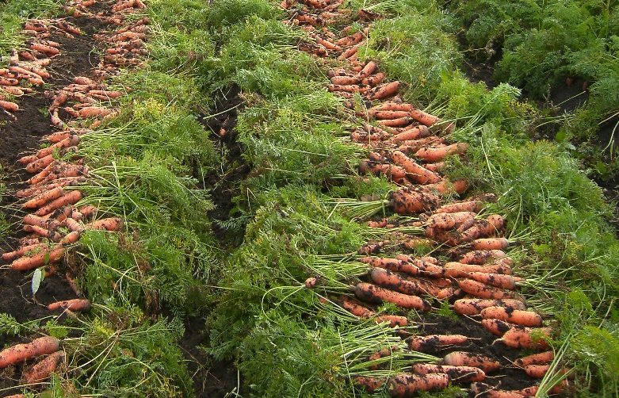
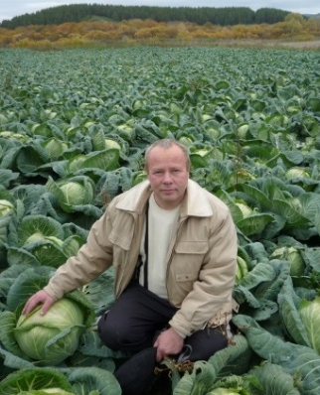
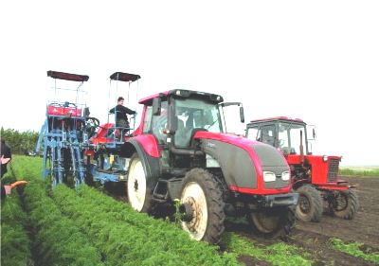
Proposals for the production of 100 thousand tons of vegetables in the open ground
There is a project of complete cycle from production to sale of:
Cabbage – 15 thousand tons
Carrot – 3 thousand tons
Red beet – 2 thousand tons
9

Slide 11
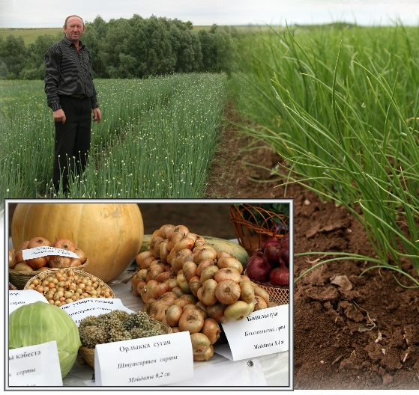
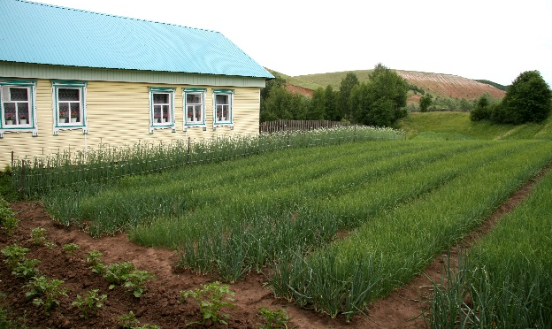
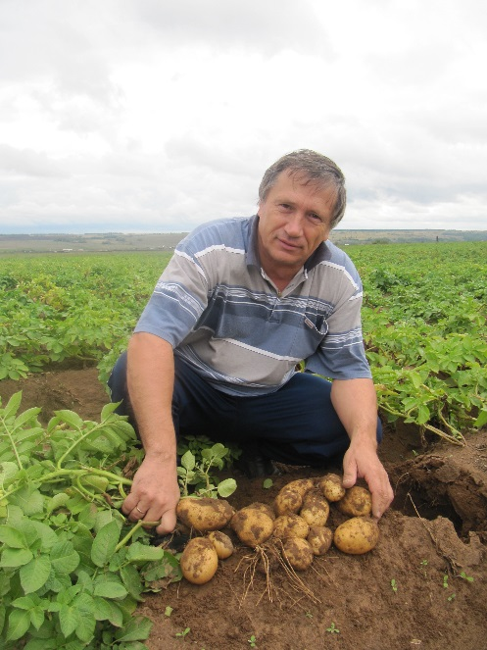
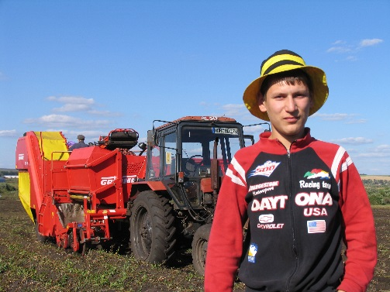
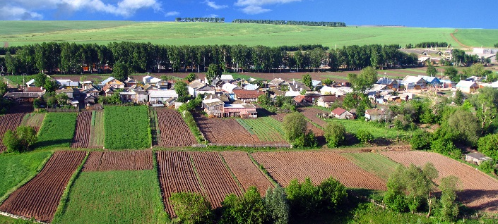
Proposals for the production of vegetables in the open ground
Production of vegetables in the open ground
- onion
- potato
10

Slide 12
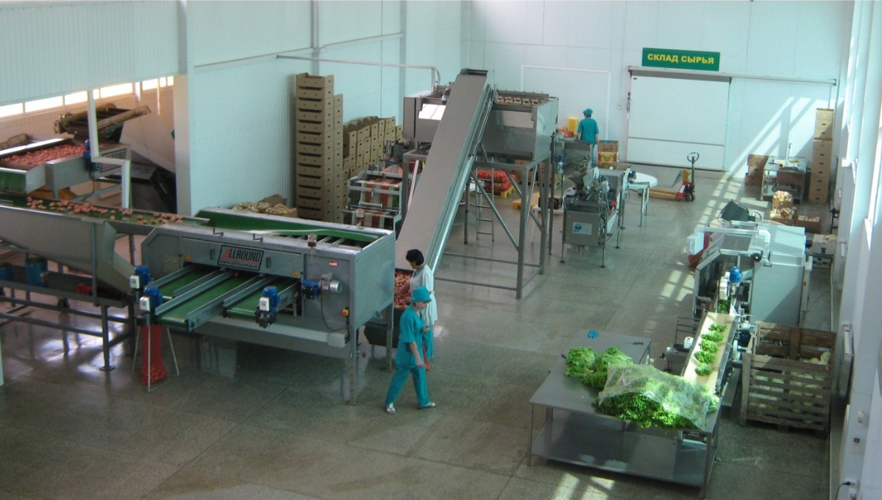
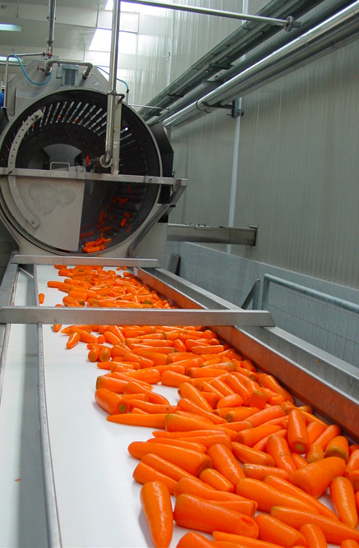


The implementation of projects on vegetable processing with
total power of 50 thousand tons per year
11

Slide 13




The construction of the potato processing plant with the power
of 140 thousand tons per year
Project cost– 4,3 billion rubles.
Finished goods:
Frozen french fries
Potato flakes
12

Slide 14










Proposals for fruit and berry crops
Establishing intensive apple and pear orchards.
Berries establishing
and production:
- strawberry
- raspberry
- currant
Stone fruit establishing and production:
- plum
- cherry
13

Slide 15





The establishment of
fruit and berry processing production
14

Slide 16




The implementation of projects of beef cattle husbandry on fattening about 10 thousand heads of horned cattle
15

Slide 17





The implementation of projects of industrial production
of waterfowl (duck)
«Ramayevskoe» farm:
From 2012 - 3 billions heads of ducks are raised
and more than 5,5 thousand tons of meat is sold.
16

Slide 18





The implementation of projects of industrial production
of waterfowl (goose)
«Khamadishin» farm:
Breeding stock– 5 thousand heads
The volume of production per year:
1 day old goslings – 100 thousand heads
geese's carcasses – 10 thousand heads
17

Slide 19







THANKS FOR ATTENTION!
18

