Slide 1
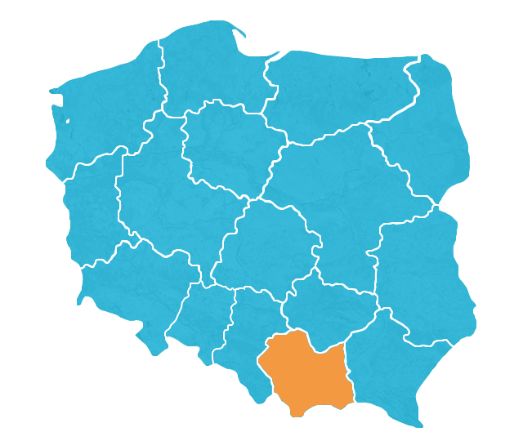
Business opportunities
in Małopolska

Slide 2
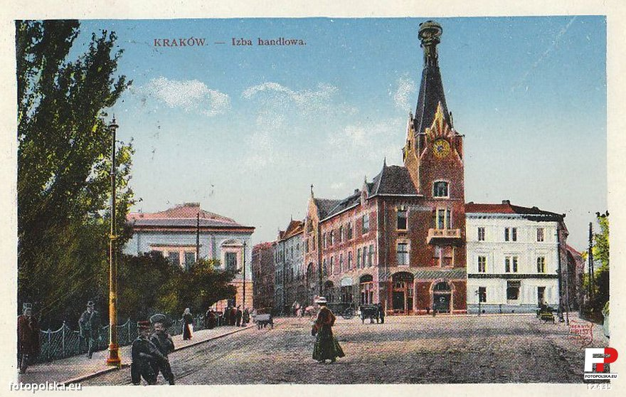
History
14 November 1850 – establishing of Chamber of Commerce and Industry in Cracow
Dissolved in 1950 by communist authorities
6 February 1992 – reactivation of the CCI

Slide 3
Members

Slide 4
IPH services for member companies
Promotion of member companies in Poland and abroad
Representing their economic interests before any authorities
Taking part in realization of regional economic policy
Matchmaking - B2B meetings
Organization of trade missions, participation in fairs
Organization of conferences, seminars, training
Informing about EU founds & projects
Legalization of foreign trade documents
Mediation and arbitration

Slide 5
Current Projects
Enterprise Europe Network
Building technology scenarios for SME
Arbitration and Mediation Center
Q-Tales

Slide 6
Enterprise Europe Network
„Business Support on Your Doorstep”
Enterprise Europe Network is one of the most important tools of European Commission supporting development of small and medium enterprises (SME)

Slide 7
Enterprise Europe Network
Our member organizations include chambers of commerce and industry, technology centers, research institutes and development agencies. Most of them have been supporting local businesses for a long time. They know their clients' strengths and needs - and they know Europe.
600 organizations worldwide
50 countries
30 organizations in Poland
6 organizations in Slovenia: www.een.si

Slide 8
Enterprise Europe Network
Develop your business in new markets
Source or license new technologies
Access EU finance and EU funding

Slide 9
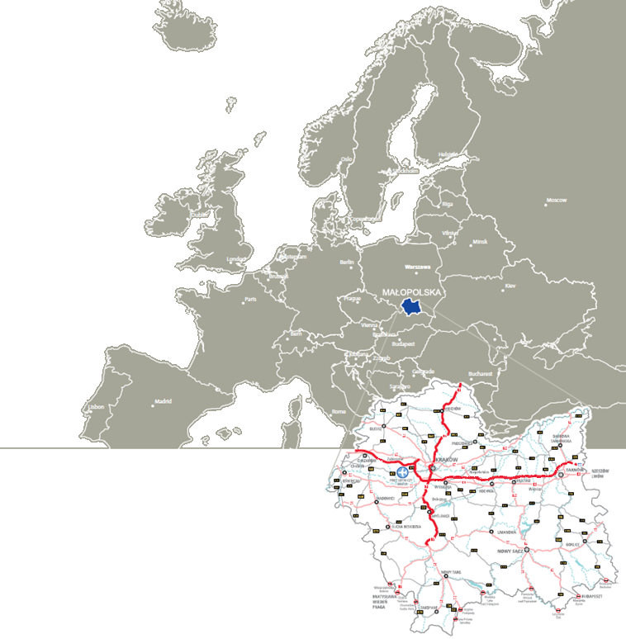
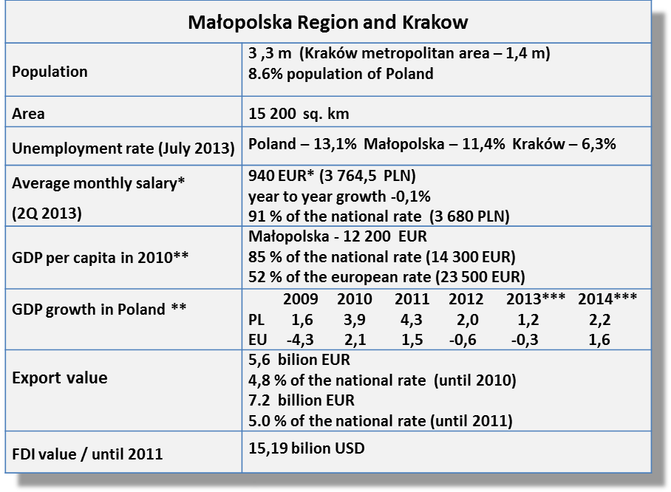
Małopolska
*) in enterprise sector
**) EUROSTAT
***) forecast
1 EUR = 4 PLN

Slide 10
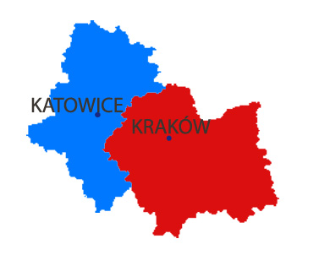
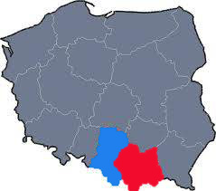
Southern Poland
8 m people in the perimeter of 100 km
from Krakow

Slide 11
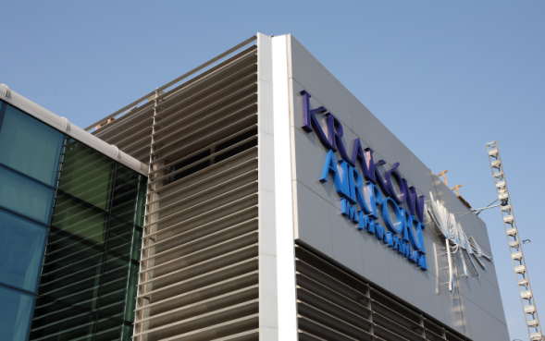
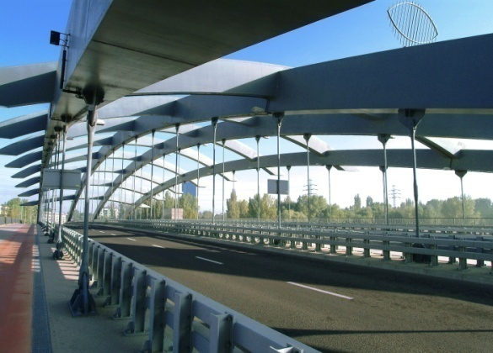
Transport and Communication
Kraków-Balice Airport
over 60 direct connections (London – STN, LGN, Munich , Frankfurt, Dublin, Berlin, Dusseldorf, Milano, Madrid, Paris, Kiev, and others)
19 carriers (Lufthansa, Finnair, PLL LOT, AirBerlin, Ryanair)
ca. 3 mln passengers per year
max. 2 hours of flight to other Western European cities
Katowice-Pyrzowice Airport – 80 km from Kraków
Network of roads
3 international transport routes
(E40–motorway A4: Calais-Brussels-Cologne-Dresden- Wrocław-Kraków-Lviv-Kiev; E77, E462)
2326 km of national/regional roads (57.39 km/100 sq. km)
Kraków – Slovakia border 94 km
Kraków – Ukraine border 258 km
Kraków – Czech Republic border 124 km
Kraków – Germany border 450 km

Slide 12
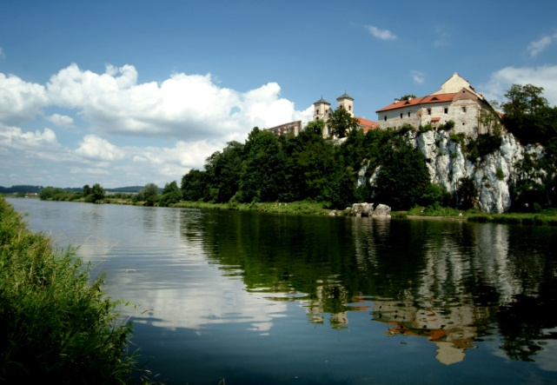
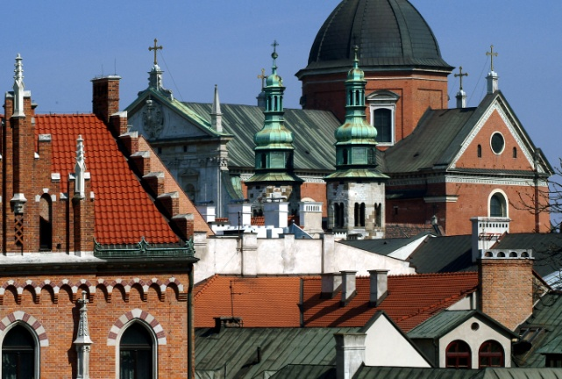
Top tourist destination in Poland
Exceptional natural environment
6 National Parks
11 Environmental & Landscape parks
86 Nature preserves
10 Spa resorts
Outstanding heritage
14 UNESCO monuments in Poland including 10 in Małopolska
11 Heritage & Ethnographic parks
12 Castles
Over 10 mln tourist per year (25% foreigners)

Slide 13
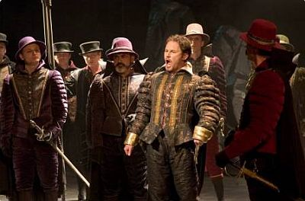
Attractive place for living
Culture (Krakow)
6,000 Objects of historical value
¼ of Polish historical and artistic collections
38 Permanent exhibitions in Krakow ’s museums
8 Theatres
4 Orchestras
ca. 40 International festivals
Sports and recreation facilities (Krakow) :
28 Sport Fields
22 Sport Stadiums
8 Swimming Pools (outdoor & indoor)
40 Tennis Courts
14 Multi-functional pitches
2 Sailing marinas
1 Mountain canoeing track
3 Artificial ice rinks
3 Hippodromes
2 Golf courses

Slide 14
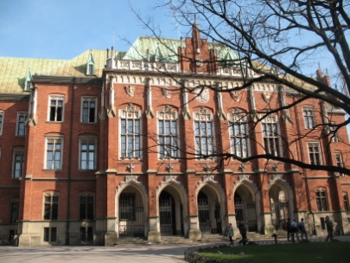
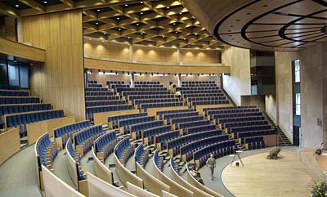
Top academic center
33 colleges and universities (22 in Kraków)
Jagiellonian University (Poland’s oldest, founded in 1364)
AGH University of Science and Technology
Krakow University of Technology (PK)
Kraków University of Economics (UEK)
National-Louis University (WSB) in Nowy Sącz
2011/2012
208 113 students (2 640 foreigners) in Małopolska – 2nd place in Poland
54 978 graduates
economic and administrative - 24,5%
social studies and humanities – 20,3%
medical studies – 5,9%
engineering and technical – 8,3%
IT and computer science – 3,1%
2nd place in Poland in R&D
1091,4 mln PLN (in 2010) – expenditure on R&D
10,8 % of Poland’s overall employment in the sector
over 100 R&D units

Slide 15
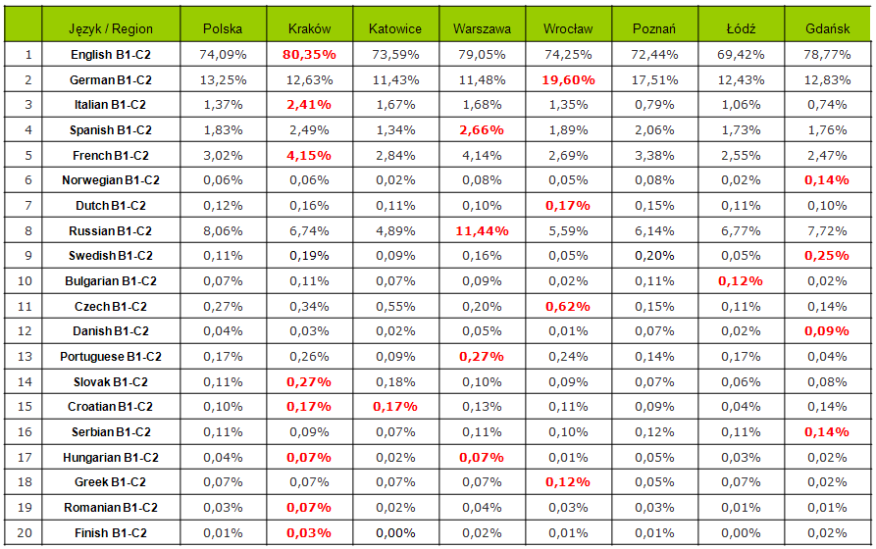
Foreign languages availability in Poland
Source: AG TEST HR survey based on pracuj.pl, 2012, 203 996 observations, candidates aged 25-40 with university degree

Slide 16
Gross value added in Małopolska by sectors

Slide 17
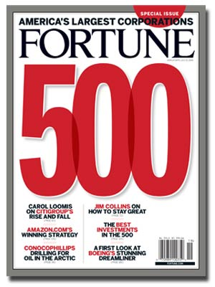
Foreign Direct Investments in Małopolska
Main sector of the investment:
Industry 51%
Services 17%
Trade 9%
Hotels 2%
Construction 1%
Foreign investment in the region:
15,19 bln USD 1989-2011
Main new investors:
BPO / ITO sector
automotive
steel processing
construction (housing, retail industry…)
power station
chemistry
IBM(14)
State Street (276)
Motorola corp. (78)
Philip Morris International (93)
Coca Cola ent. (116)
Google (117)
CH2M HILL (436)
International Paper (93)
RR Donnelly (233)
Delphi (121)
ACS (401)

Slide 18
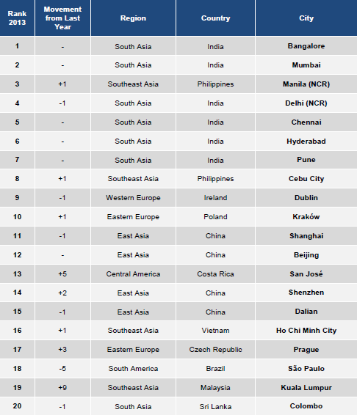
Tholons Top
Outsourcing
Cities 2013
Source: Annual Global Services and
Tholons Top Outsourcing Cities Ranking 2013
(scale and quality of workforce, business catalyst, financial, infrastructure, risk environment, quality of life)
Three steps survey: business centers survey, government institutions, quantitative & qualitative Tholons consultants analysis

Slide 19
Main investors in Małopolska in recent years
2009
2010
2011
2012
2013

Slide 20
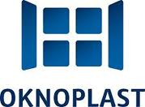
The biggest exporters by sector of activity
IT / ITC
Chemistry
Construction materials
Food processing, food and beverage packaging
Biotechnology
Rail, automotive industries
others

Slide 21
State aid system in SEZ - example
Public aid from the title of investing within the special economic zone assumes the form of income tax relief.
investment (in PLN) | new jobs
1. land 3 million 2. building 10 million 3. other fixed assets 11 million | 1. labour cost (monthly, incl.tax) PLN 5000 2. new jobs 1000 3. number of months (2 years) 24
Total (1+2+3) 24 million | Total (1×2×3) 18 milion
Public aid (35%) 8.4 million Public aid (45%) 10.8 million Public aid (55%) 13.4 milion | Public aid (35%) 6.3 million Public aid (45%) 8.1 million Public aid (55%) 9.9 milion

Slide 22
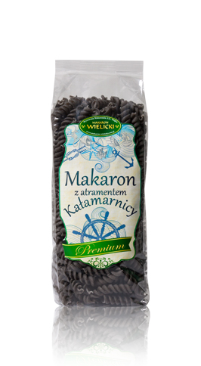
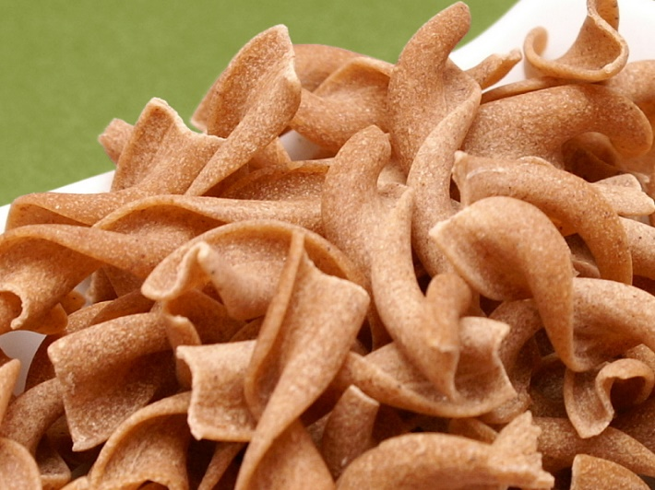
„Makaron Wielicki” was established in 1996 as a family business. The company is geared to the quality and therefore has a relatively small production capacity. Since 2007 production takes place in a new facility that meets all sanitary - hygienic requirements.
Awards:
„Polish Food Producer” 2007
„Polish Food Producer” 2008
„Best in Poland”
„Top Product” title 2013

Slide 23
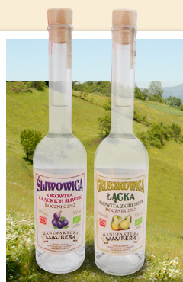
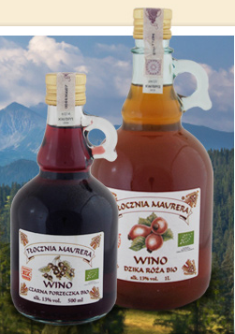
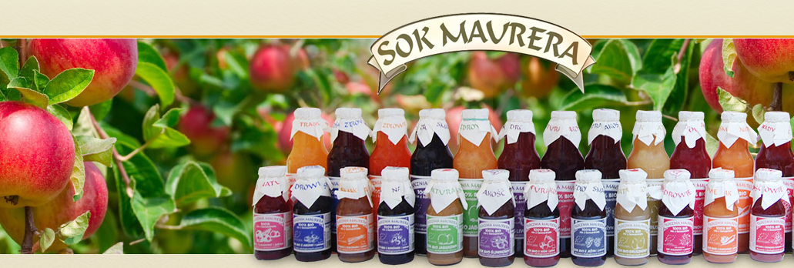
Highly regarded producer of natural fruit and vegetable juices as well as alcoholic drinks. They offer several organic juices, syrups together with wines and distillates. Their product have been awarded numerous awards. Foremost among them is Promotional Emblem ‘Teraz Polska’ (Poland Now). They own the following brand names: “Sok Maurera”, “Łąckie Ogrody” and “Manufaktura Maurera”

Slide 24
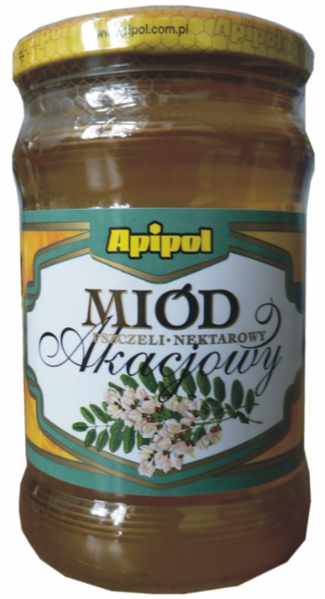
Apiarian Company "Apipol-Kraków" Ltd. is a company with many years' tradition, which produces and processes bees products. Modern biotechnologies are used by Apipol-Kraków in a complex system of apiary economy for the production of high quality food and products with healing properties. This system called the APIPOL SYSTEM allows effective and economic apiary production.
High quality requirements which are aimed at by the Apipol-Kraków company, are not only in accordance with requirements concerning food production but also meet high standards of pharmaceutical market, as numerous bees products are further used in the production of parapharmaceutical products, medicines and cosmetics, the producer of which is the Apiarian and Pharmaceutical Company "Apipol-Farma" Ltd. in Myślenice.

Slide 25
As a small, family owned bakery „Gronpiek” makes every effort to make sure that what they are offer is not only delicious but also wholesome and nutritious.
All of their products are handcrafted according to the traditional recipes and baked directly in wood-fired ovens which gives them a robust and tasty crust that seals the flavour.
The quality of their organic breads is certified.

Slide 26
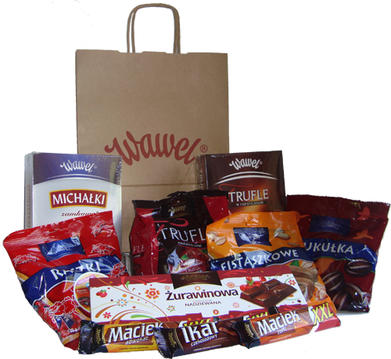
The Wawel Brand was borne out of the combination of exceptional Polish and Swiss recipes and chocolate artistry perfected over the years.
Wawel’s traditions go back to the end of the XIX century, when the novice chocolatier Adam Piasecki decided to start a confectionary workshop in Kraków. At the small workshop, located at Długa Street, he employed 5 people. His exceptional success and rising fame led Piasecki to start factory production. The chocolate products were very popular among the gourmets, and today you can still find candies that follow some of the master's recipes on store shelves.
Wawel has 16 company stores in all of Poland.

Slide 27
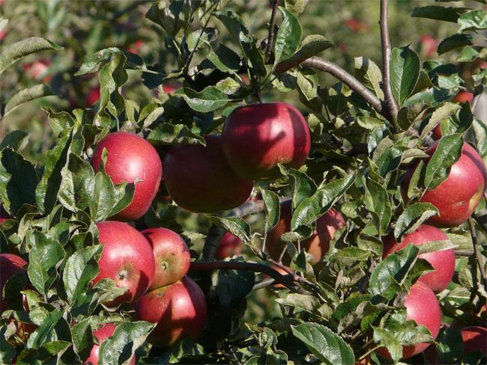
Producers of Fruit and Vegetables „Olsad” was established in October 2007 and aims at organizing the common trade and promotion of the agricultural products of Nowy Sącz District. The Group unites 64 shareholders – fruit growers on 165 hectares of common production acreage that are able to produce 5000 tons of high-quality fruit. They have modern controlled atmosphere cold rooms of 4000 tons capacity. They also own automated sorting and packaging lines with the work output of 6 tons per hour. Offered fruits:
Apples
Pears
Plums
Sour Cherries

Slide 28
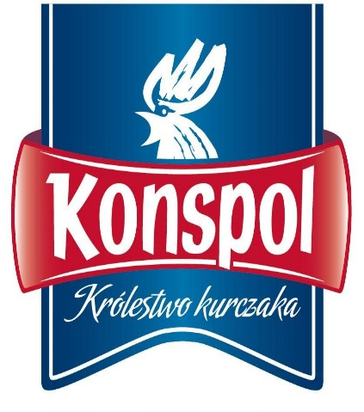
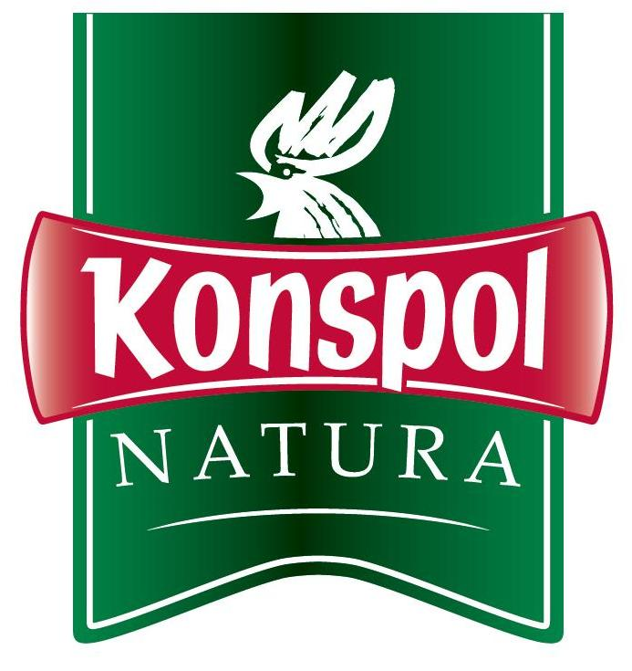
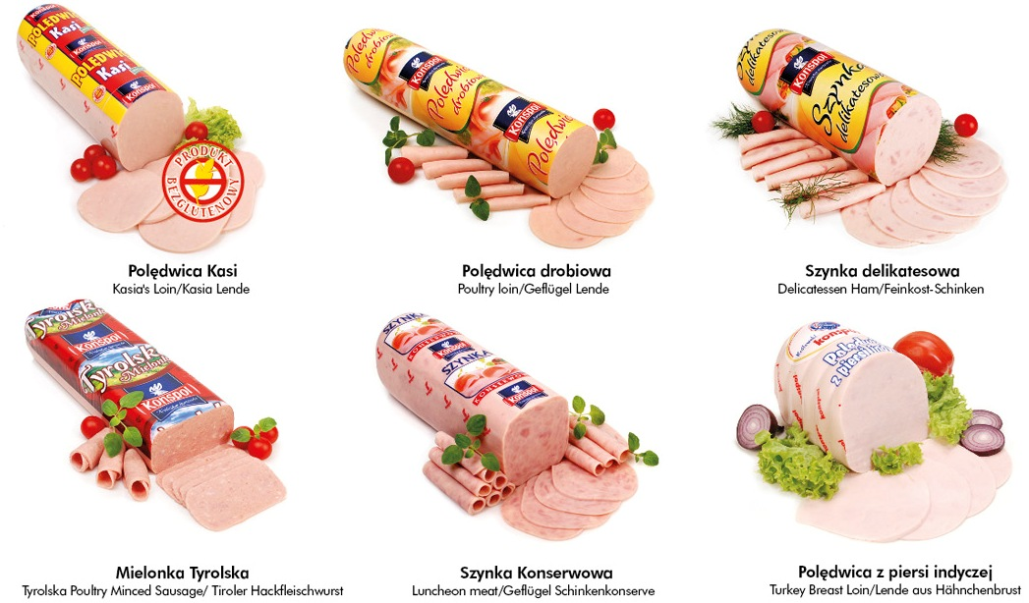
The Konspol Group is the most technologically advanced producer and processor of chicken in Poland and is included among European industry leaders. The Group consists of four integrated companies.
Konspol Group is exceptionally attractive for its clients as it offers a wide assortment of chicken products ranging from fresh meat to the highly processed delicatessen products with its own distribution throughout Poland.
Key customers:
Wholesalers and retailers
HoReCa sector
Hypermarkets and discount chains

Slide 29
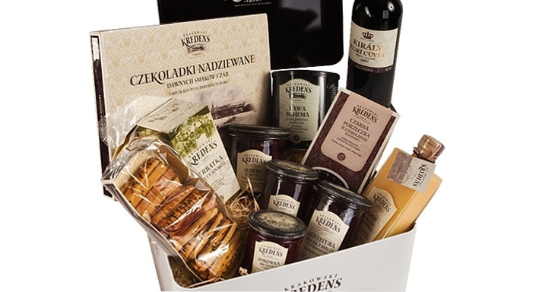
Krakowski Kredens Tradycja Galicyjska was established 15 May 2007. Under the name Krakowski Kredens sales premium food products. 100% of the shares in the company has Alma Market S.A. Products of Krakowski Kredens are offered in flagstores Krakowski Kredens, Alma Delicatessen and online store run by Alma Market. Krakowski Kredens brand was created in response to the growing demand for high quality food products.
Krakowski Kredens products are available in nearly 44 flag stores located in the biggest cities of Poland, in the best shopping centers and in each Alma store.

